Slide 1
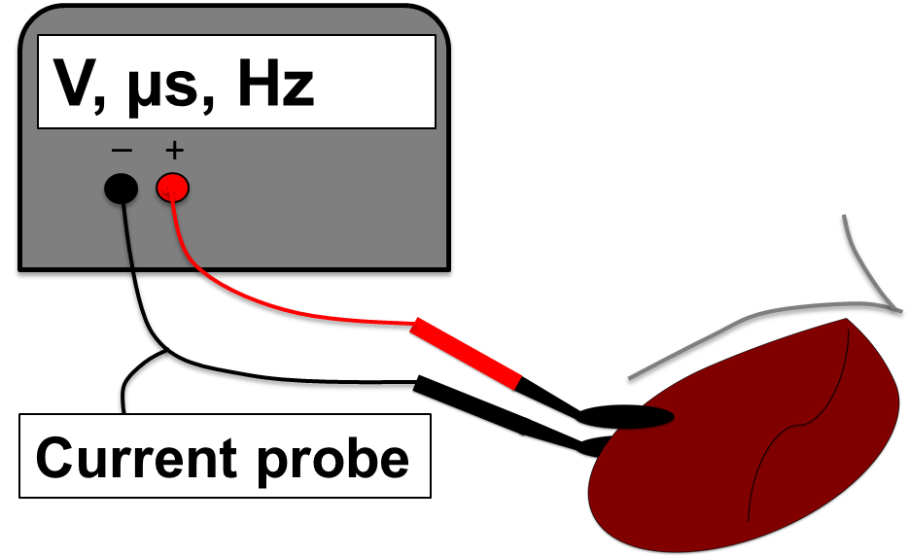
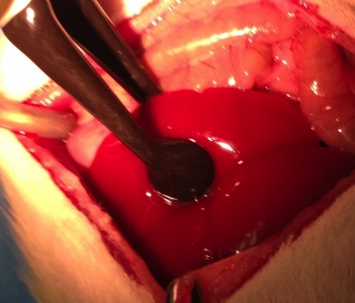
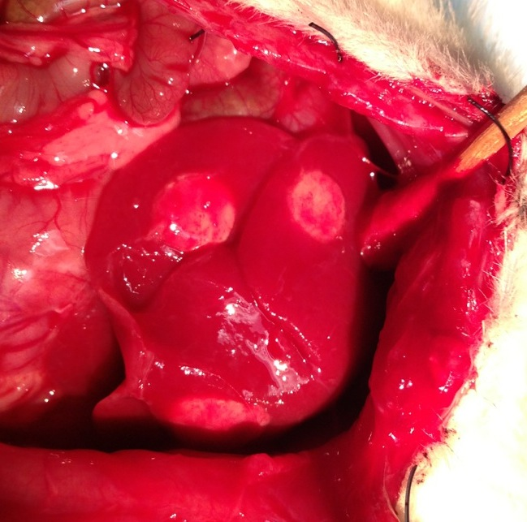
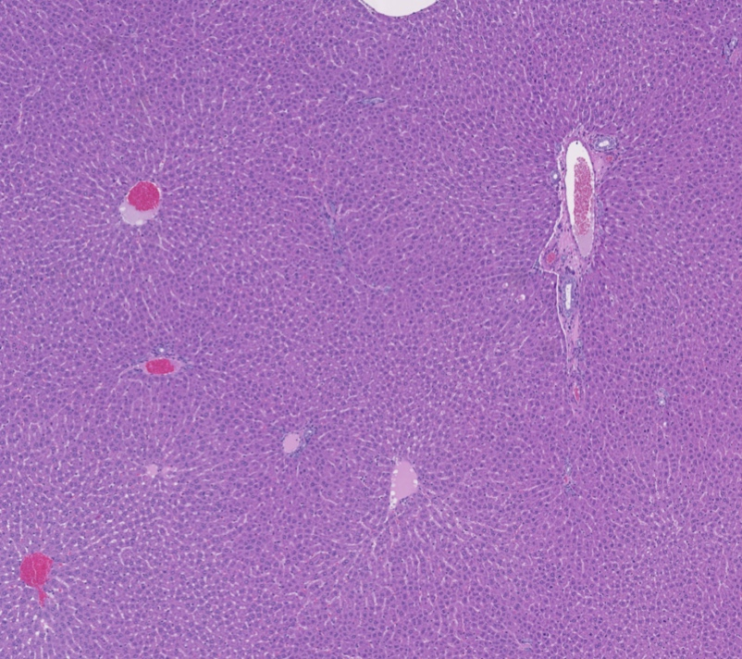
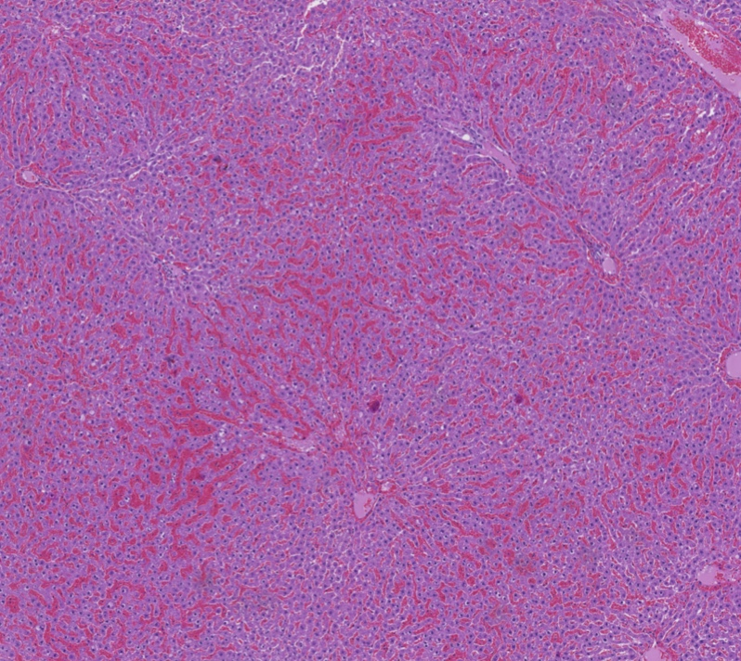
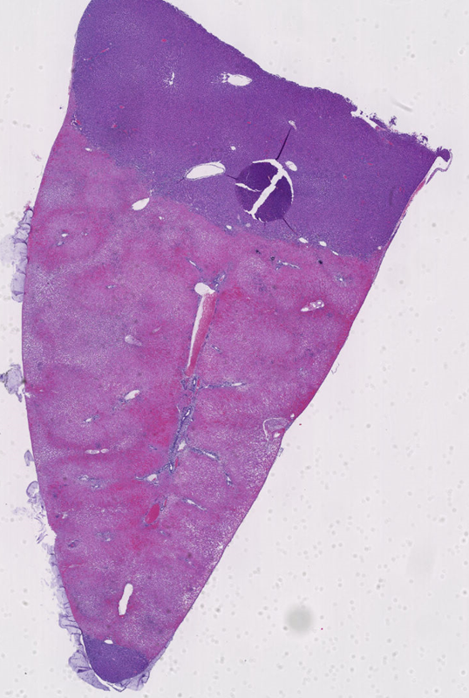
b
c
a
Electrodes
IRE ablated areas
Pulse generator
d
e
f
IRE treated Liver
T = 24h post IRE
Normal Liver
250 µm
IRE treated Liver
T = 0h post IRE
5mm
Untreated
250 µm

Slide 2
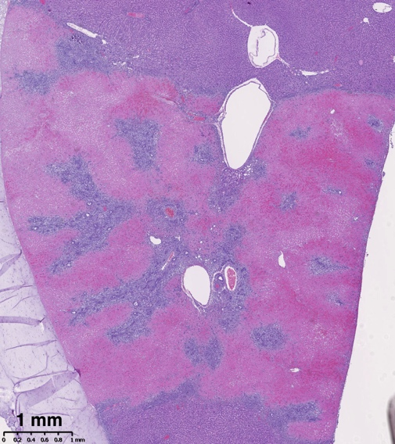
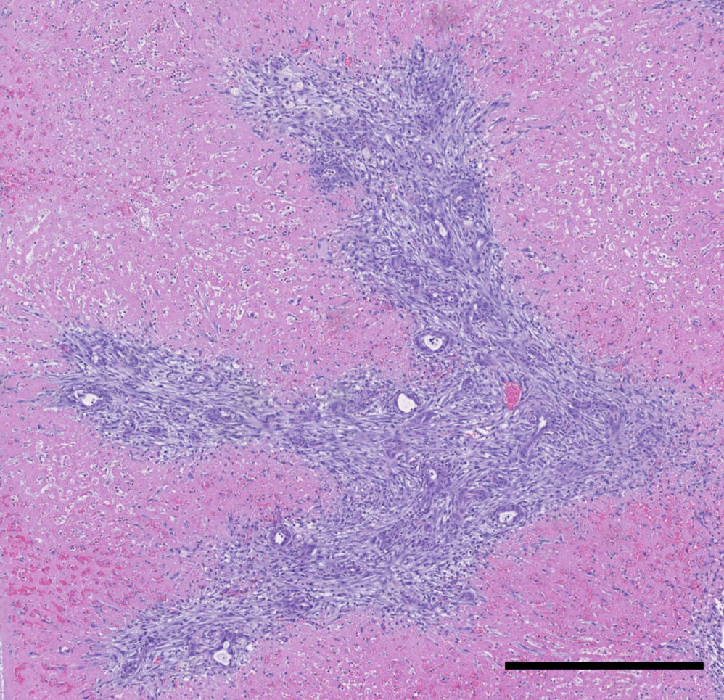
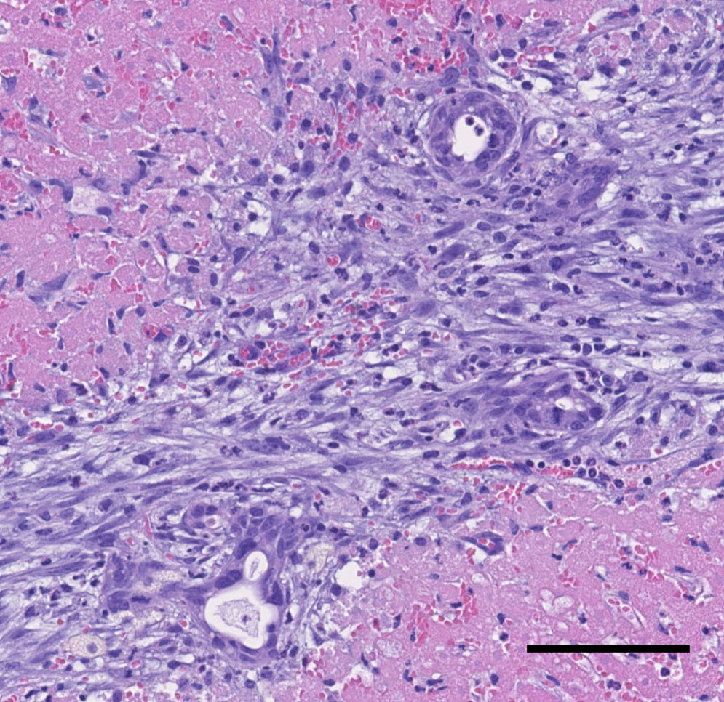
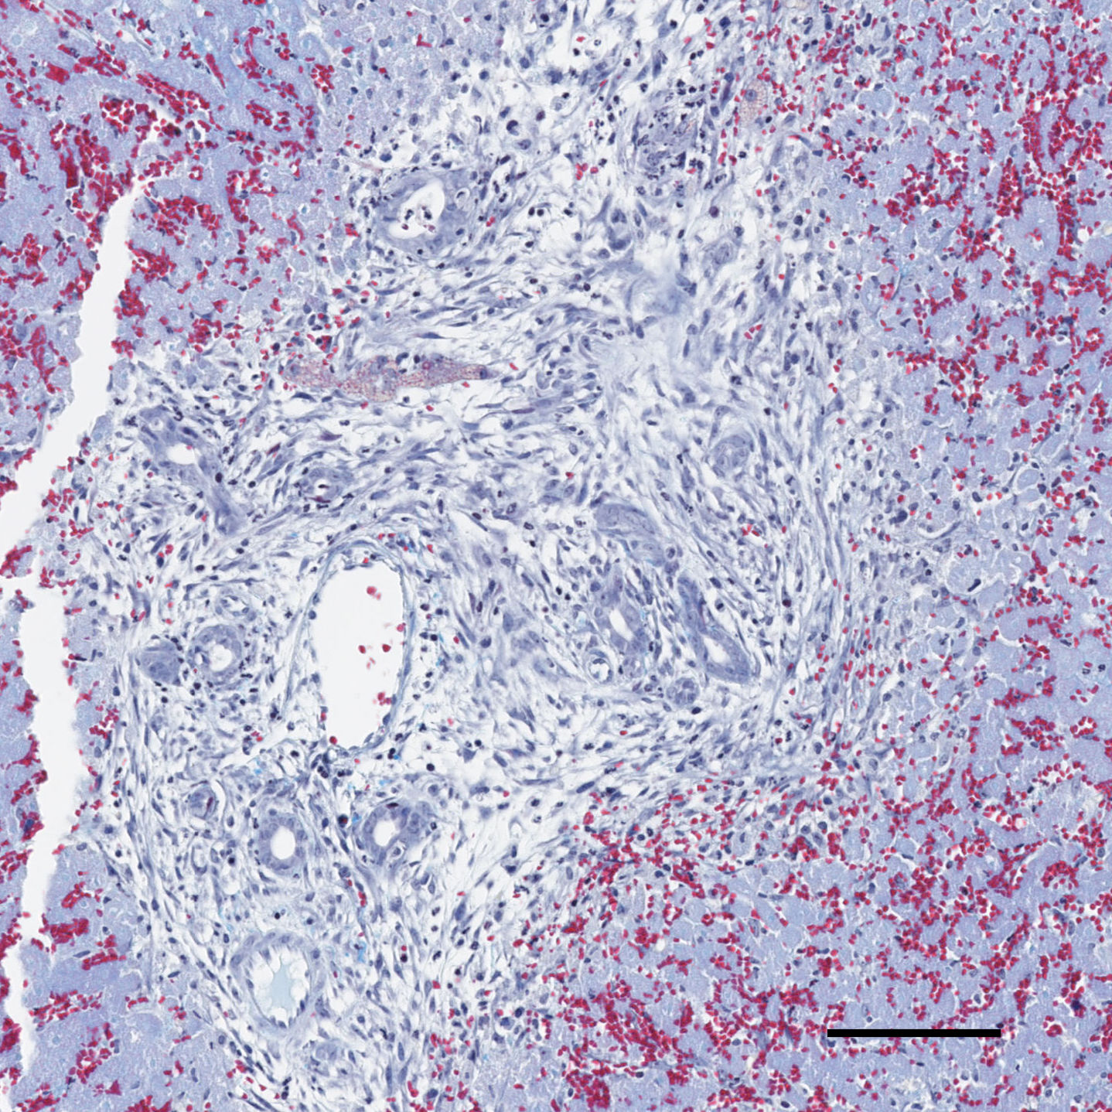
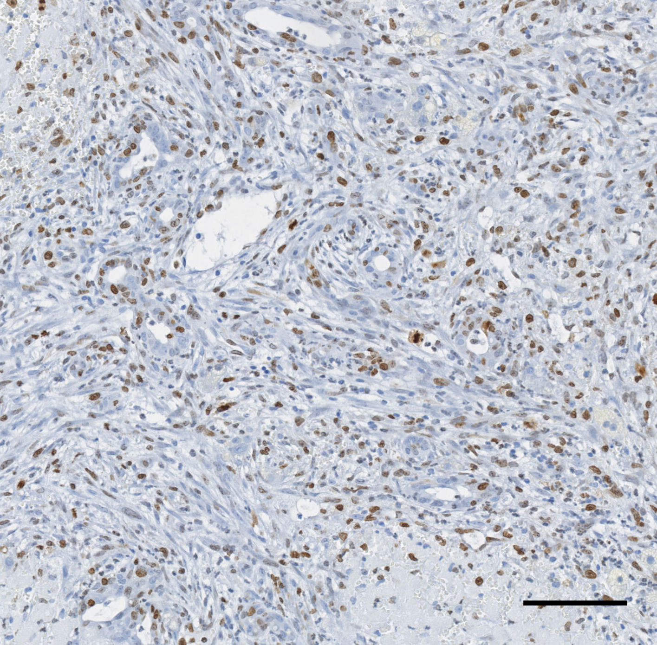
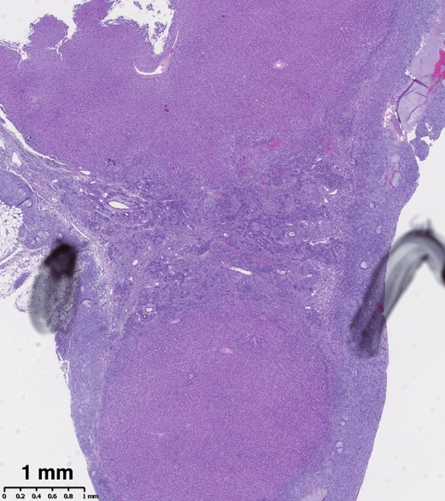
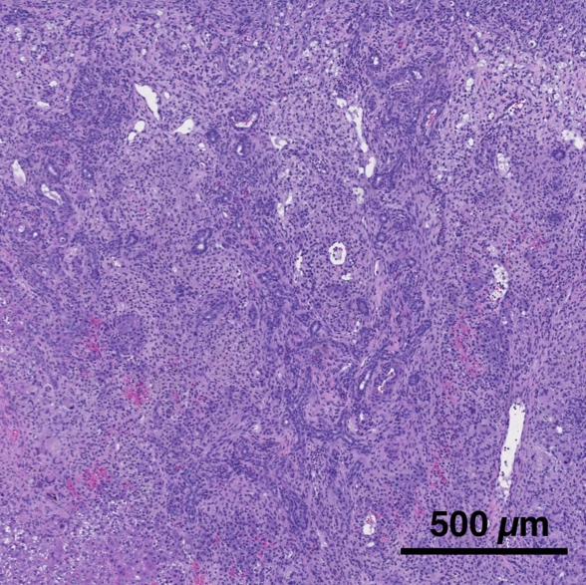
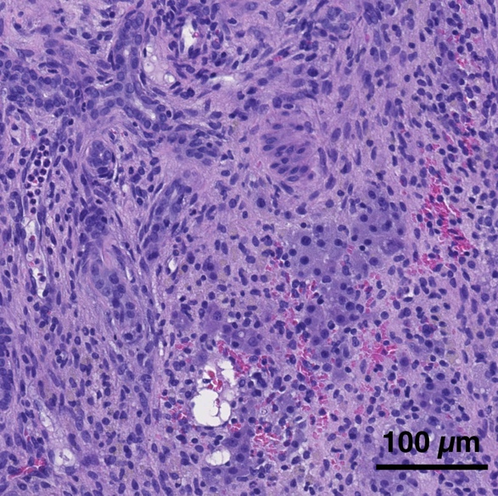
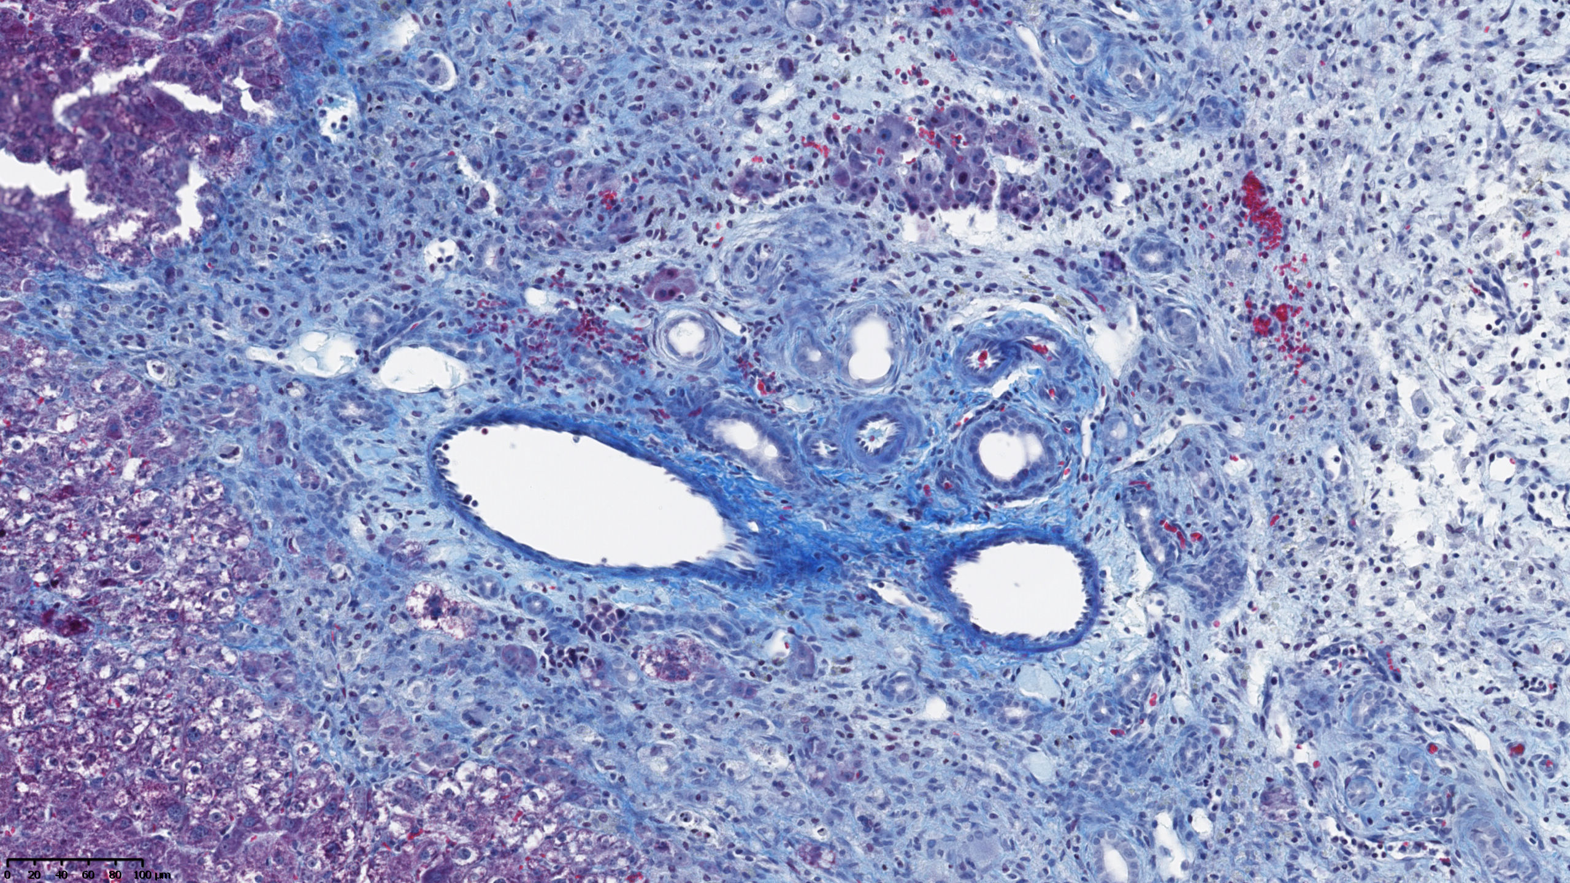
a
H&E
3d post IRE
H&E
3d post IRE
H&E
3d post IRE
Trichrome Masson
3d post IRE
Ki67
3d post IRE
1 mm
500 µm
100 µm
100 µm
100 µm
b
H&E
7d post IRE
H&E
7d post IRE
H&E
7d post IRE
Trichrome Masson
7d post IRE
Ki67
7d post IRE
1 mm
100 µm
100 µm

Slide 3
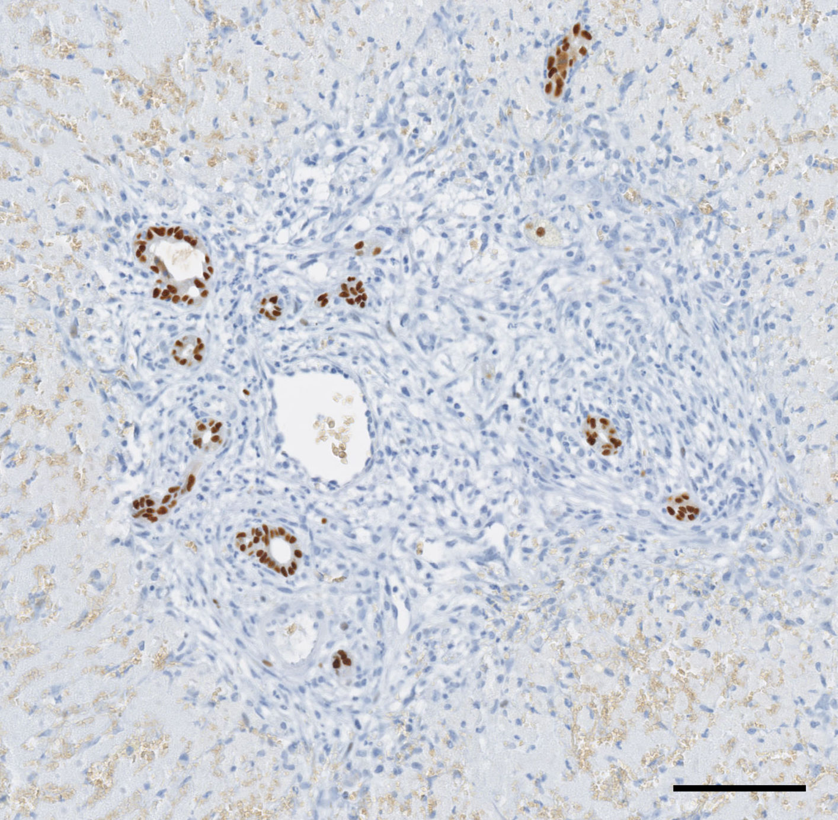
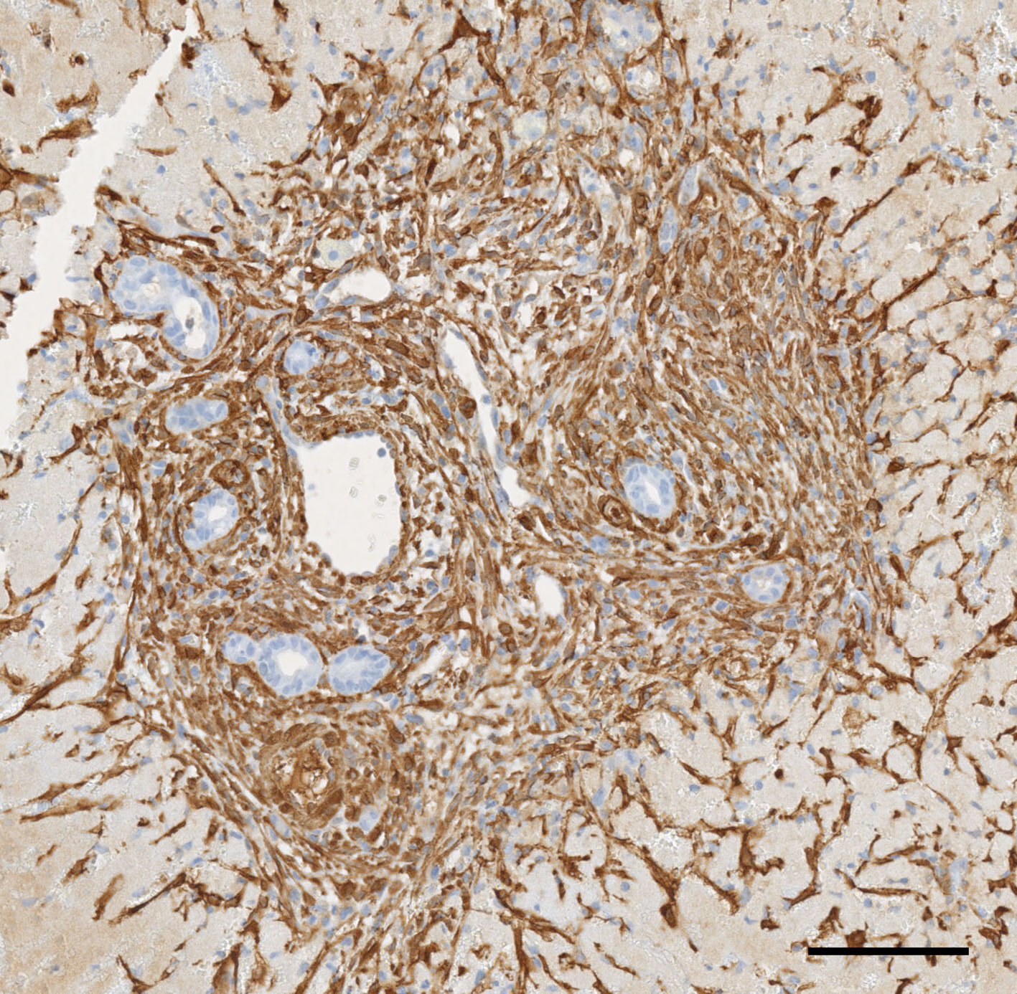
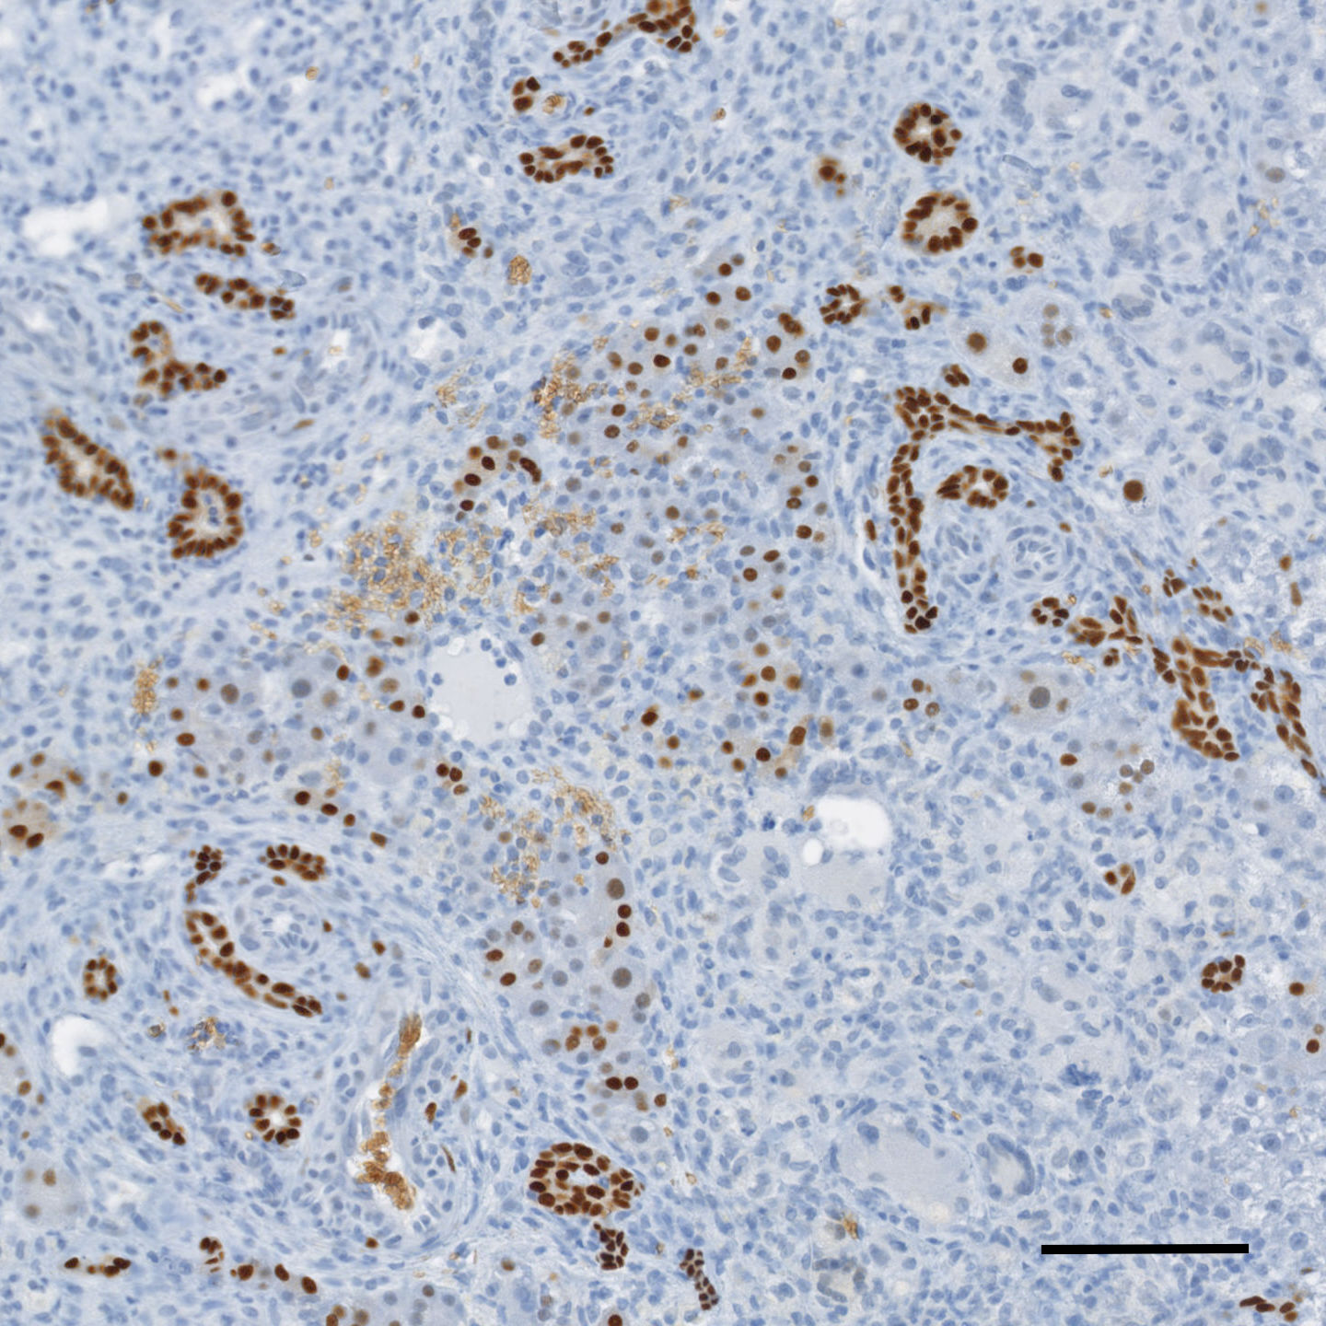
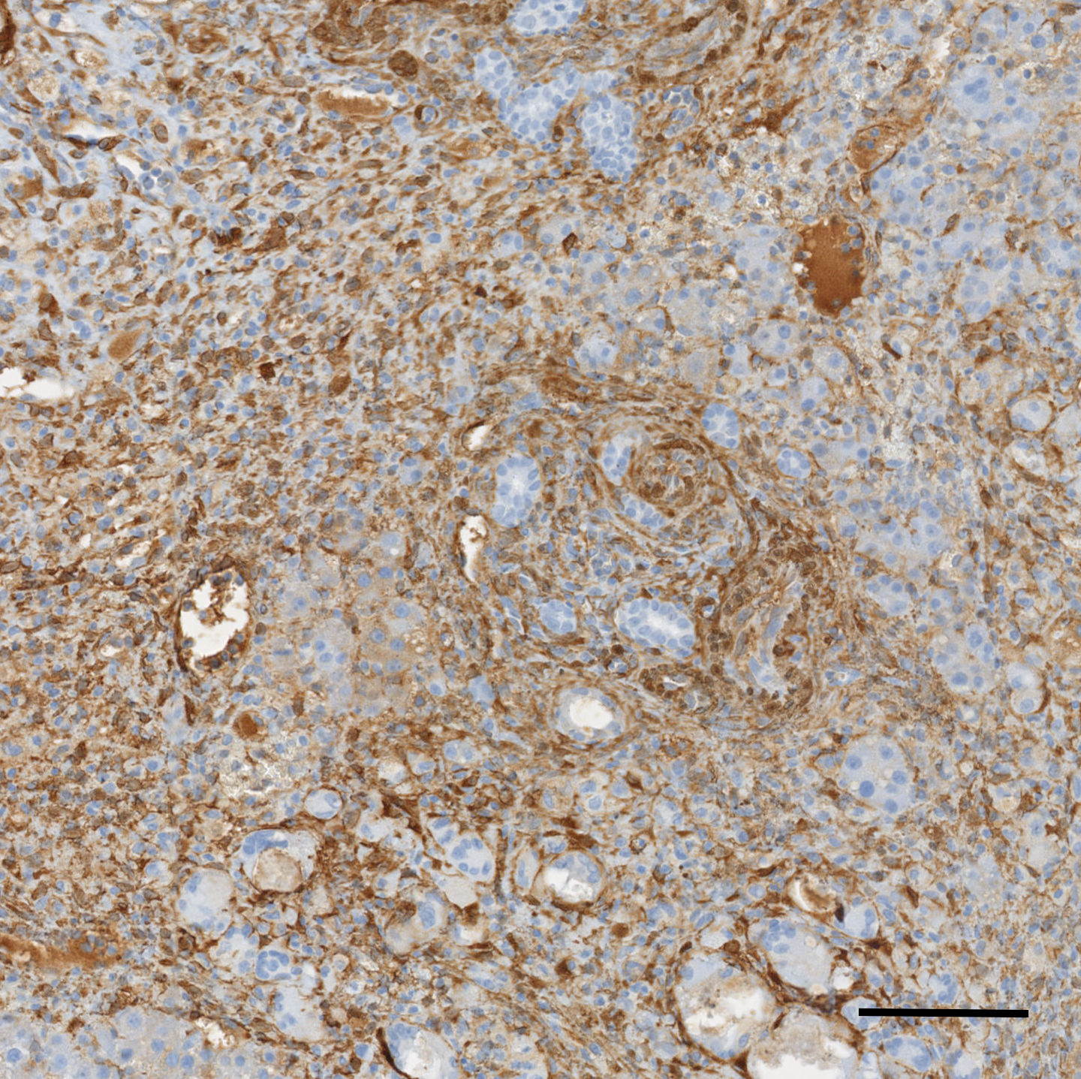
a
Sox9
3d post IRE
alpha-SMA
3d post IRE
100 µm
100 µm
b
Sox9
7d post IRE
alpha-SMA
7d post IRE
100 µm
100 µm

Slide 4
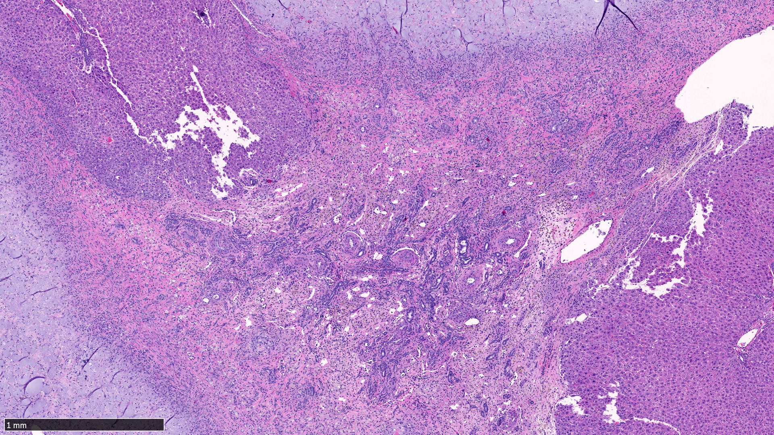
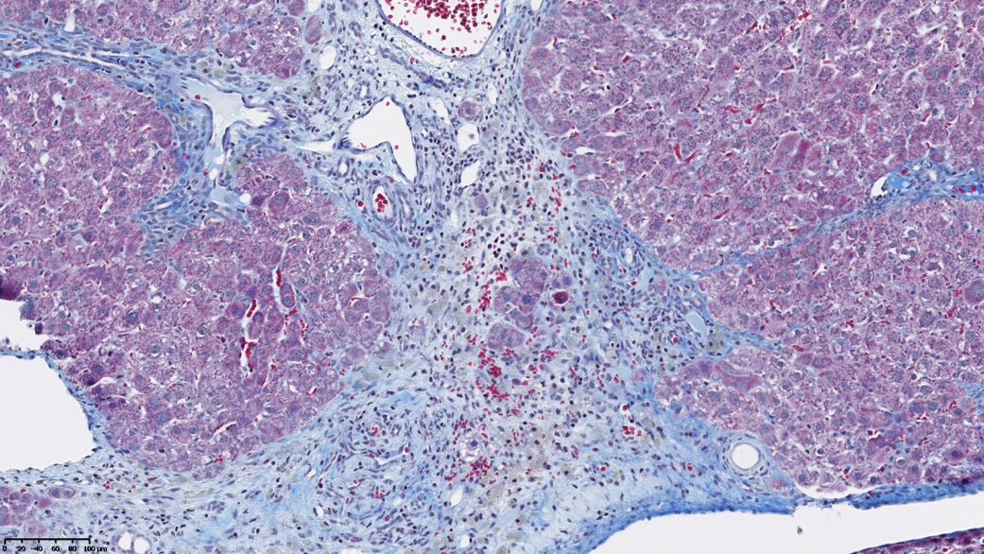
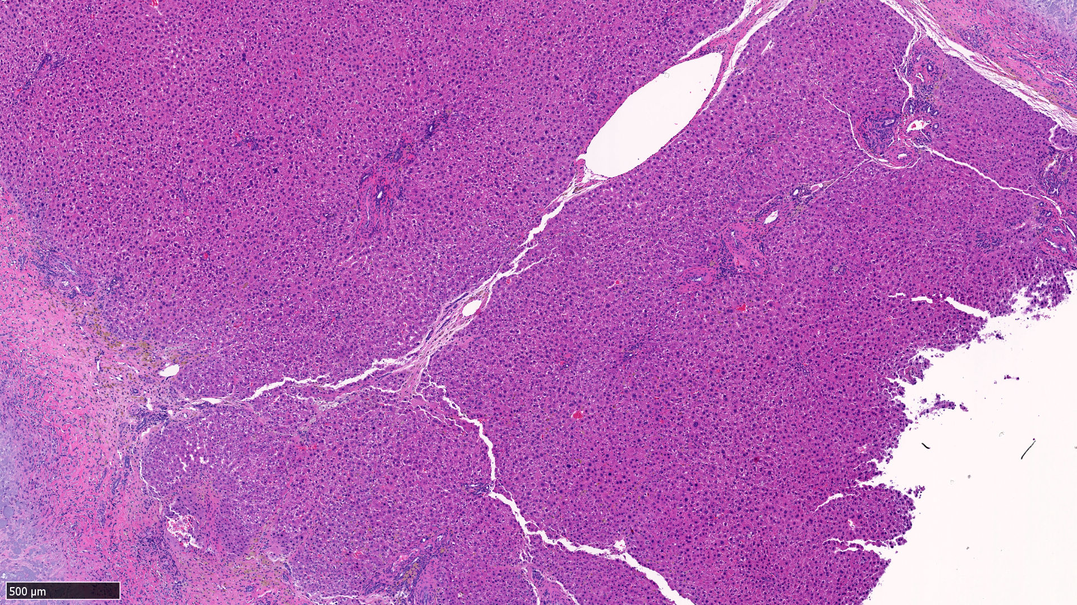
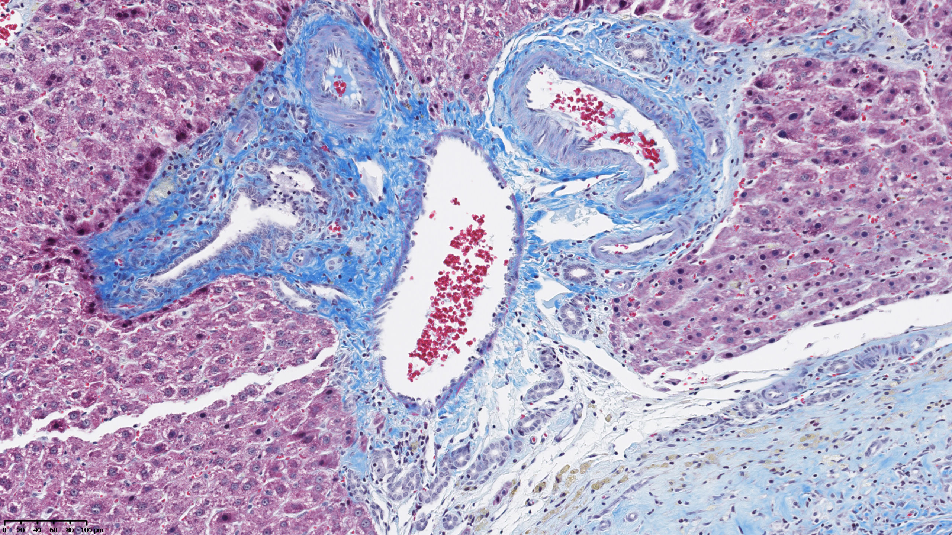
a
H&E
14d post IRE
Trichrome Masson
14d post IRE
Ki67
14d post IRE
500 µm
100 µm
100 µm
b
H&E
28d post IRE
Trichrome Masson
28d post IRE
Ki67
28d post IRE
500 µm
100 µm
100 µm

Slide 5
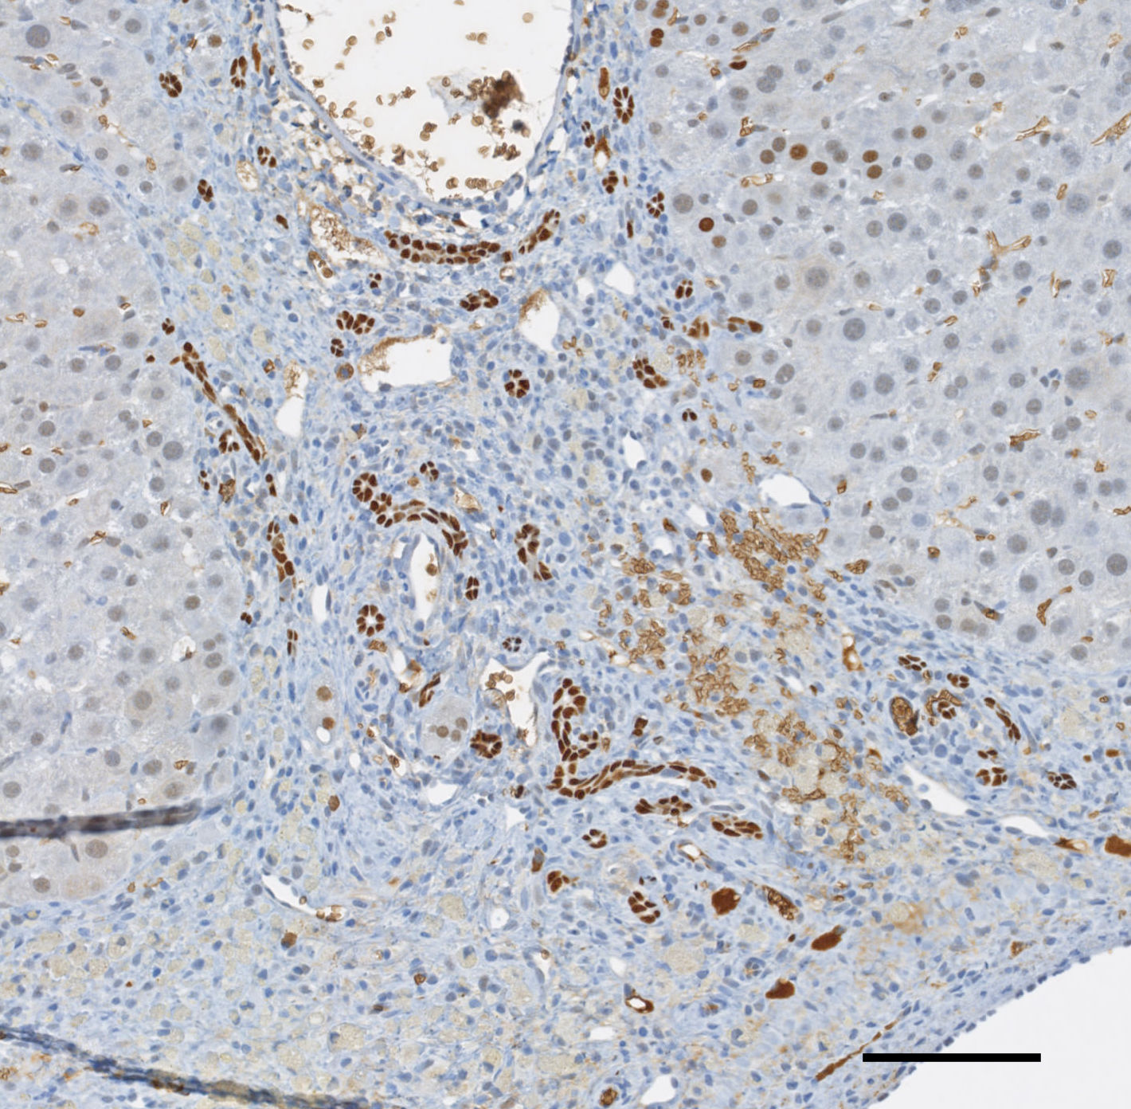
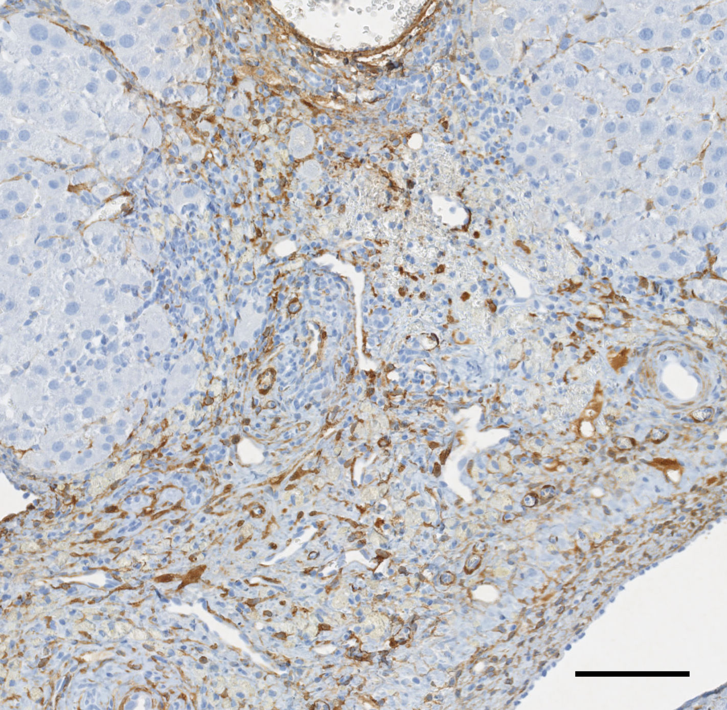
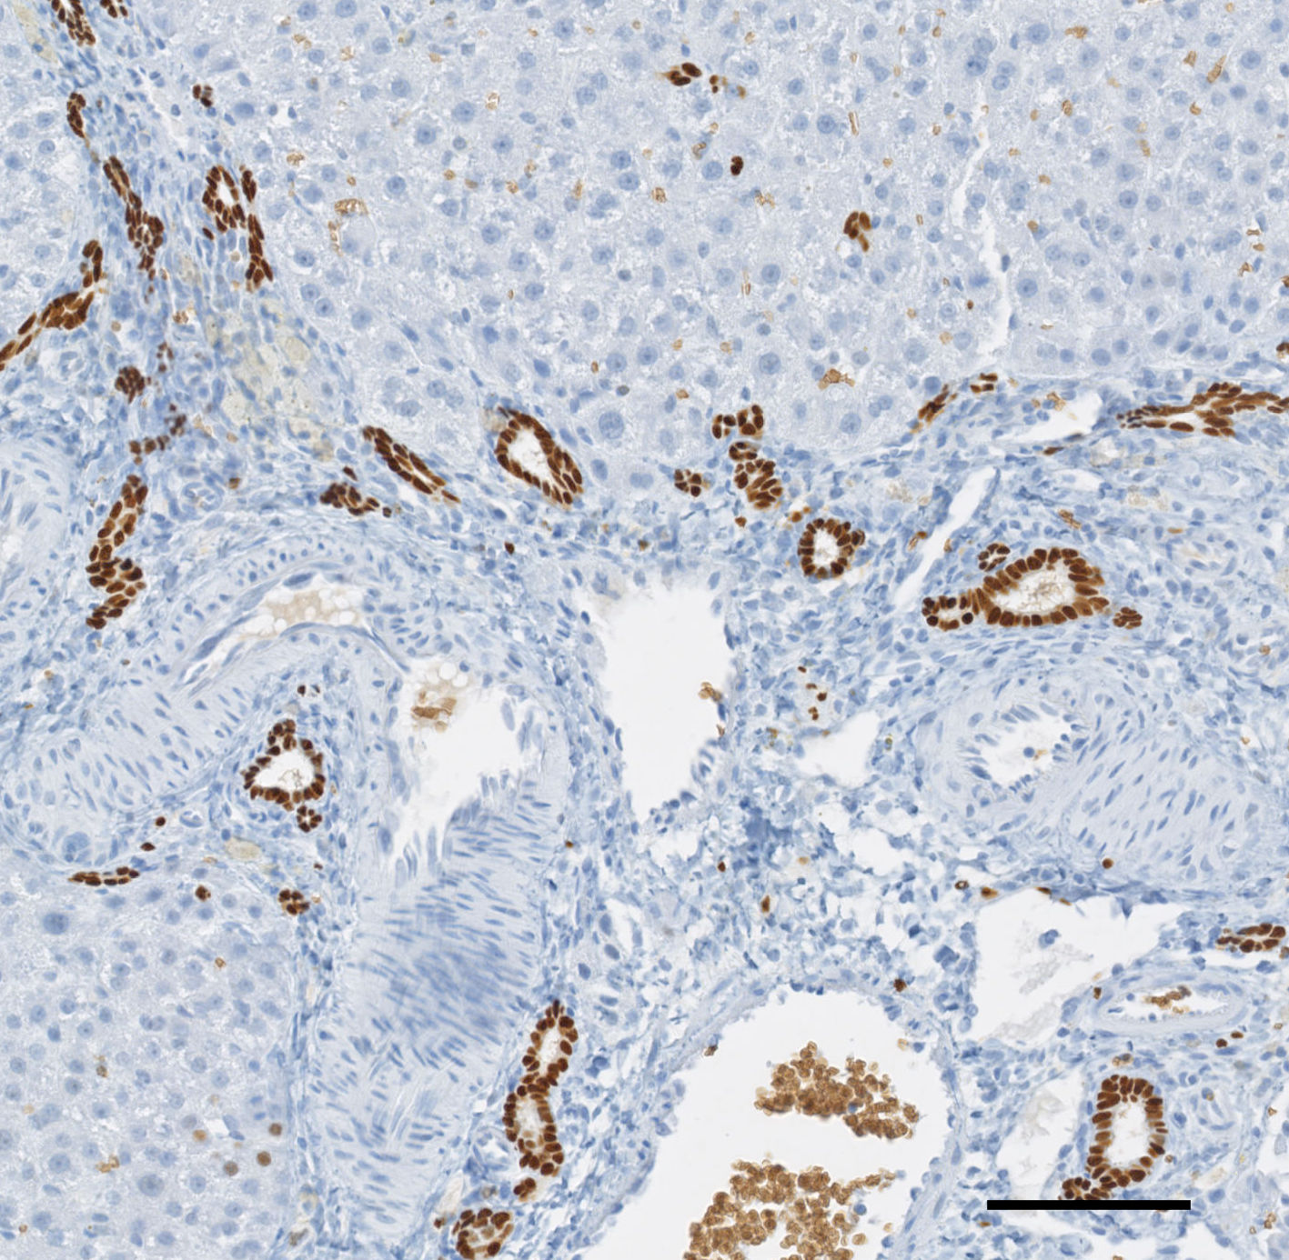
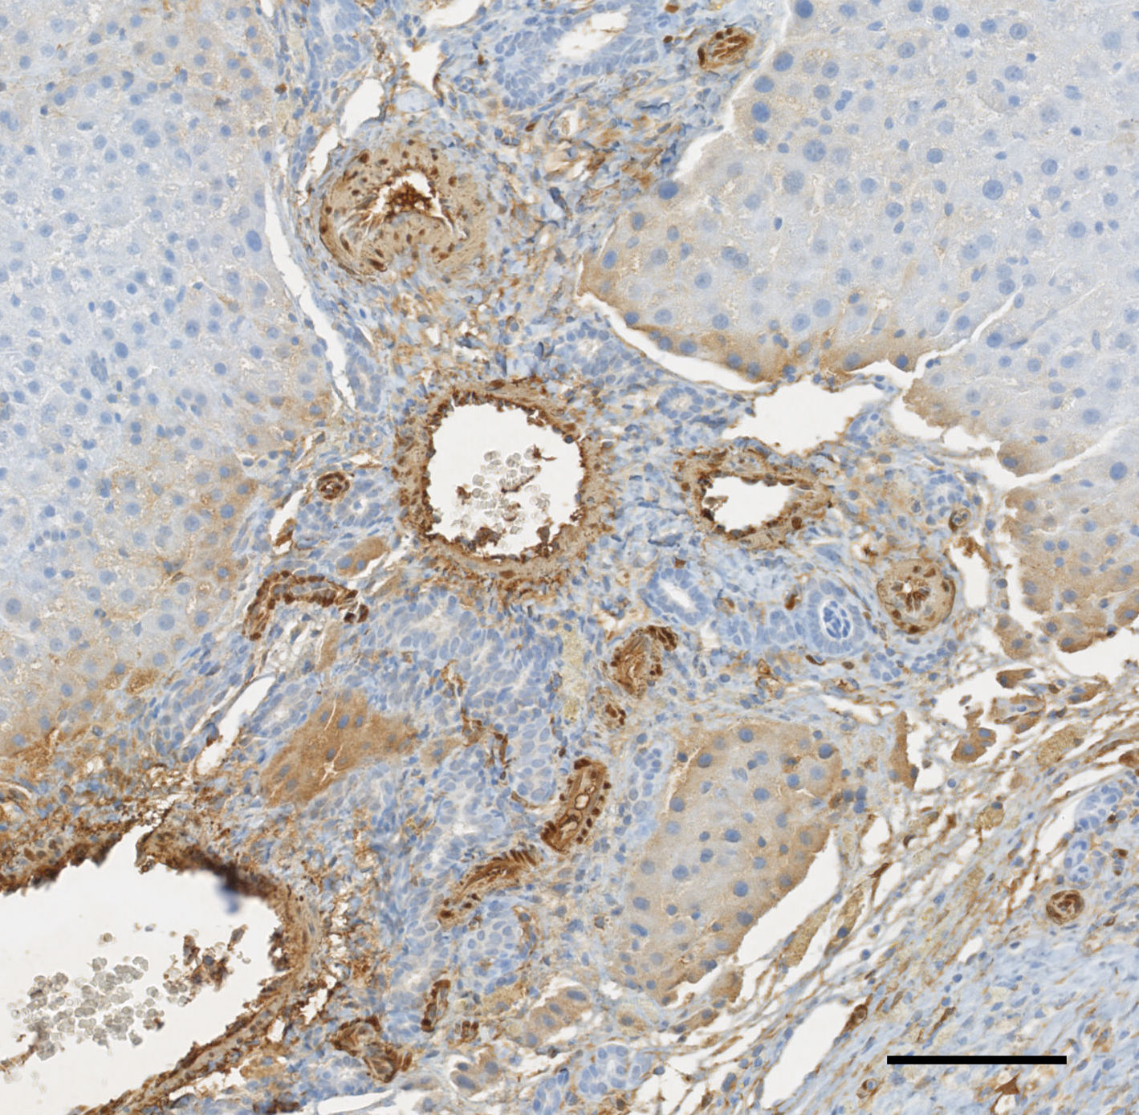
a
Sox9
14d post IRE
Alpha-SMA
14d post IRE
100 µm
100 µm
b
Sox9
28d post IRE
Alpha-SMA
28d post IRE
100 µm
100 µm

Slide 6
a
c
*
*
b
*p < 0.05
*
Control

Slide 7
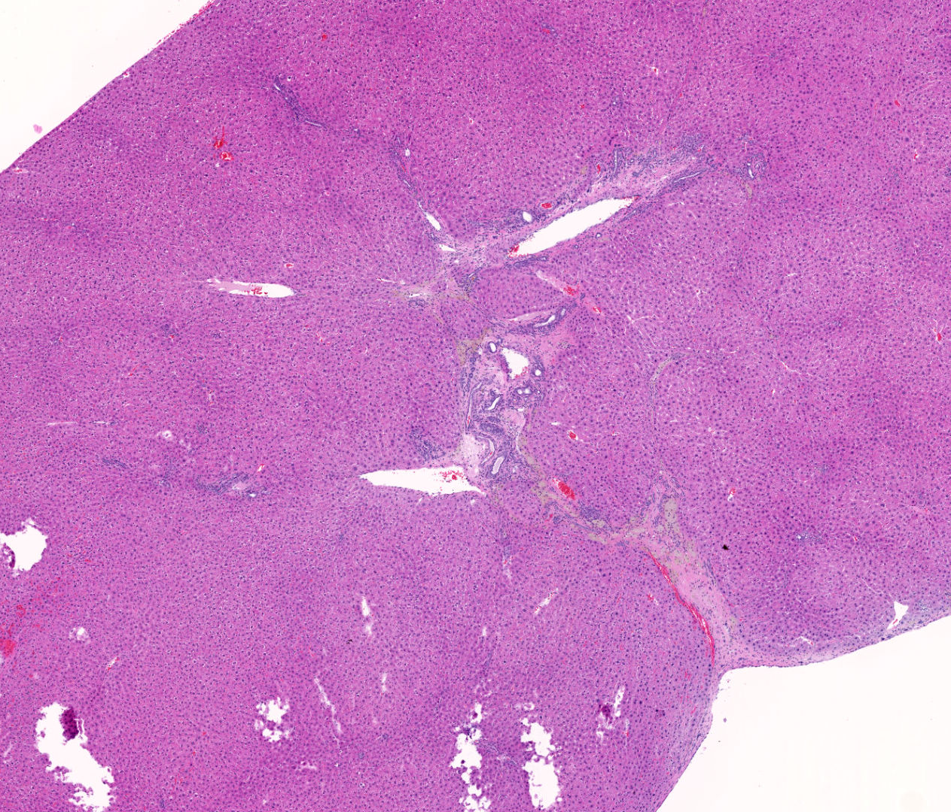
a
IRE treated Liver
T = 6m post IRE
Lesion 2
Lesion
b
H&E IRE treated Liver
T = 6m post IRE
1 mm

Slide 8
IRE
1d
3d
7d
14d
28d
6 mo
Cell death
Progenitor activation/proliferation
Ductular Sox9+ cells appear first around day 3 and last until day 28 although their numbers decrease.
Gene expression analysis on day 14 confirms activation and proliferation of progenitor cells.
Hepatic regeneration
Around day 7, larger cells that are Sox9+ appear among the ductular cells suggesting differentiation of progenitor cells towards hepatic lineage.
The ablated region is taken over by cells that resemble mature hepatocytes over time, with very few remnant Sox9+ cells on day 28.

