Slide 1
CPE and real time PCR for Table 2

Slide 2
CPE : P1 after 3 day (72) 700 ul

Slide 3
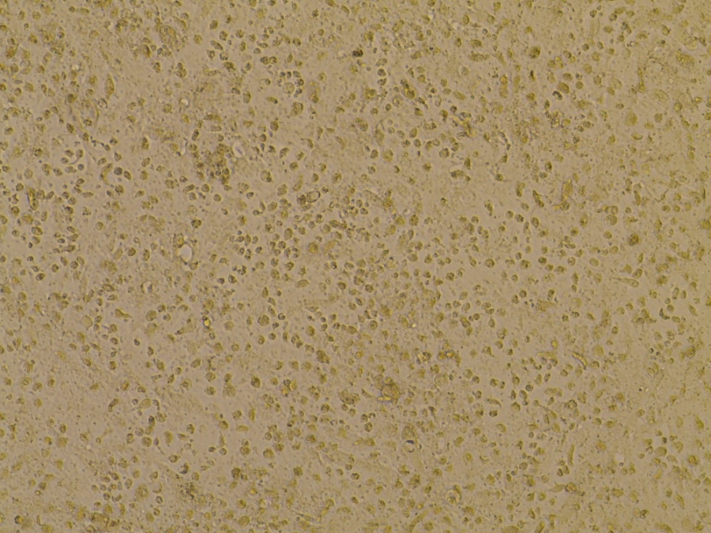
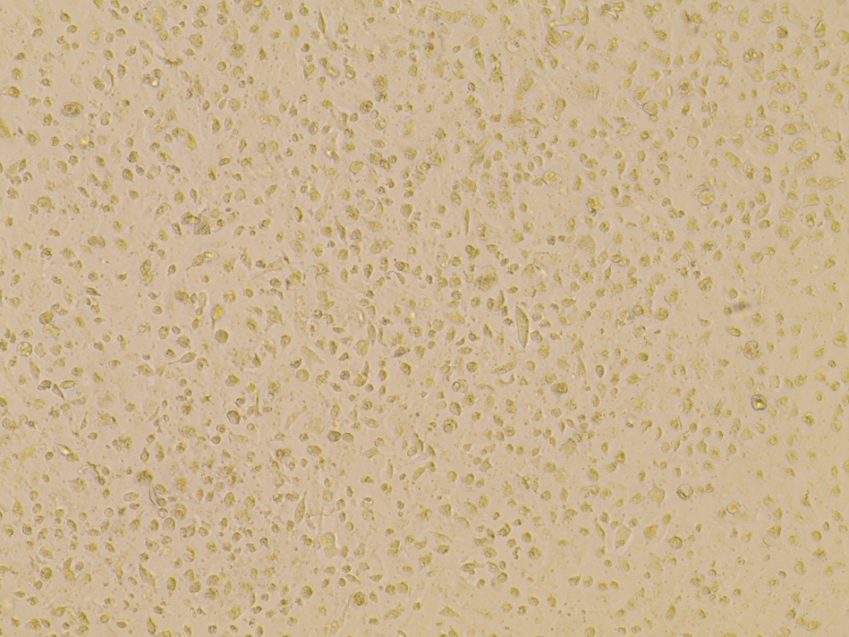
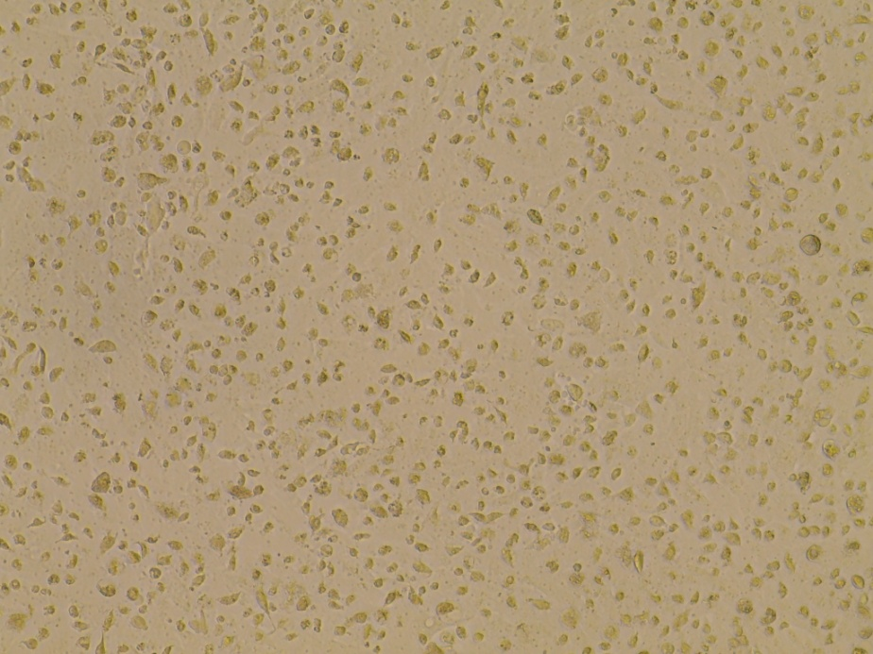
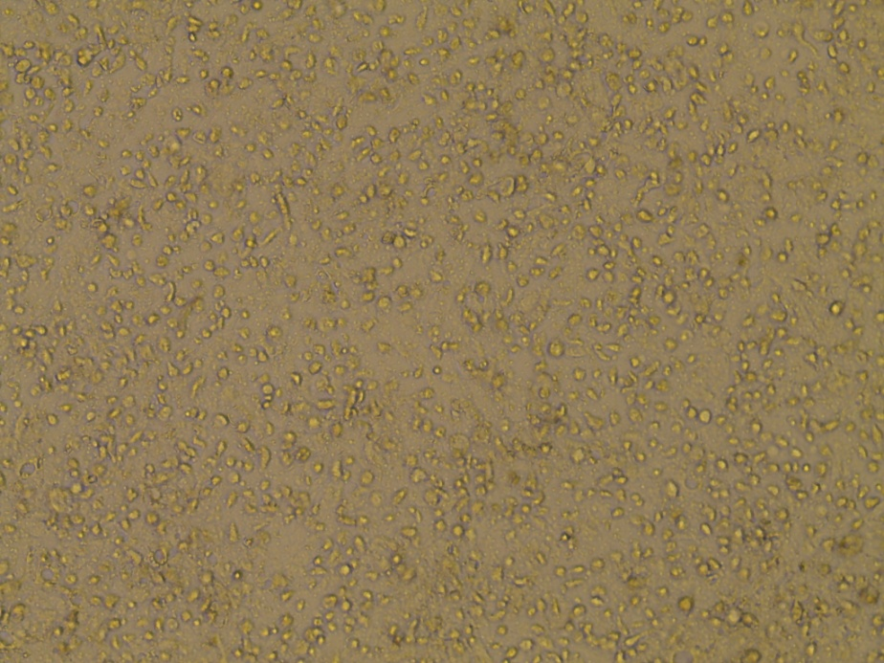
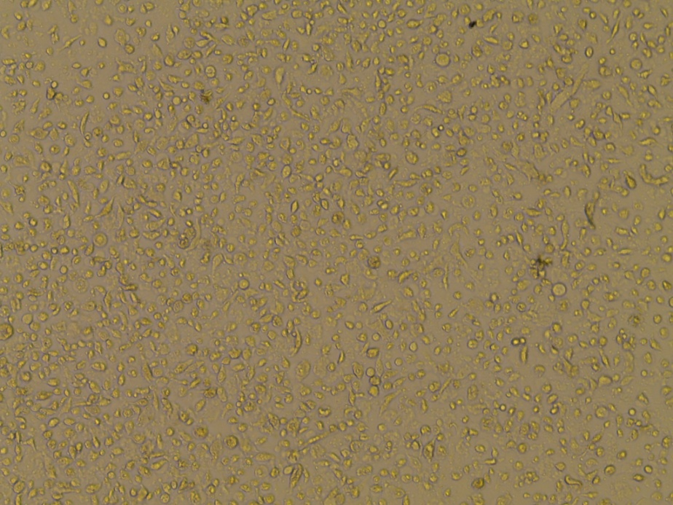
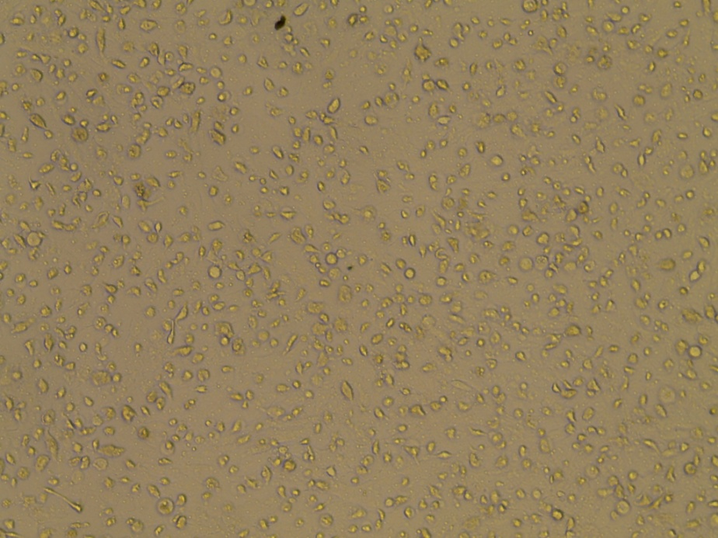
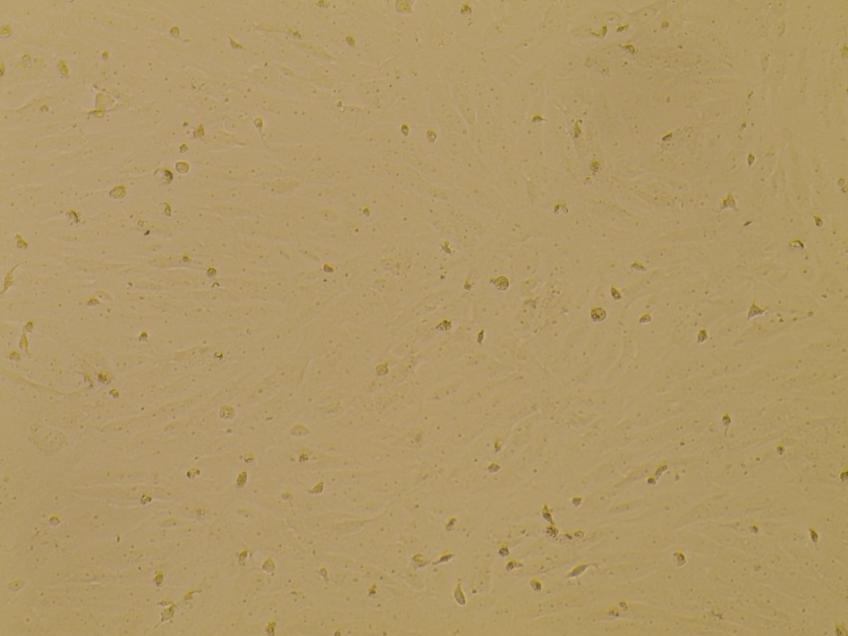
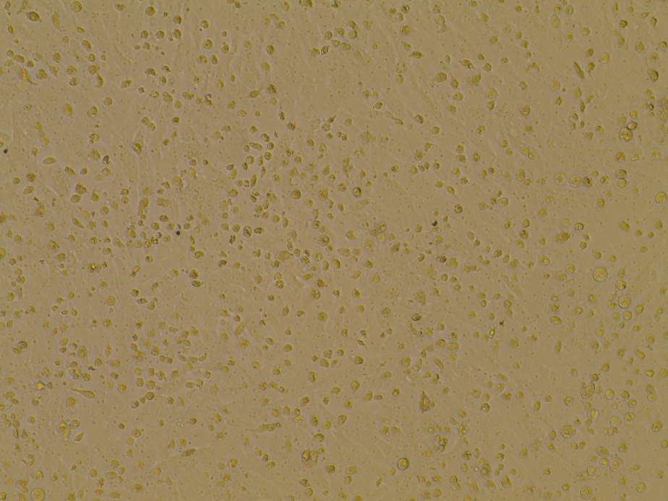
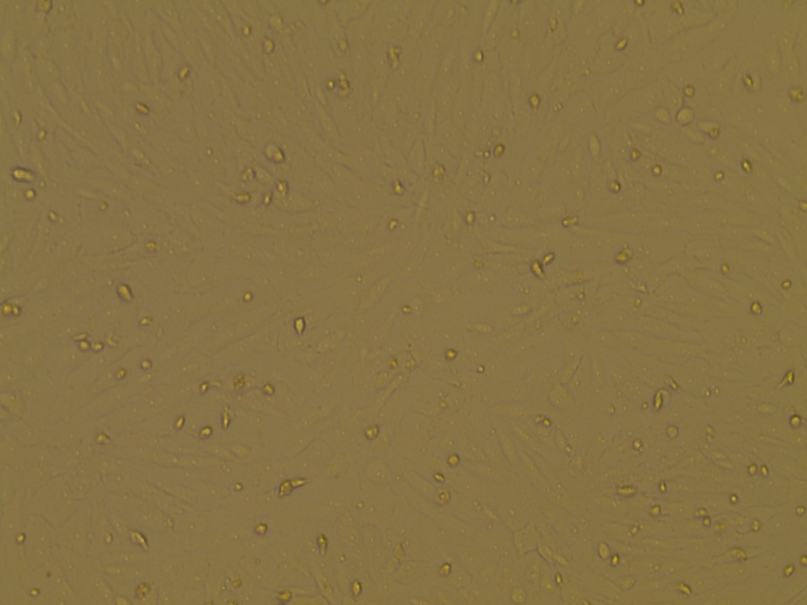
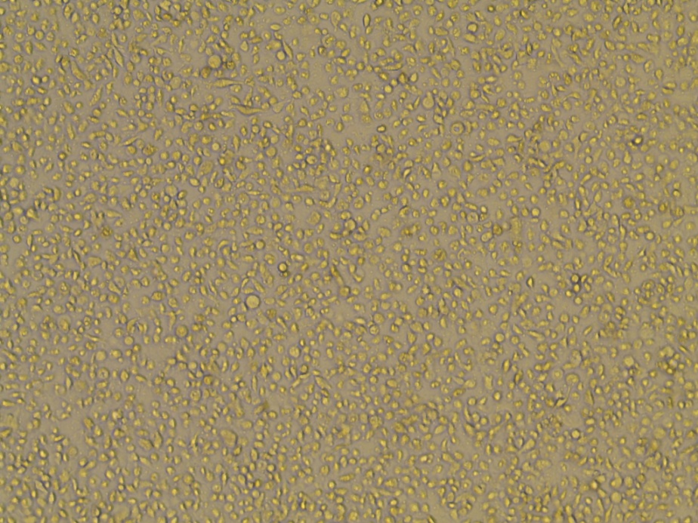
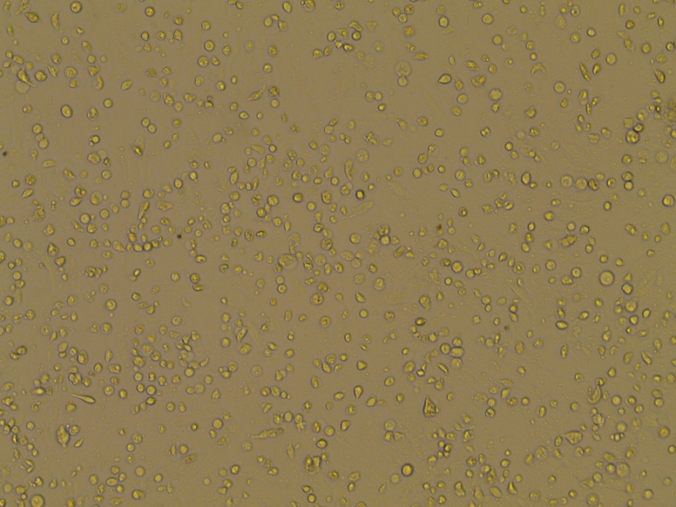
A
B
C
D
E
F

Slide 4
A
B
C
E
F
D

Slide 5
A
B
C
D
E
F

Slide 6
A
B
C
C
D
E
F

Slide 7
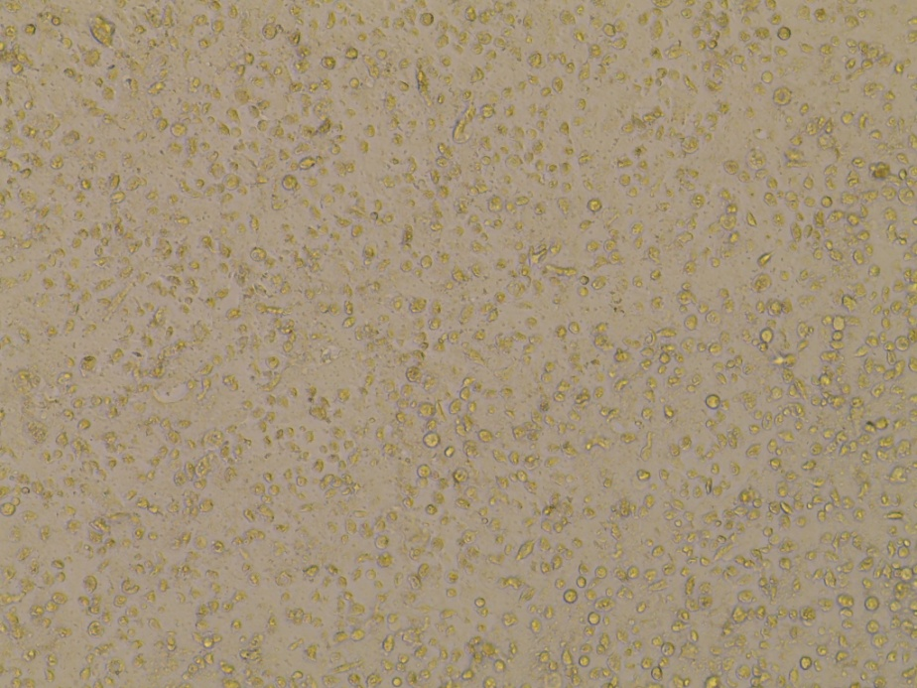
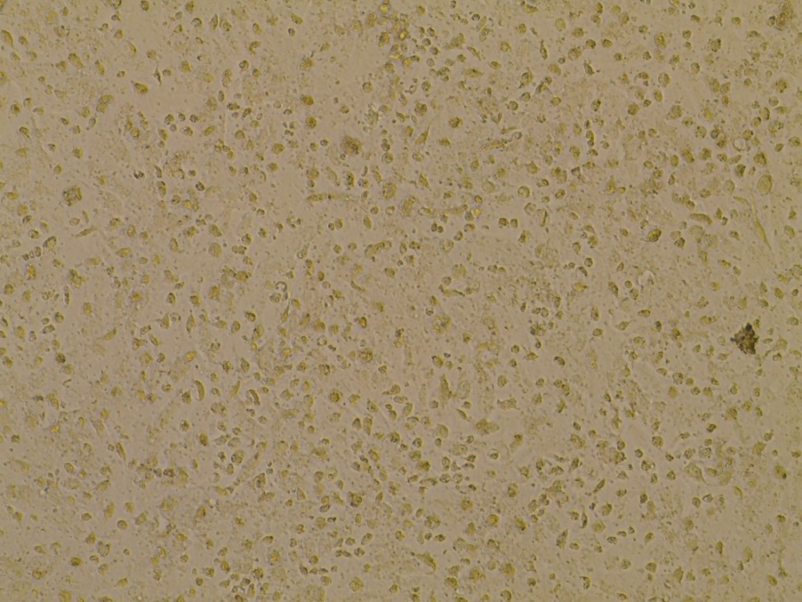
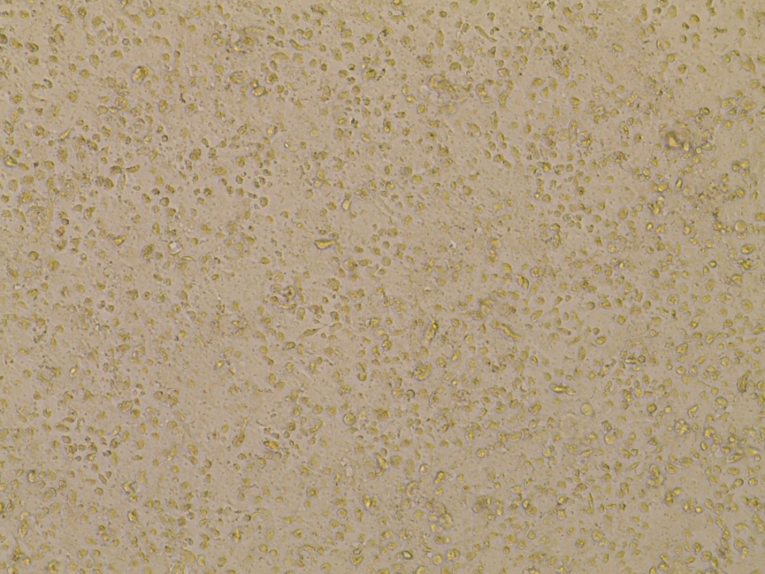

Slide 8
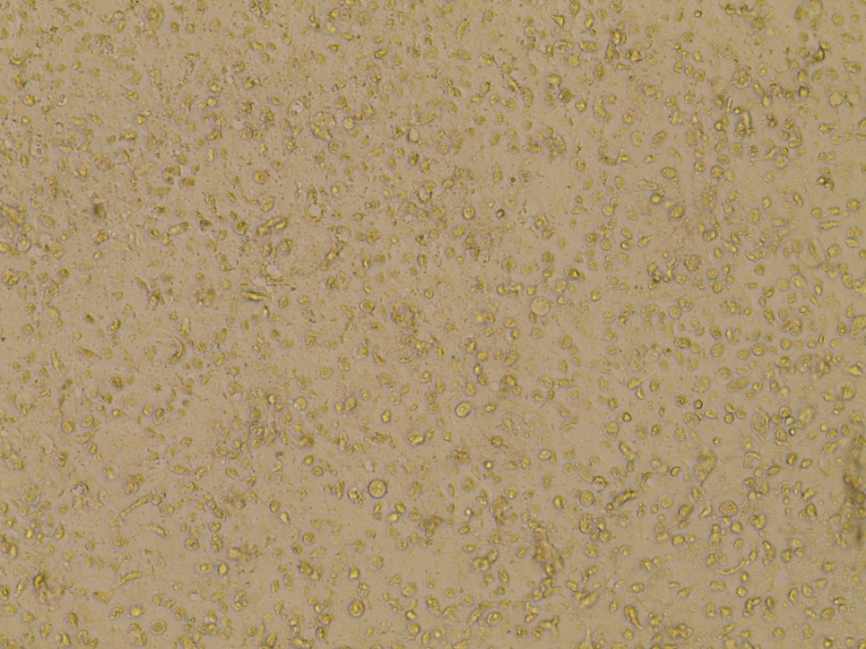
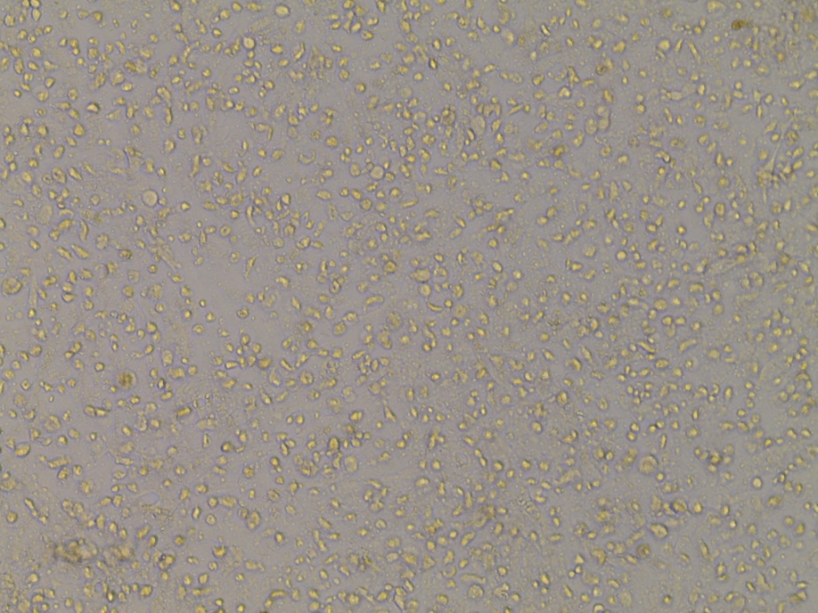
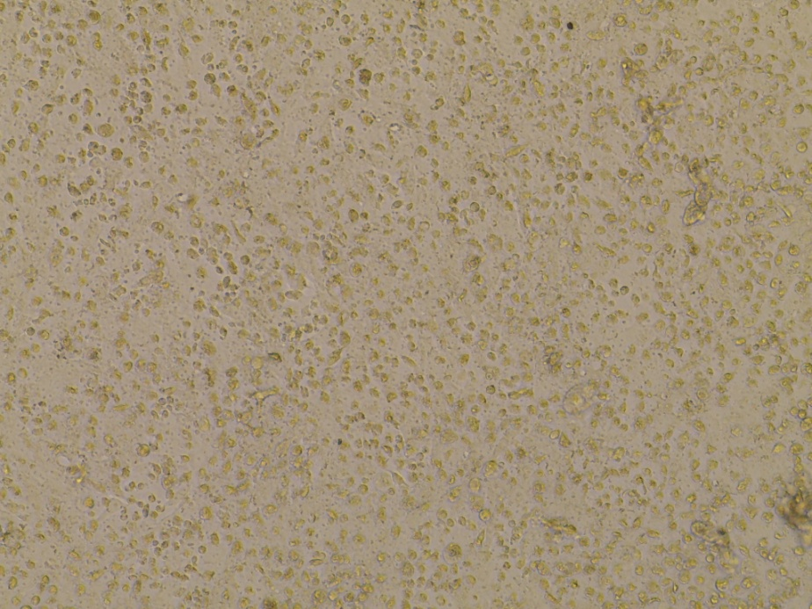

Slide 9
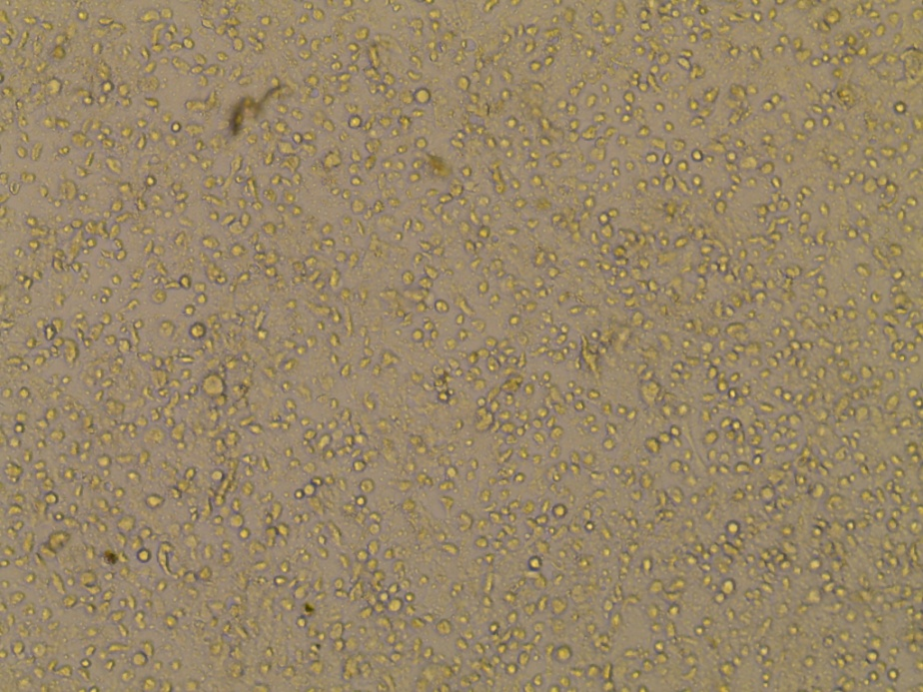
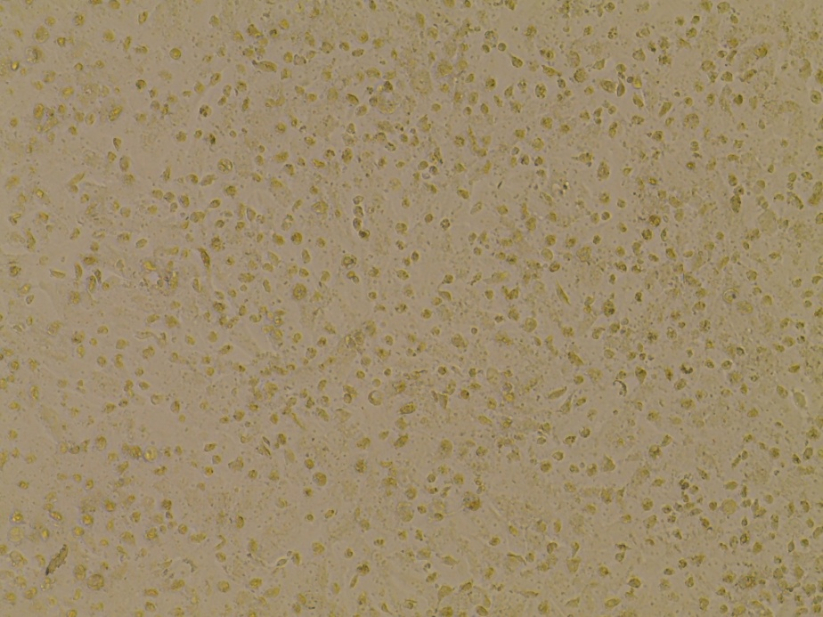
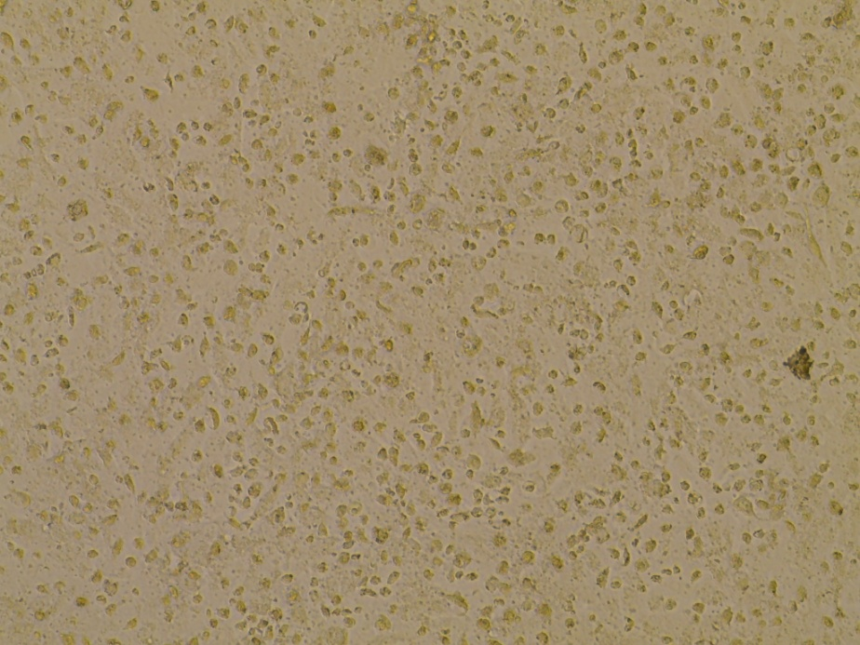
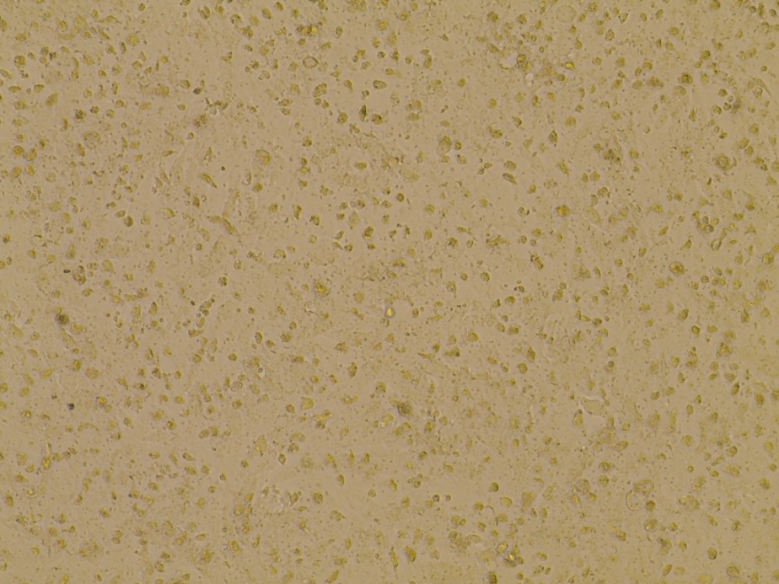

Slide 10
P1 after 4 day 700ul cp 32,
+ve control cp 20 , -ve control
P1 after 4 day 700ul cp 32, Vaccine cp 34
+ve control cp 20 , -ve control
P1 after 4 day 700ul cp 31,
+ve control cp 20 , -ve control
P1 after 4 day 700ul cp 31, Vaccine cp 34
+ve control cp 20 , -ve control

Slide 11
Original lung sample cp 23, +ve control cp 21 , -ve control
P1 after 4 day 700ul cp 32, +ve control cp 20 , -ve control
P2 after 4 day 700ul cp 34, +ve control cp 20 , -ve control
P3 after 4 day 700ul cp 37,+ve control cp 20 , -ve control
P2 after 5 day 800ul cp 32, +ve control cp 20 , -ve control
P3 after 6 day 700ul cp 34,+ve control cp 21 , -ve control

Slide 12
A
B
C
D
E
F

Slide 14
CPE : P2 after 3 day (72) 700 ul

Slide 15
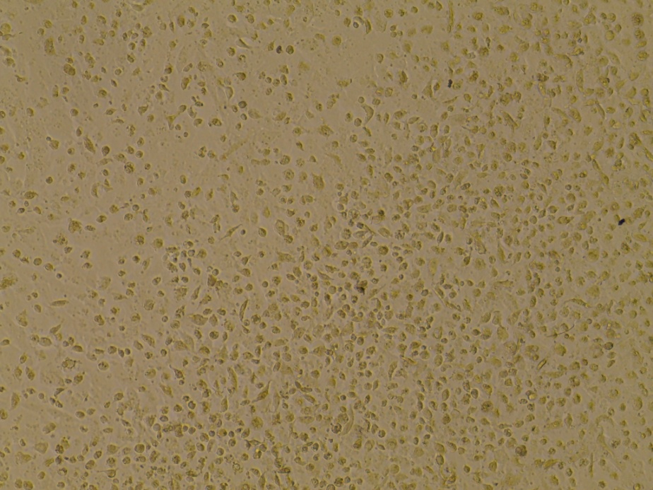
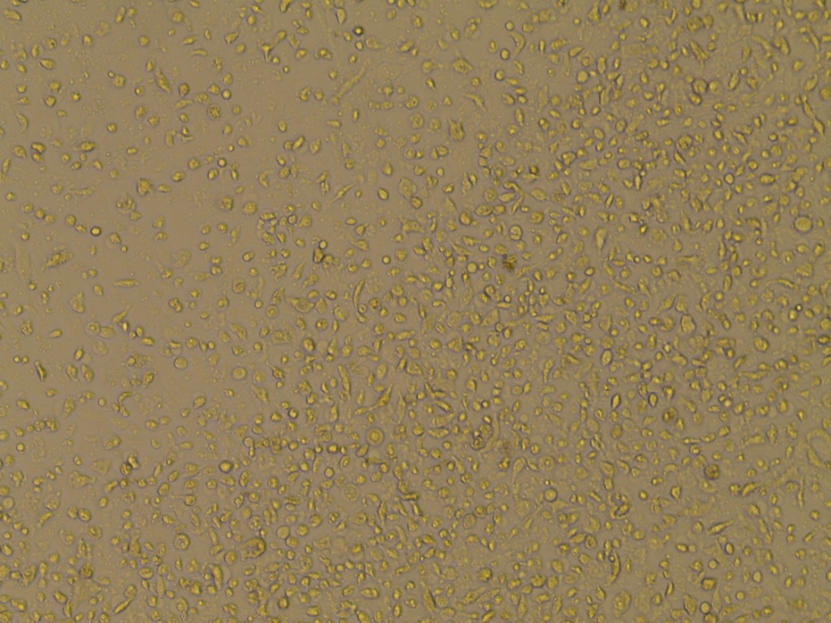
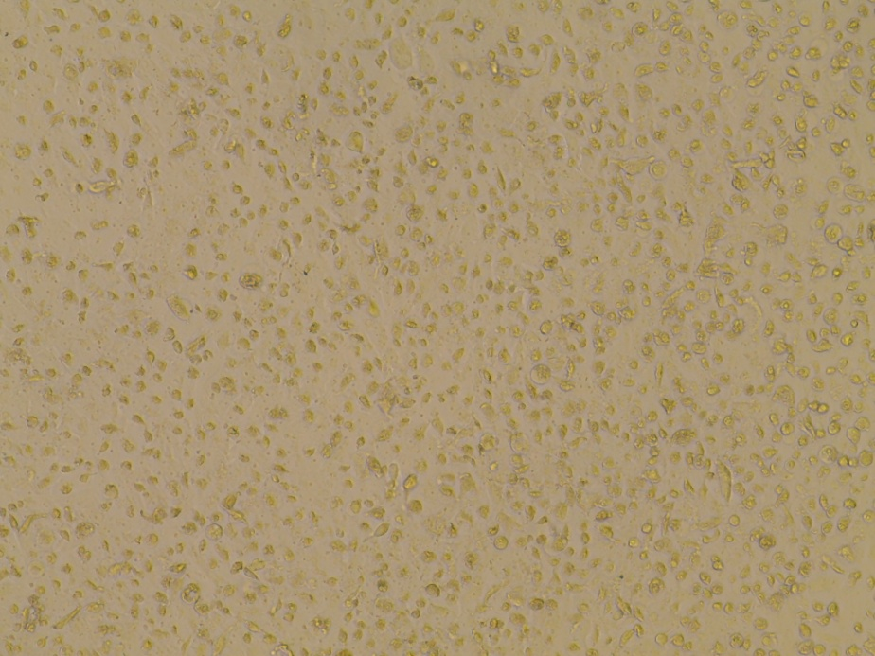
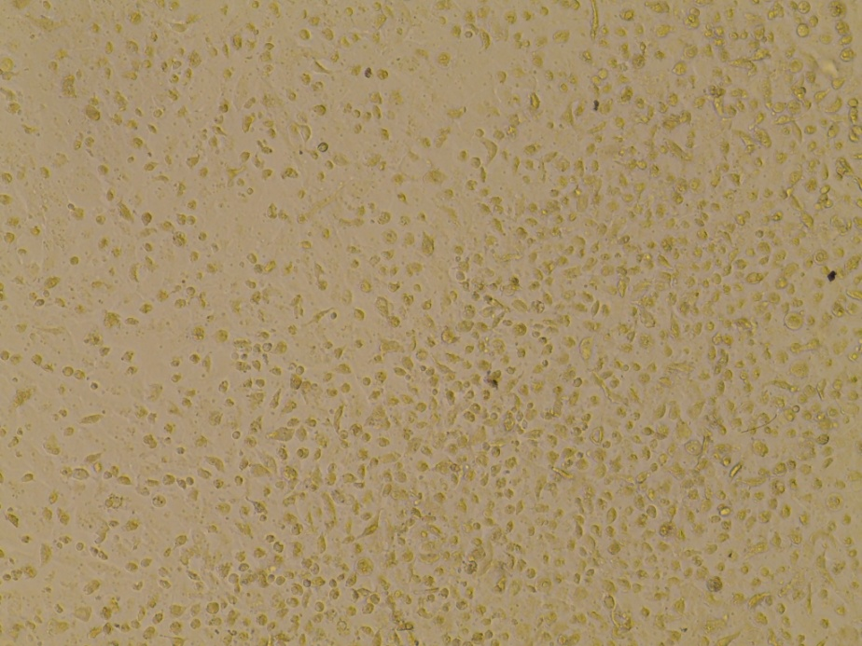

Slide 16
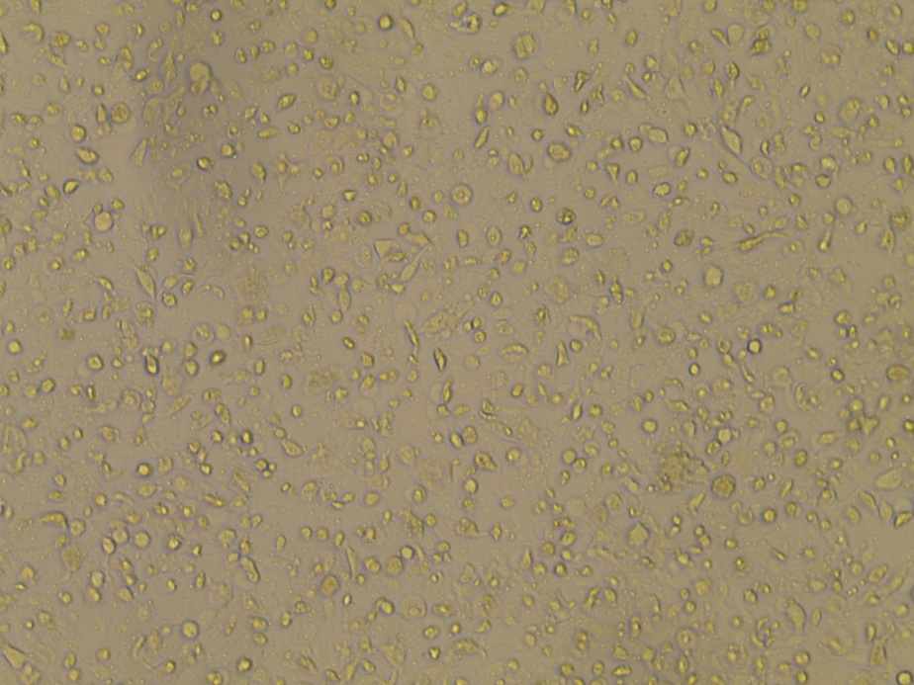
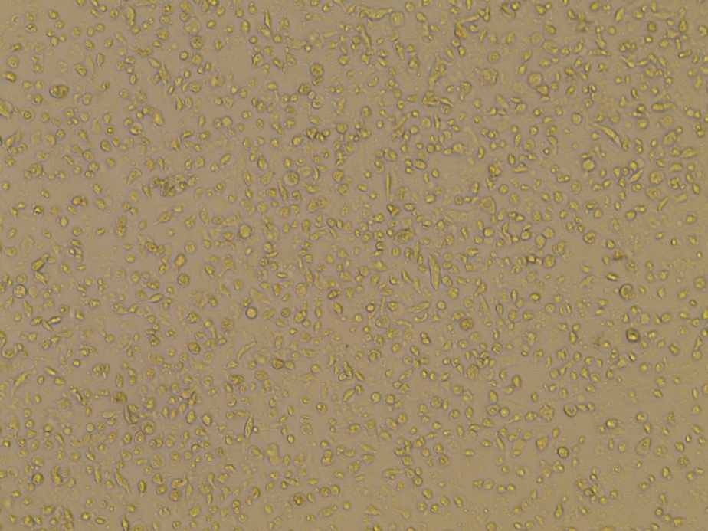

Slide 17
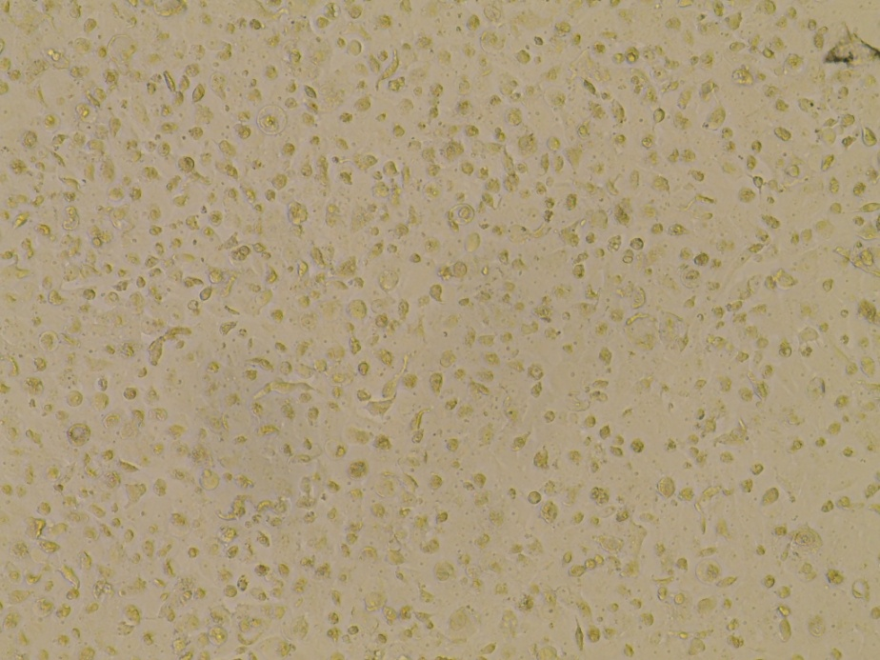
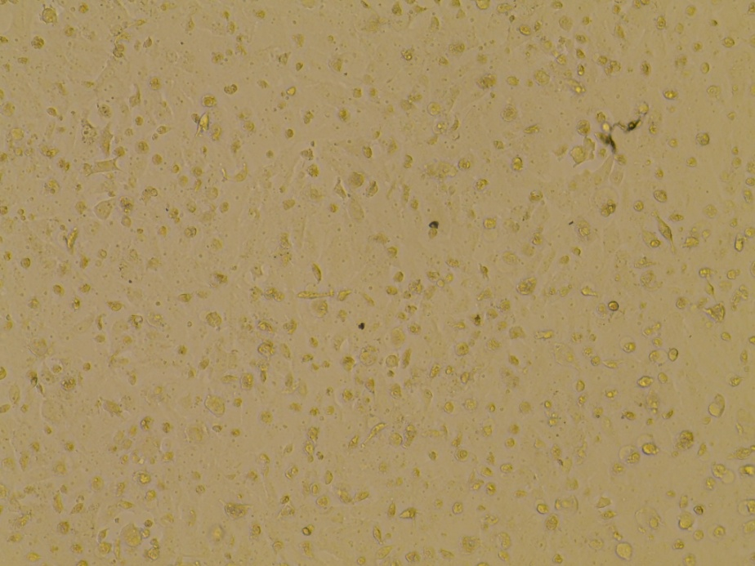
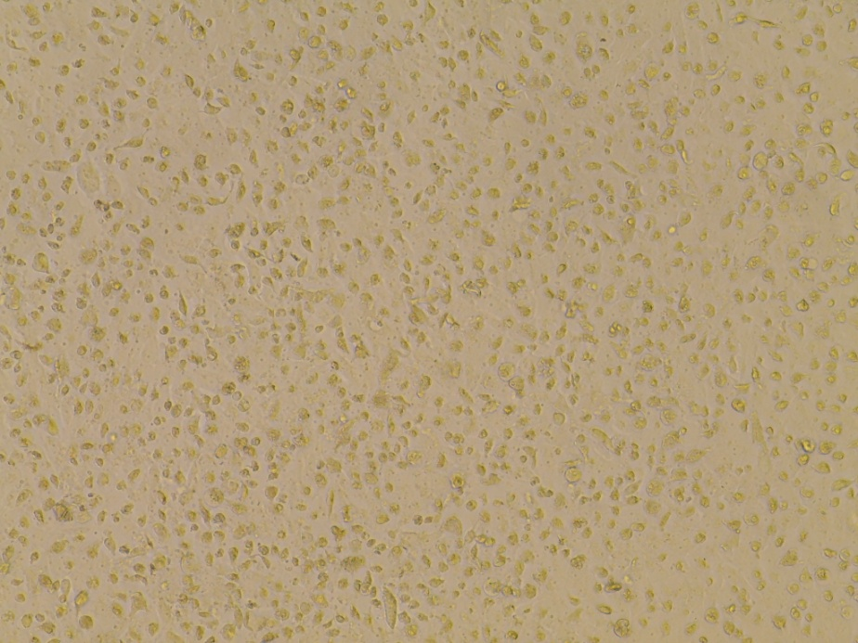

Slide 18
P2 after 4 day 700ul cp 34, Vaccine cp 34
+ve control cp 20 , -ve control
P2 after 4 day 700ul cp 34,
+ve control cp 20 , -ve control
P2 after 5 day 800ul cp 32, Vaccine cp 34
,+ve control cp 20 , -ve control
P2 after 5 day 800ul cp 32,
+ve control cp 20 , -ve control

Slide 19
P2 after 5 day 800ul cp 32, P2 after 4 day 700ul cp 34
+ve control cp 20 , -ve control
P2 eye swab from 3rd group after 4 day negatne ,+ve control cp 20 , -ve control

Slide 20
CPE : P3 after 3 day (72) 700 ul

Slide 21
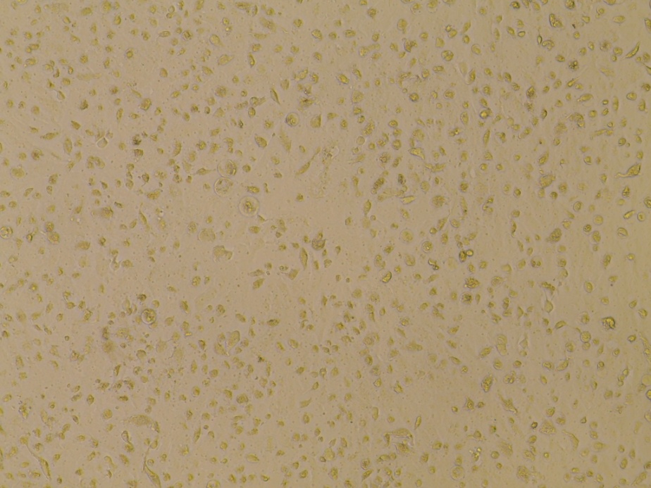
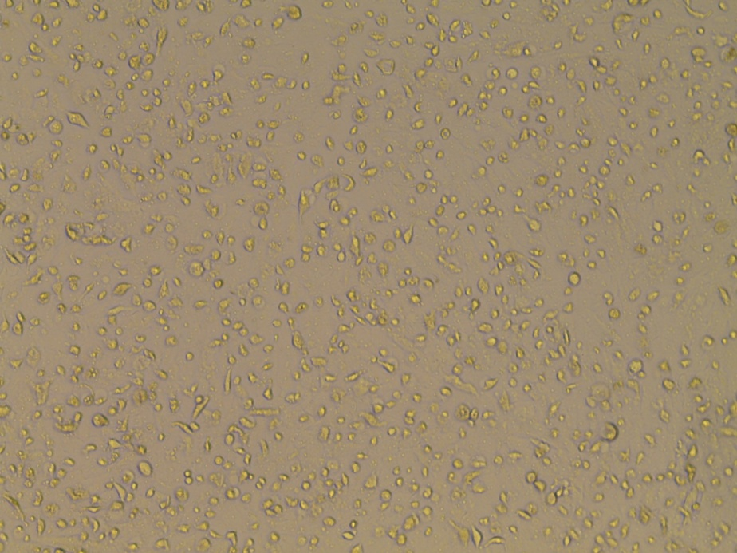
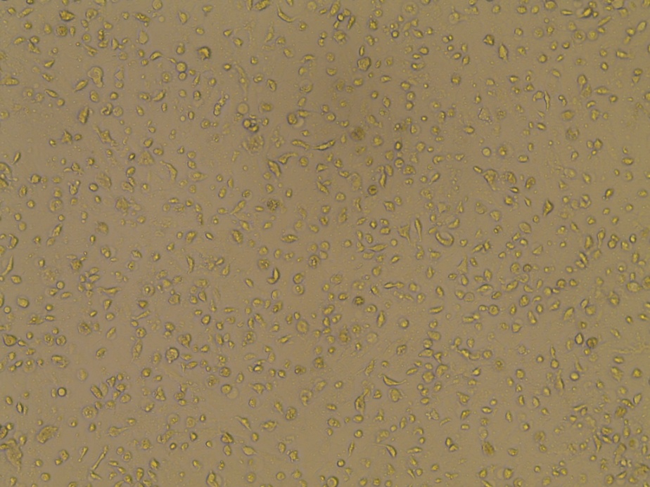

Slide 22
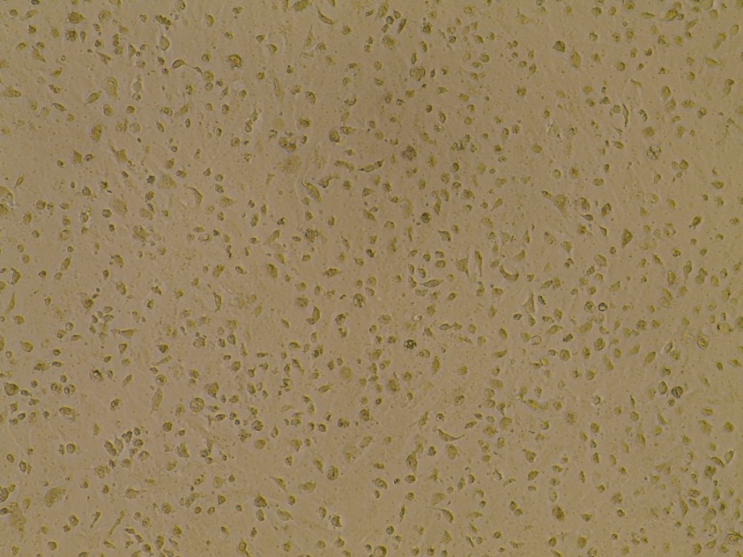
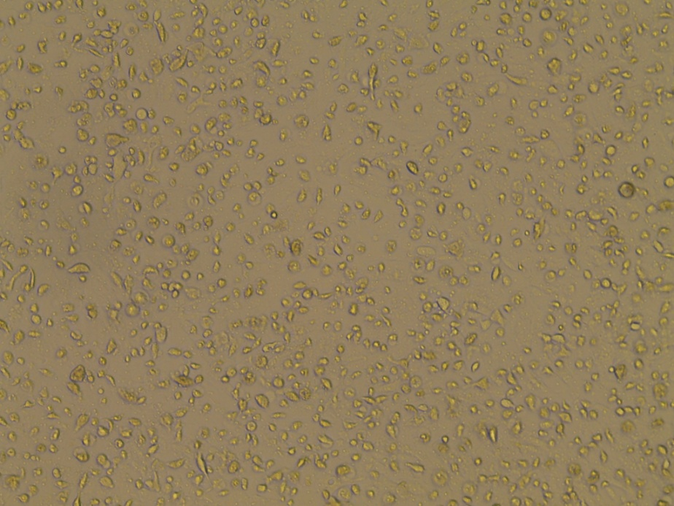
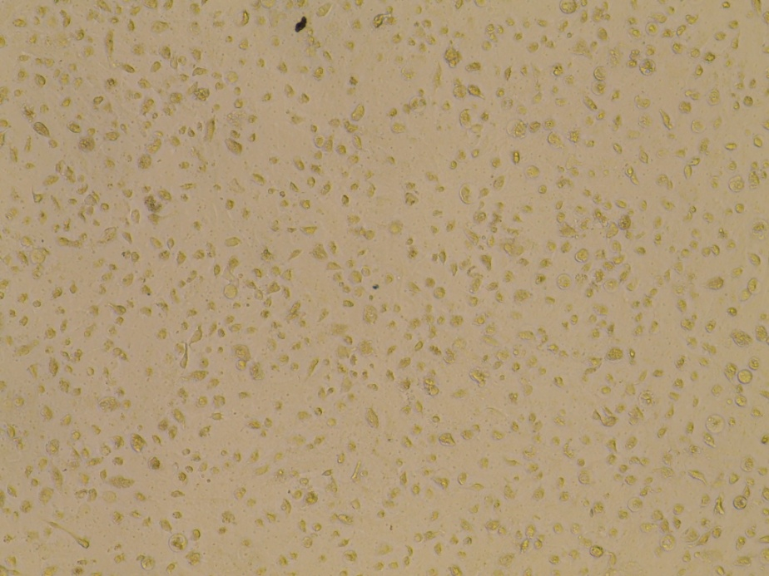
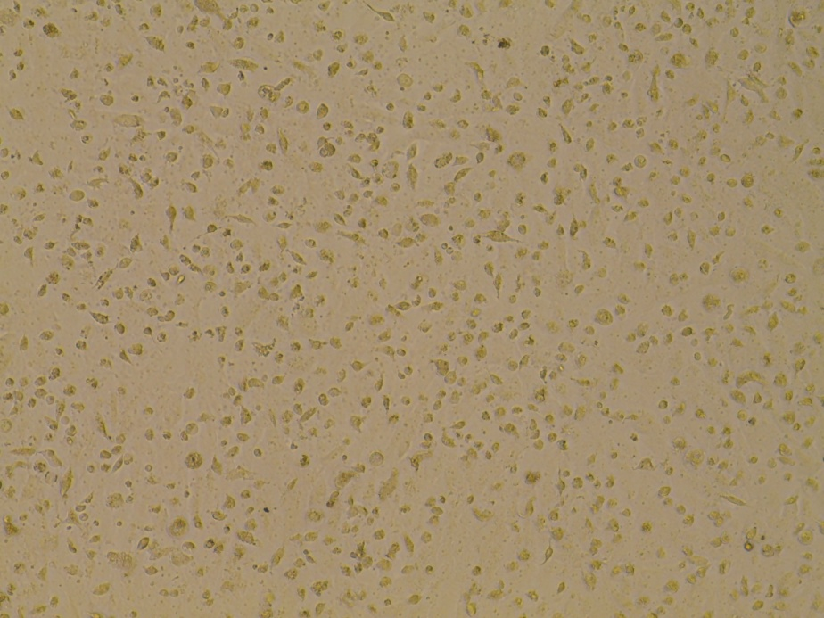

Slide 23
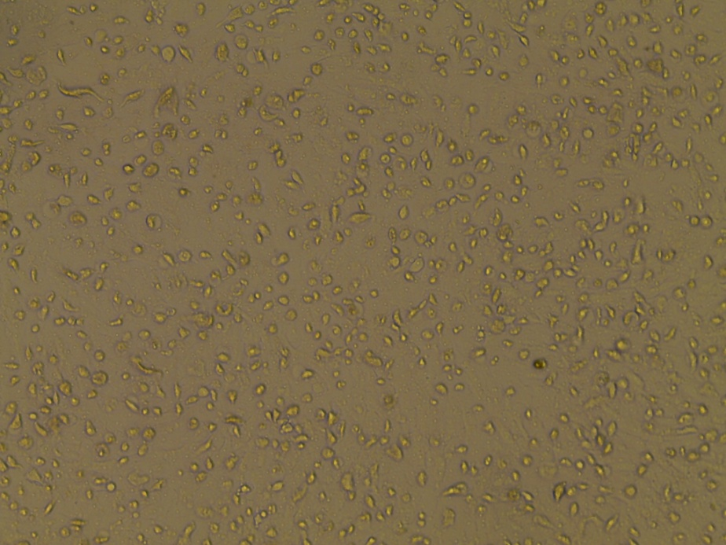
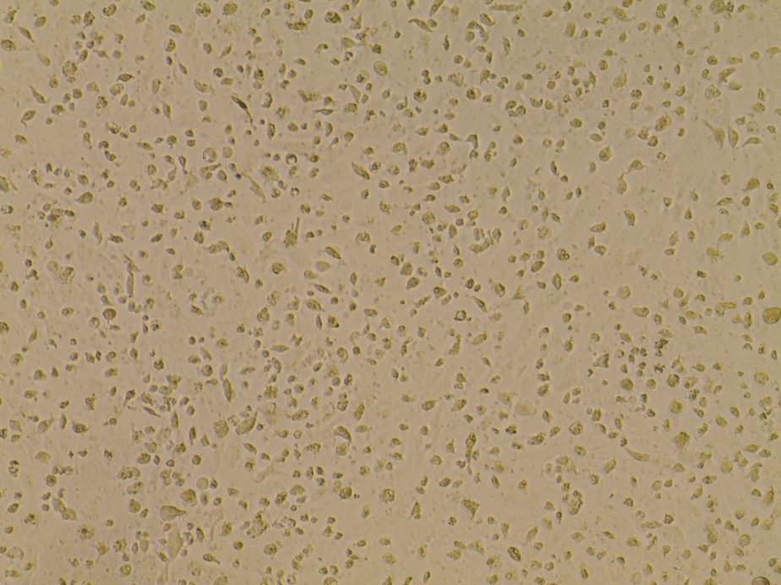
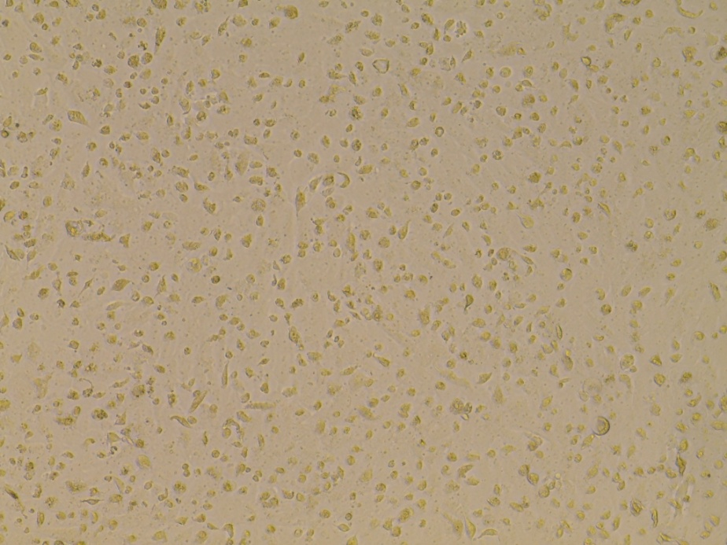

Slide 24
P3 after 4 day 700ul cp 37,+ve control cp 20 , -ve control
P3 after 4 day 700ul cp 36,+ve control cp 20 , -ve control
P3 after 6 day 700ul cp 34, Vaccine cp 34
+ve control cp 21 , -ve control
P3 after 6 day 700ul cp 34,+ve control cp 21 , -ve control

Slide 25
P3 after 4 day 700ul two different flask cp 36 and 37,+ve control cp 20 , -ve control

Slide 26
Figure : demonstrate the best cp of different passage
Original lung sample cp 23,P1 after 4 day 700ul cp 31, P2 after 5 day 800ul cp 32,P3 after 6 day 700ul cp 34 ,+ve vaccine cp 34, +ve control cp 21 , -ve control
Original lung sample cp 23,P1 after 4 day 700ul cp 31, P2 after 5 day 800ul cp 32,P3 after 6 day 700ul cp 34
+ve control cp 21 , -ve control

Slide 27
Start with pssage 1 after 4 day flowed by First blind culture : oral swab, oral swab, eye swab, lung , spleen sample . after 4 day tested all tested samples negative except eye swab cp 32 , +ve control cp 20, -ve control
Start with pssage 1 after 4 day flowed by First blind culture : oral swab, oral swab, eye swab, lung , spleen sample . after 4 day tested all samples negative , +ve control cp 20, -ve control
Start with pssage 1 after 4 day flowed by First culture: eye swab sample . after 4 day tested cp 32, +ve control cp 20, -ve control

Slide 28
A
A
B
B

Slide 29
P2 after 5 day in tissue culture cp 36, in the media cp 37 , +ve control cp 20 , -ve control
in different analysis (noise band) : P2 after 5 day the tissue culture cp 36, the media cp 38 , +ve control cp 20 , -ve control

Slide 30
Original eye swab sample cp 24, +ve control cp 18 , -ve control
First culture eye swab sample after 4 day cp 32, +ve control cp 20, -ve control
P1 after 4 day 700ul cp 34 from First subculture ,+ve control cp 19 , -ve control
P2 after 4 day 700ul cp 38 from First subculture ,+ve control cp 20 , -ve control

Slide 31
A
B
C
D

Slide 32
+ve ,Pink 4 ,Yellw 4, Pink 4
CPE : after 3 day (72) 1ml of media was add in luphalized vaccine then diluted 1/100 : 2 ml was add in flask with 6 ml media
Liquid vaccine seed diluted 1/100 : 2 ml was add in flask with 6 ml media

Slide 33
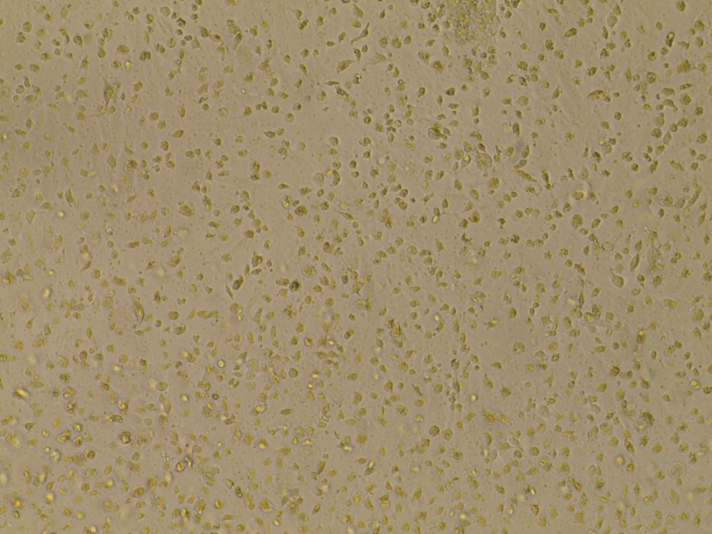
Pink: liquid vaccine (seed)

Slide 34
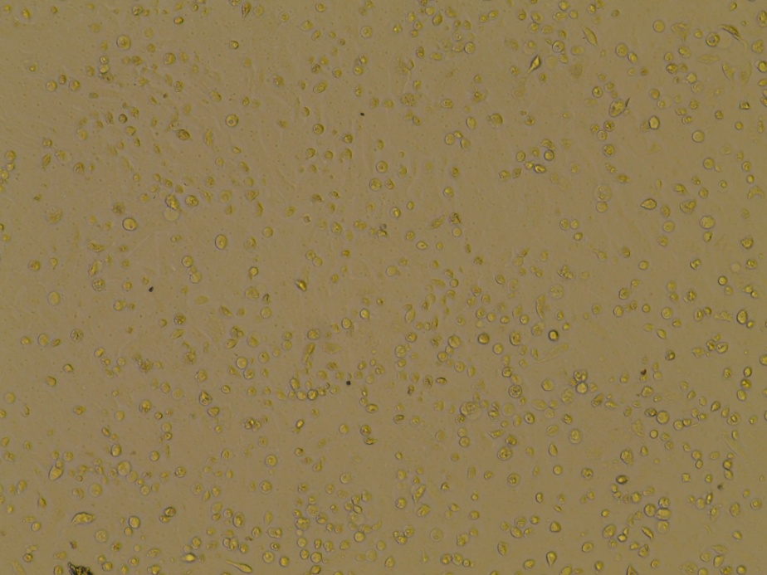
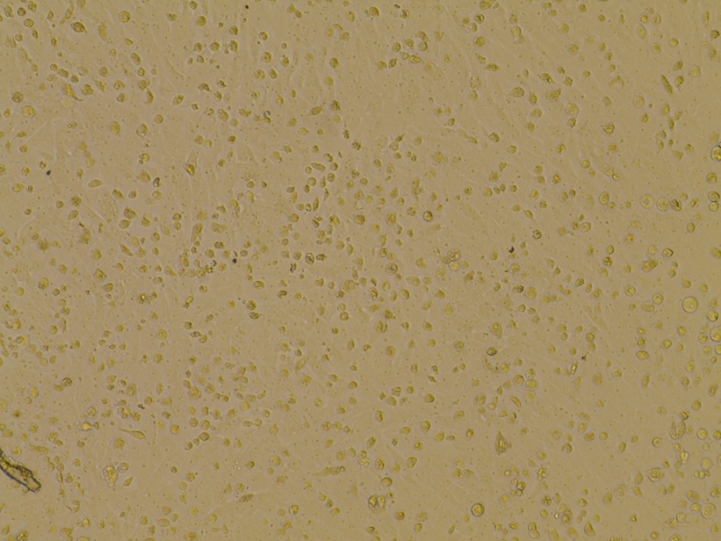
Yellow : lyophilize vaccine

Slide 35
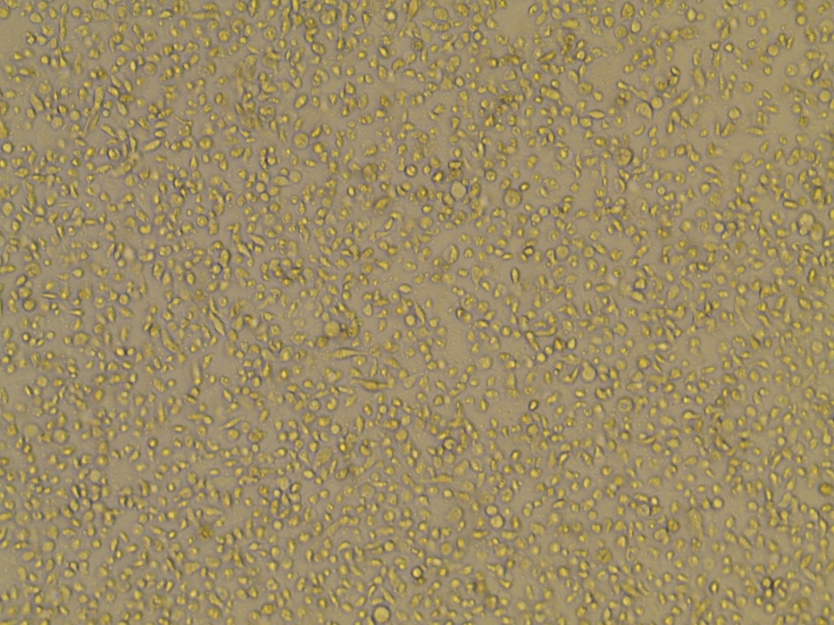
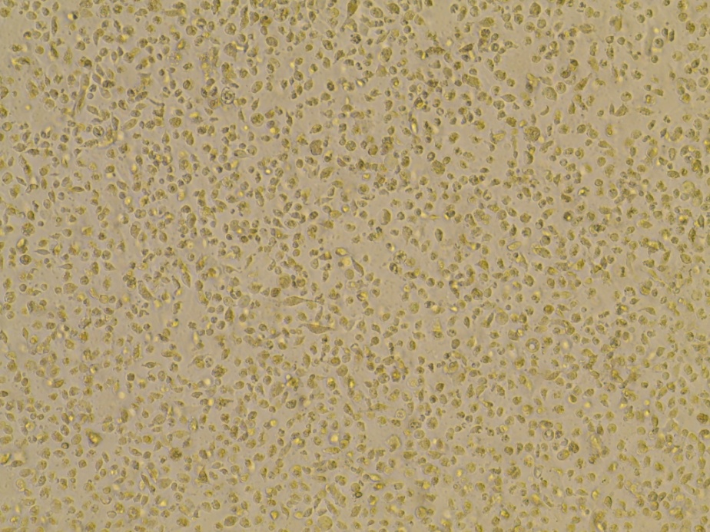
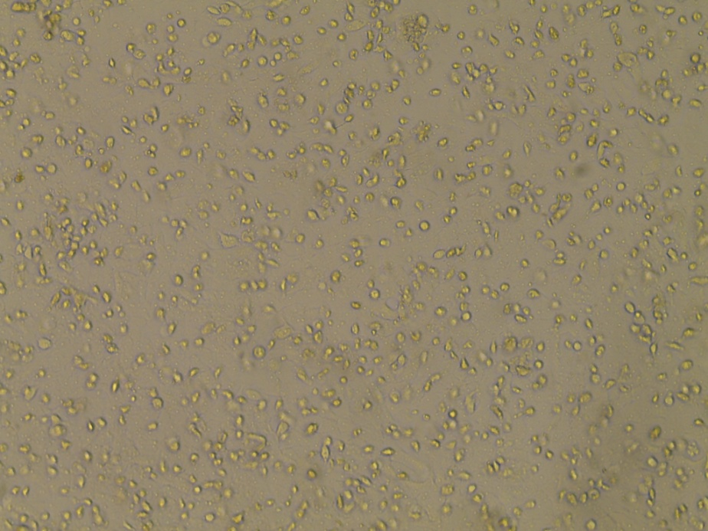
Pink: liquid vaccine (seed)

Slide 36
-ve: after 3 day (72) from isolation

Slide 37
