Slide 1
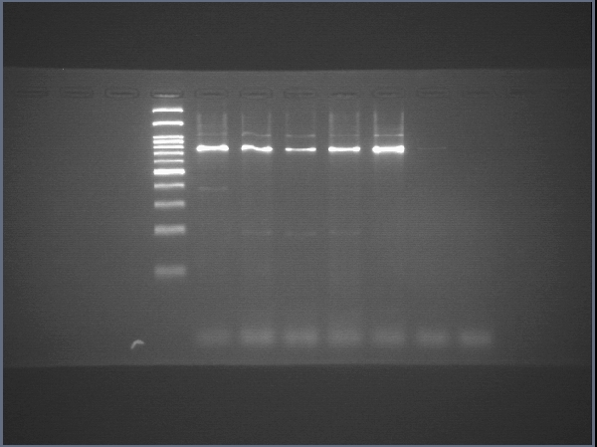
Supplementary data: Raw data of agarose gel with labels
Human SOX17
M 1 2 3 4 5 6 NTC
bp
3000
1500
1000
800
500
400
300
200
100
M: 100-bp DNA ladder
1: Human iPSCs 019
2: 5-Day 2D culture of human iPSCs 019
3: 10-Day 2D culture of human iPSCs 019
4: 15-Day 2D culture of human iPSCs 019
5: 25-Day 2D culture of human iPSCs 019
6: 17-Day 3D culture of human iPSCs 019
NTC: no template control
Arrow: expected size of amplicons

Slide 2
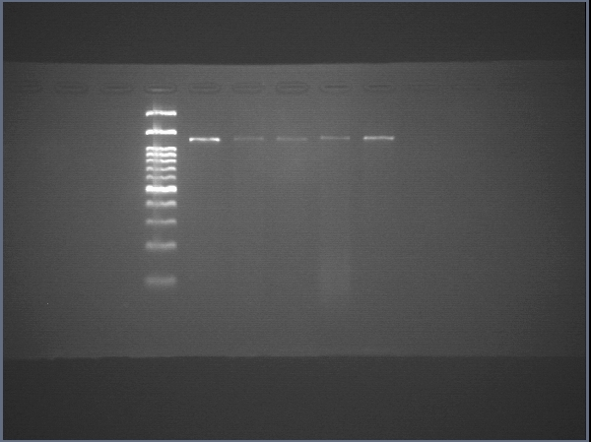
Supplementary data: Raw data of agarose gel with labels
Human FOXA2
M 1 2 3 4 5 6 NTC
bp
3000
1500
1000
800
500
400
300
200
100
M: 100-bp DNA ladder
1: Human iPSCs 019
2: 5-Day 2D culture of human iPSCs 019
3: 10-Day 2D culture of human iPSCs 019
4: 15-Day 2D culture of human iPSCs 019
5: 25-Day 2D culture of human iPSCs 019
6: 17-Day 3D culture of human iPSCs 019
NTC: no template control
Arrow: expected size of amplicons

Slide 3
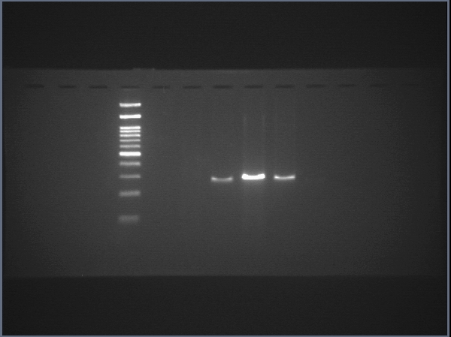
Supplementary data: Raw data of agarose gel with labels
Human AFP
M 1 2 3 4 5 6 NTC
bp
3000
1500
1000
700
500
400
300
200
100
M: 100-bp DNA ladder
1: Human iPSCs 019
2: 5-Day 2D culture of human iPSCs 019
3: 10-Day 2D culture of human iPSCs 019
4: 15-Day 2D culture of human iPSCs 019
5: 25-Day 2D culture of human iPSCs 019
6: 17-Day 3D culture of human iPSCs 019
NTC: no template control
Arrow: expected size of amplicons

Slide 4
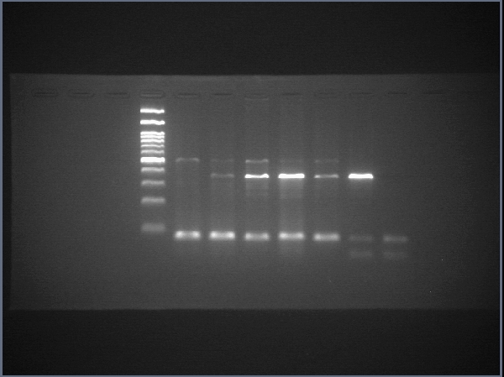
Supplementary data: Raw data of agarose gel with labels
Human ALB
M 1 2 3 4 5 6 NTC
bp
3000
1500
1000
700
500
400
300
200
100
M: 100-bp DNA ladder
1: Human iPSCs 019
2: 5-Day 2D culture of human iPSCs 019
3: 10-Day 2D culture of human iPSCs 019
4: 15-Day 2D culture of human iPSCs 019
5: 25-Day 2D culture of human iPSCs 019
6: 17-Day 3D culture of human iPSCs 019
NTC: no template control
Arrow: expected size of amplicons

Slide 5
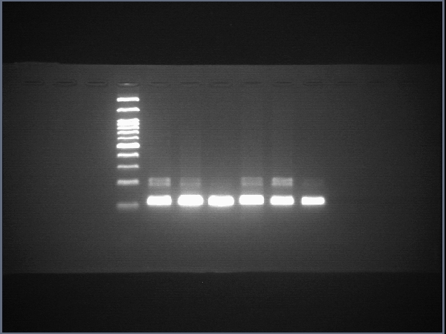
Supplementary data: Raw data of agarose gel with labels
Human ACTB
M 1 2 3 4 5 6 NTC
bp
3000
1500
1000
600
500
400
300
200
100
M: 100-bp DNA ladder
1: Human iPSCs 019
2: 5-Day 2D culture of human iPSCs 019
3: 10-Day 2D culture of human iPSCs 019
4: 15-Day 2D culture of human iPSCs 019
5: 25-Day 2D culture of human iPSCs 019
6: 17-Day 3D culture of human iPSCs 019
NTC: no template control
Arrow: expected size of amplicons

