Slide 1
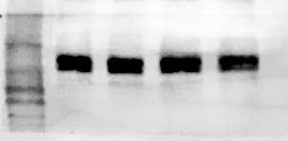
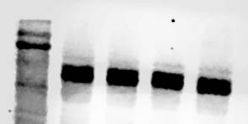
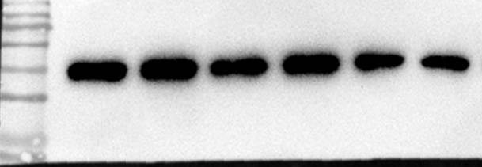
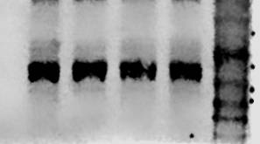
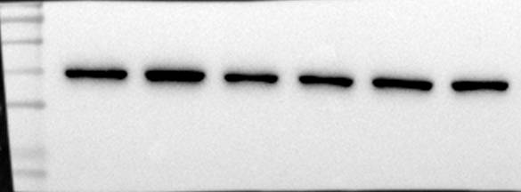
β-actin in Fig 7B
β-actin in Fig 7A
LF
- + - +
LF
- + - + - -
LA
- + - + - -
LA
- - + +
AMPK inhibitor
- - - - + +
Nummularine B
- - + + - +

Slide 2
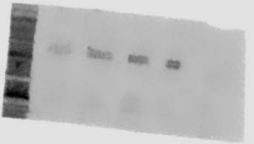
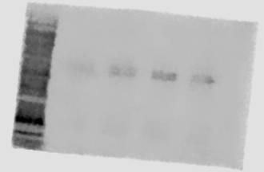
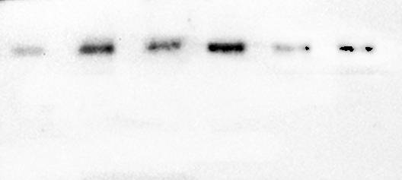
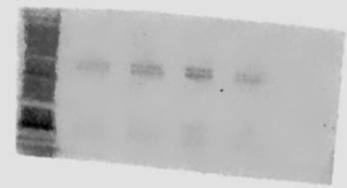
AMPK in Fig 7B
AMPK in Fig 7A
- + - + - -
LF
LF
- + - +
LA
- + - + - -
AMPK inhibitor
- - - - + +
LA
- - + +
Nummularine B
- - + + - +

Slide 3
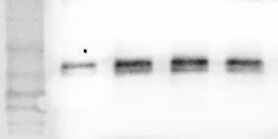
p-JNK in Fig 7A
p-JNK in Fig 7B
LF
- + - + - -
LF
- + - +
LA
- + - + - -
LA
- - + +
AMPK inhibitor
- - - - + +
Nummularine B
- - + + - +

Slide 4
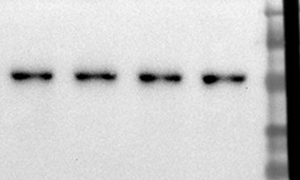
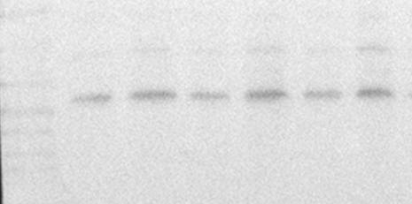
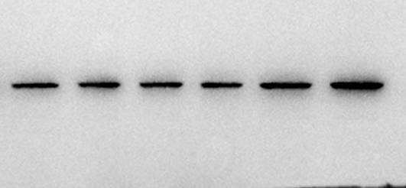
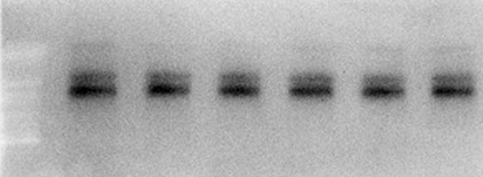
JNK in Fig 7B
JNK in Fig 7A
LF
- + - + - -
LF
- + - +
LA
- + - + - -
AMPK inhibitor
- - - - + +
LA
- - + +
Nummularine B
- - + + - +

Slide 5
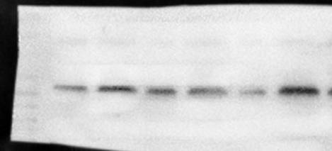
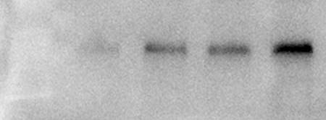
Bcl-2 in Fig 7A
Bcl-2 in Fig 7B
LF
- + - + - -
LF
- + - +
- + - + - -
LA
LA
- - + +
AMPK inhibitor
- - - - + +
Nummularine B
- - + + - +

Slide 6
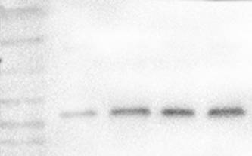
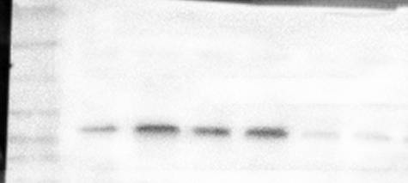
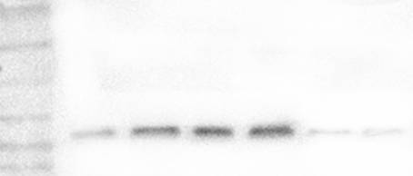
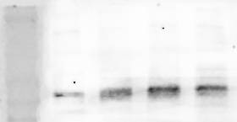
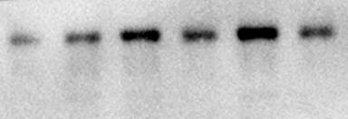
Bax in Fig 7B
Bax in Fig 7A
LF
- + - + - -
LF
- + - +
LA
- + - + - -
AMPK inhibitor
- - - - + +
LA
- - + +
Nummularine B
- - + + - +

Slide 7
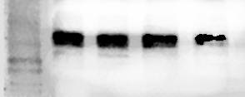
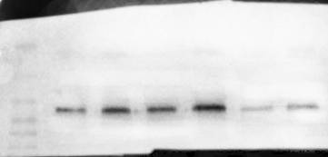
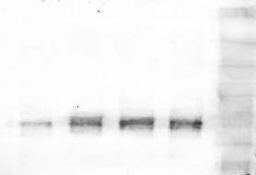
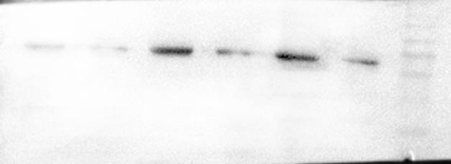
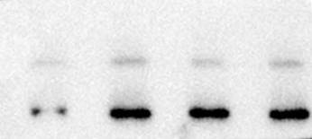
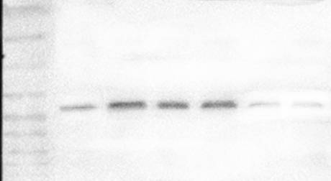
Caspase3 in Fig 7A
Caspase3 in Fig 7B
LF
- + - + - -
LF
- + - +
LA
- + - + - -
AMPK inhibitor
- - - - + +
LA
- - + +
Nummularine B
- - + + - +

