Slide 1
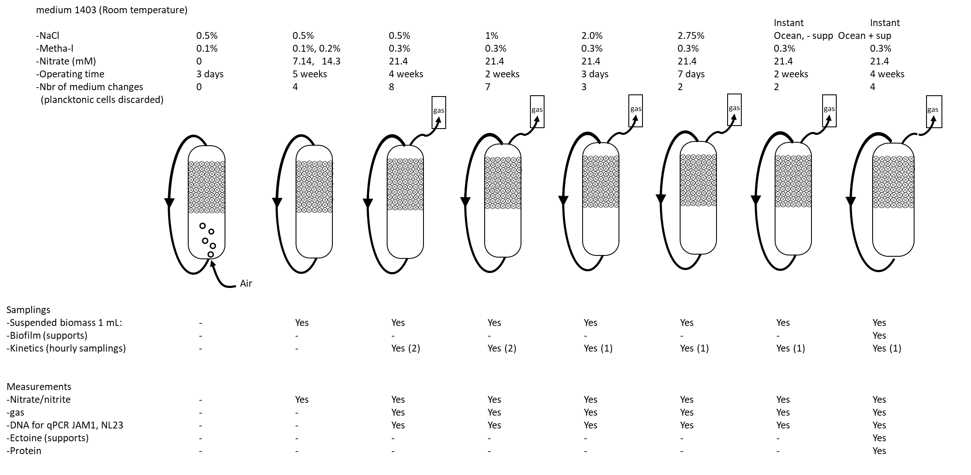
Reactor 1: Biofilm co-culture
Run from March to July 2019: 19 weeks
Methanol

Slide 2
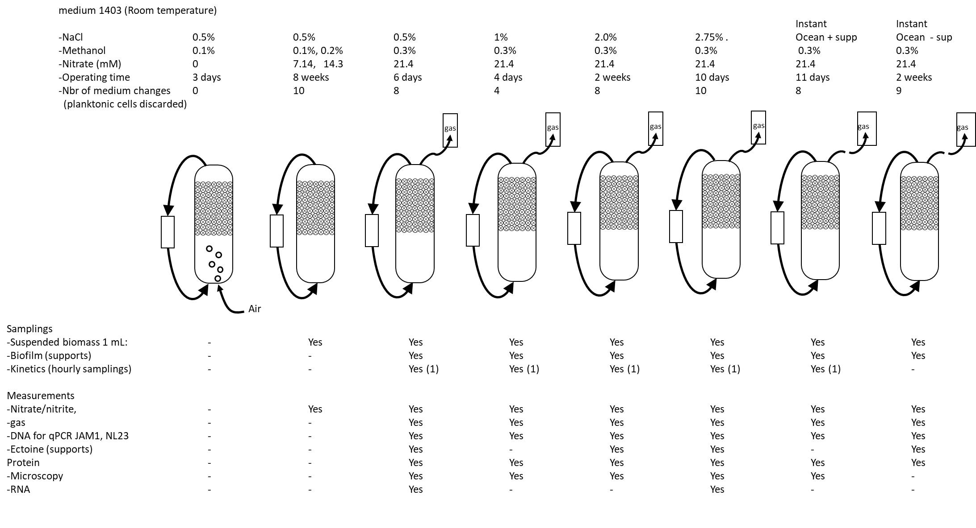
Reactor 2: Biofilm co-culture
Run from August to december 2019: 17 weeks
Yes

Slide 3
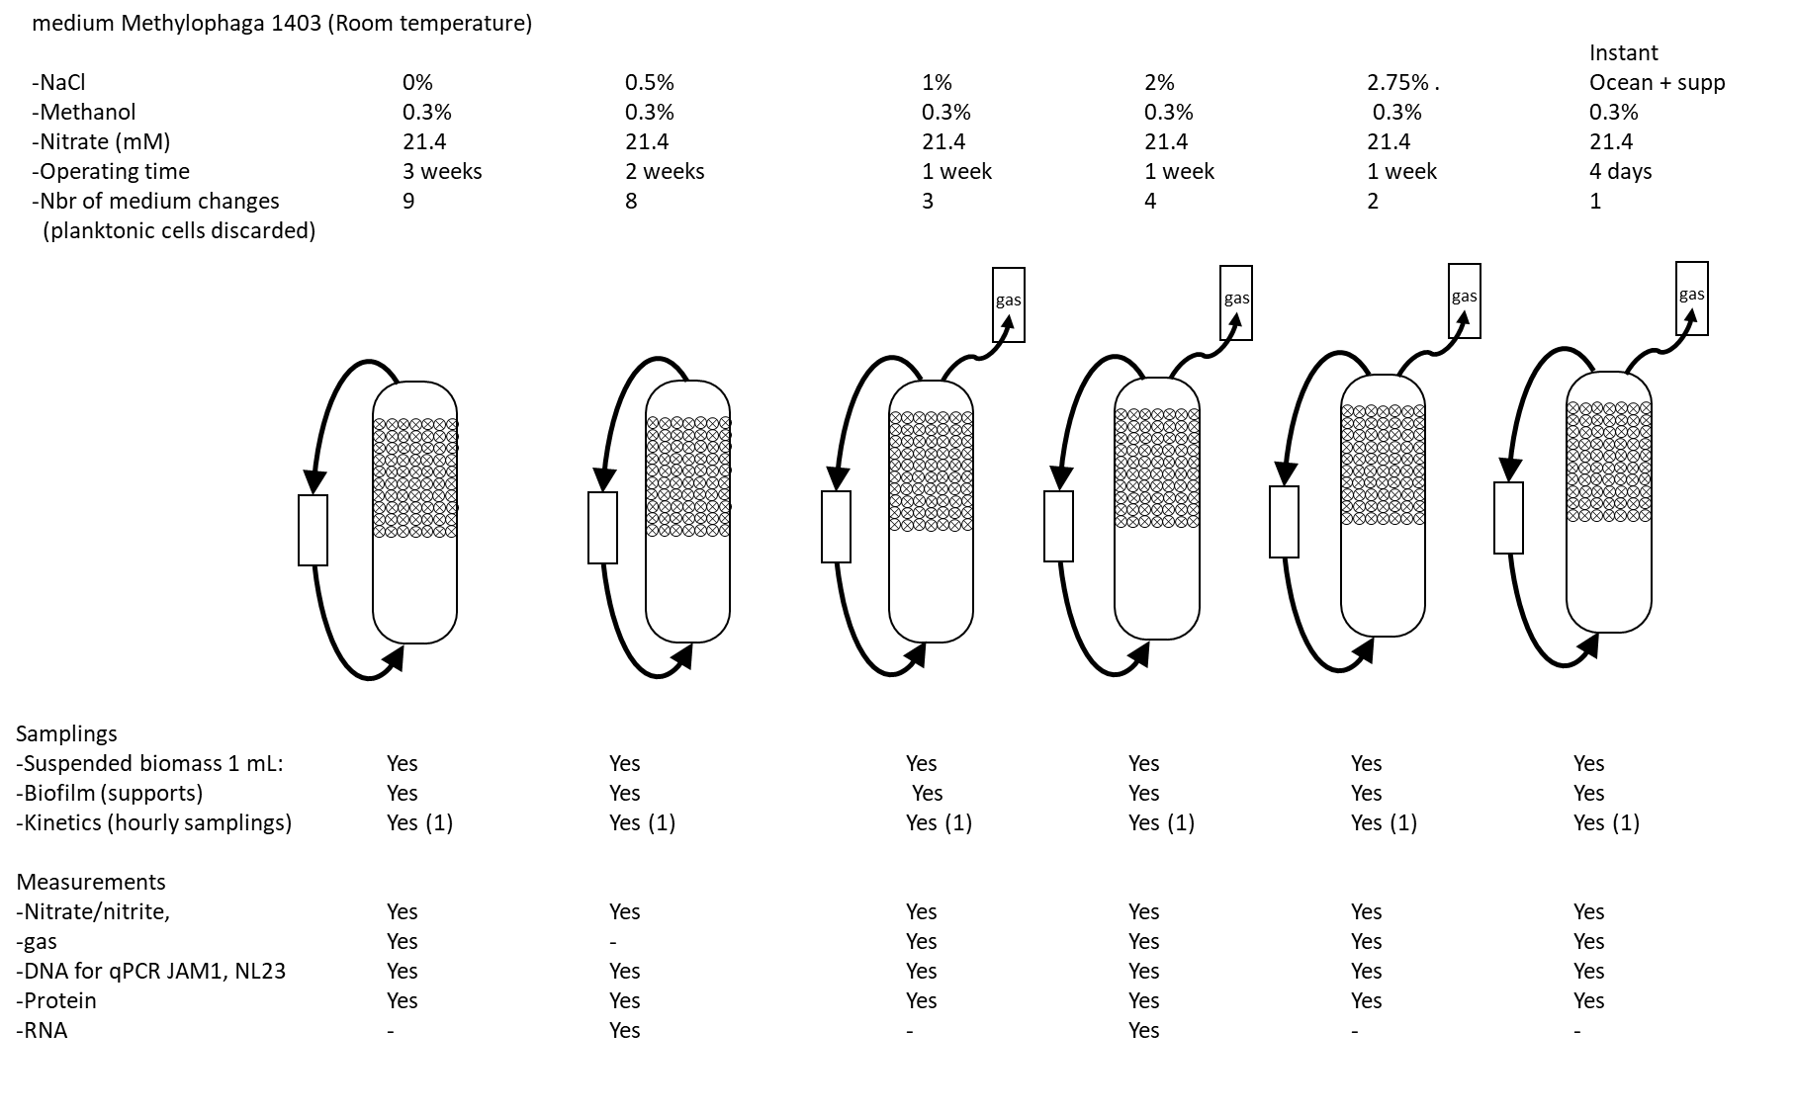
Reactor 3: Strain NL23 Biofilm mono-culture
Run from December 2019 to February 2020: 8 weeks

