Slide 1
Fig4: ACTIN
LPS+Theacrine
control
LPS
42kDa
Fig4: Caspase-1
LPS+Theacrine
control
LPS
22kDa

Slide 2
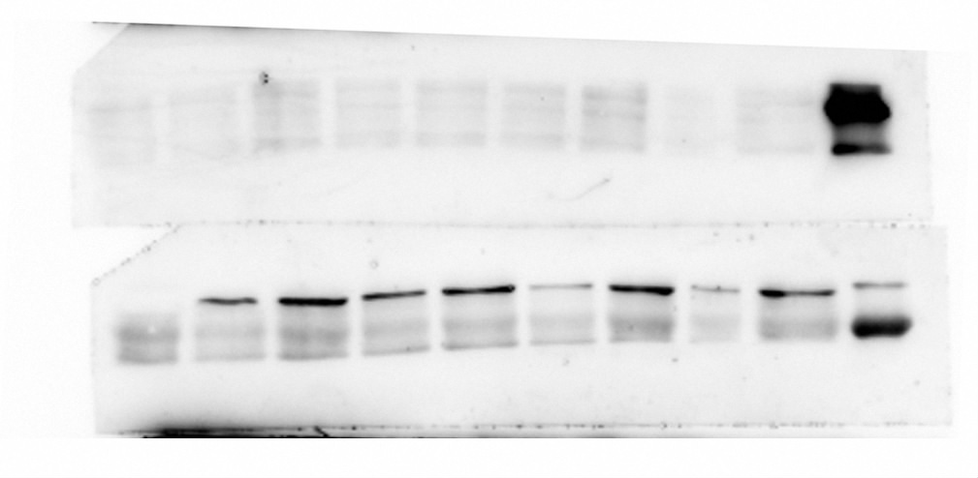
Fig4: Cleaved caspase-1
LPS+Theacrine
control
LPS
20kDa
Fig4: NLRP3
control
LPS+Theacrine
LPS
118kDa

