Slide 1
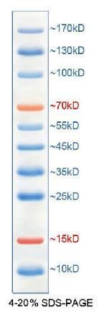
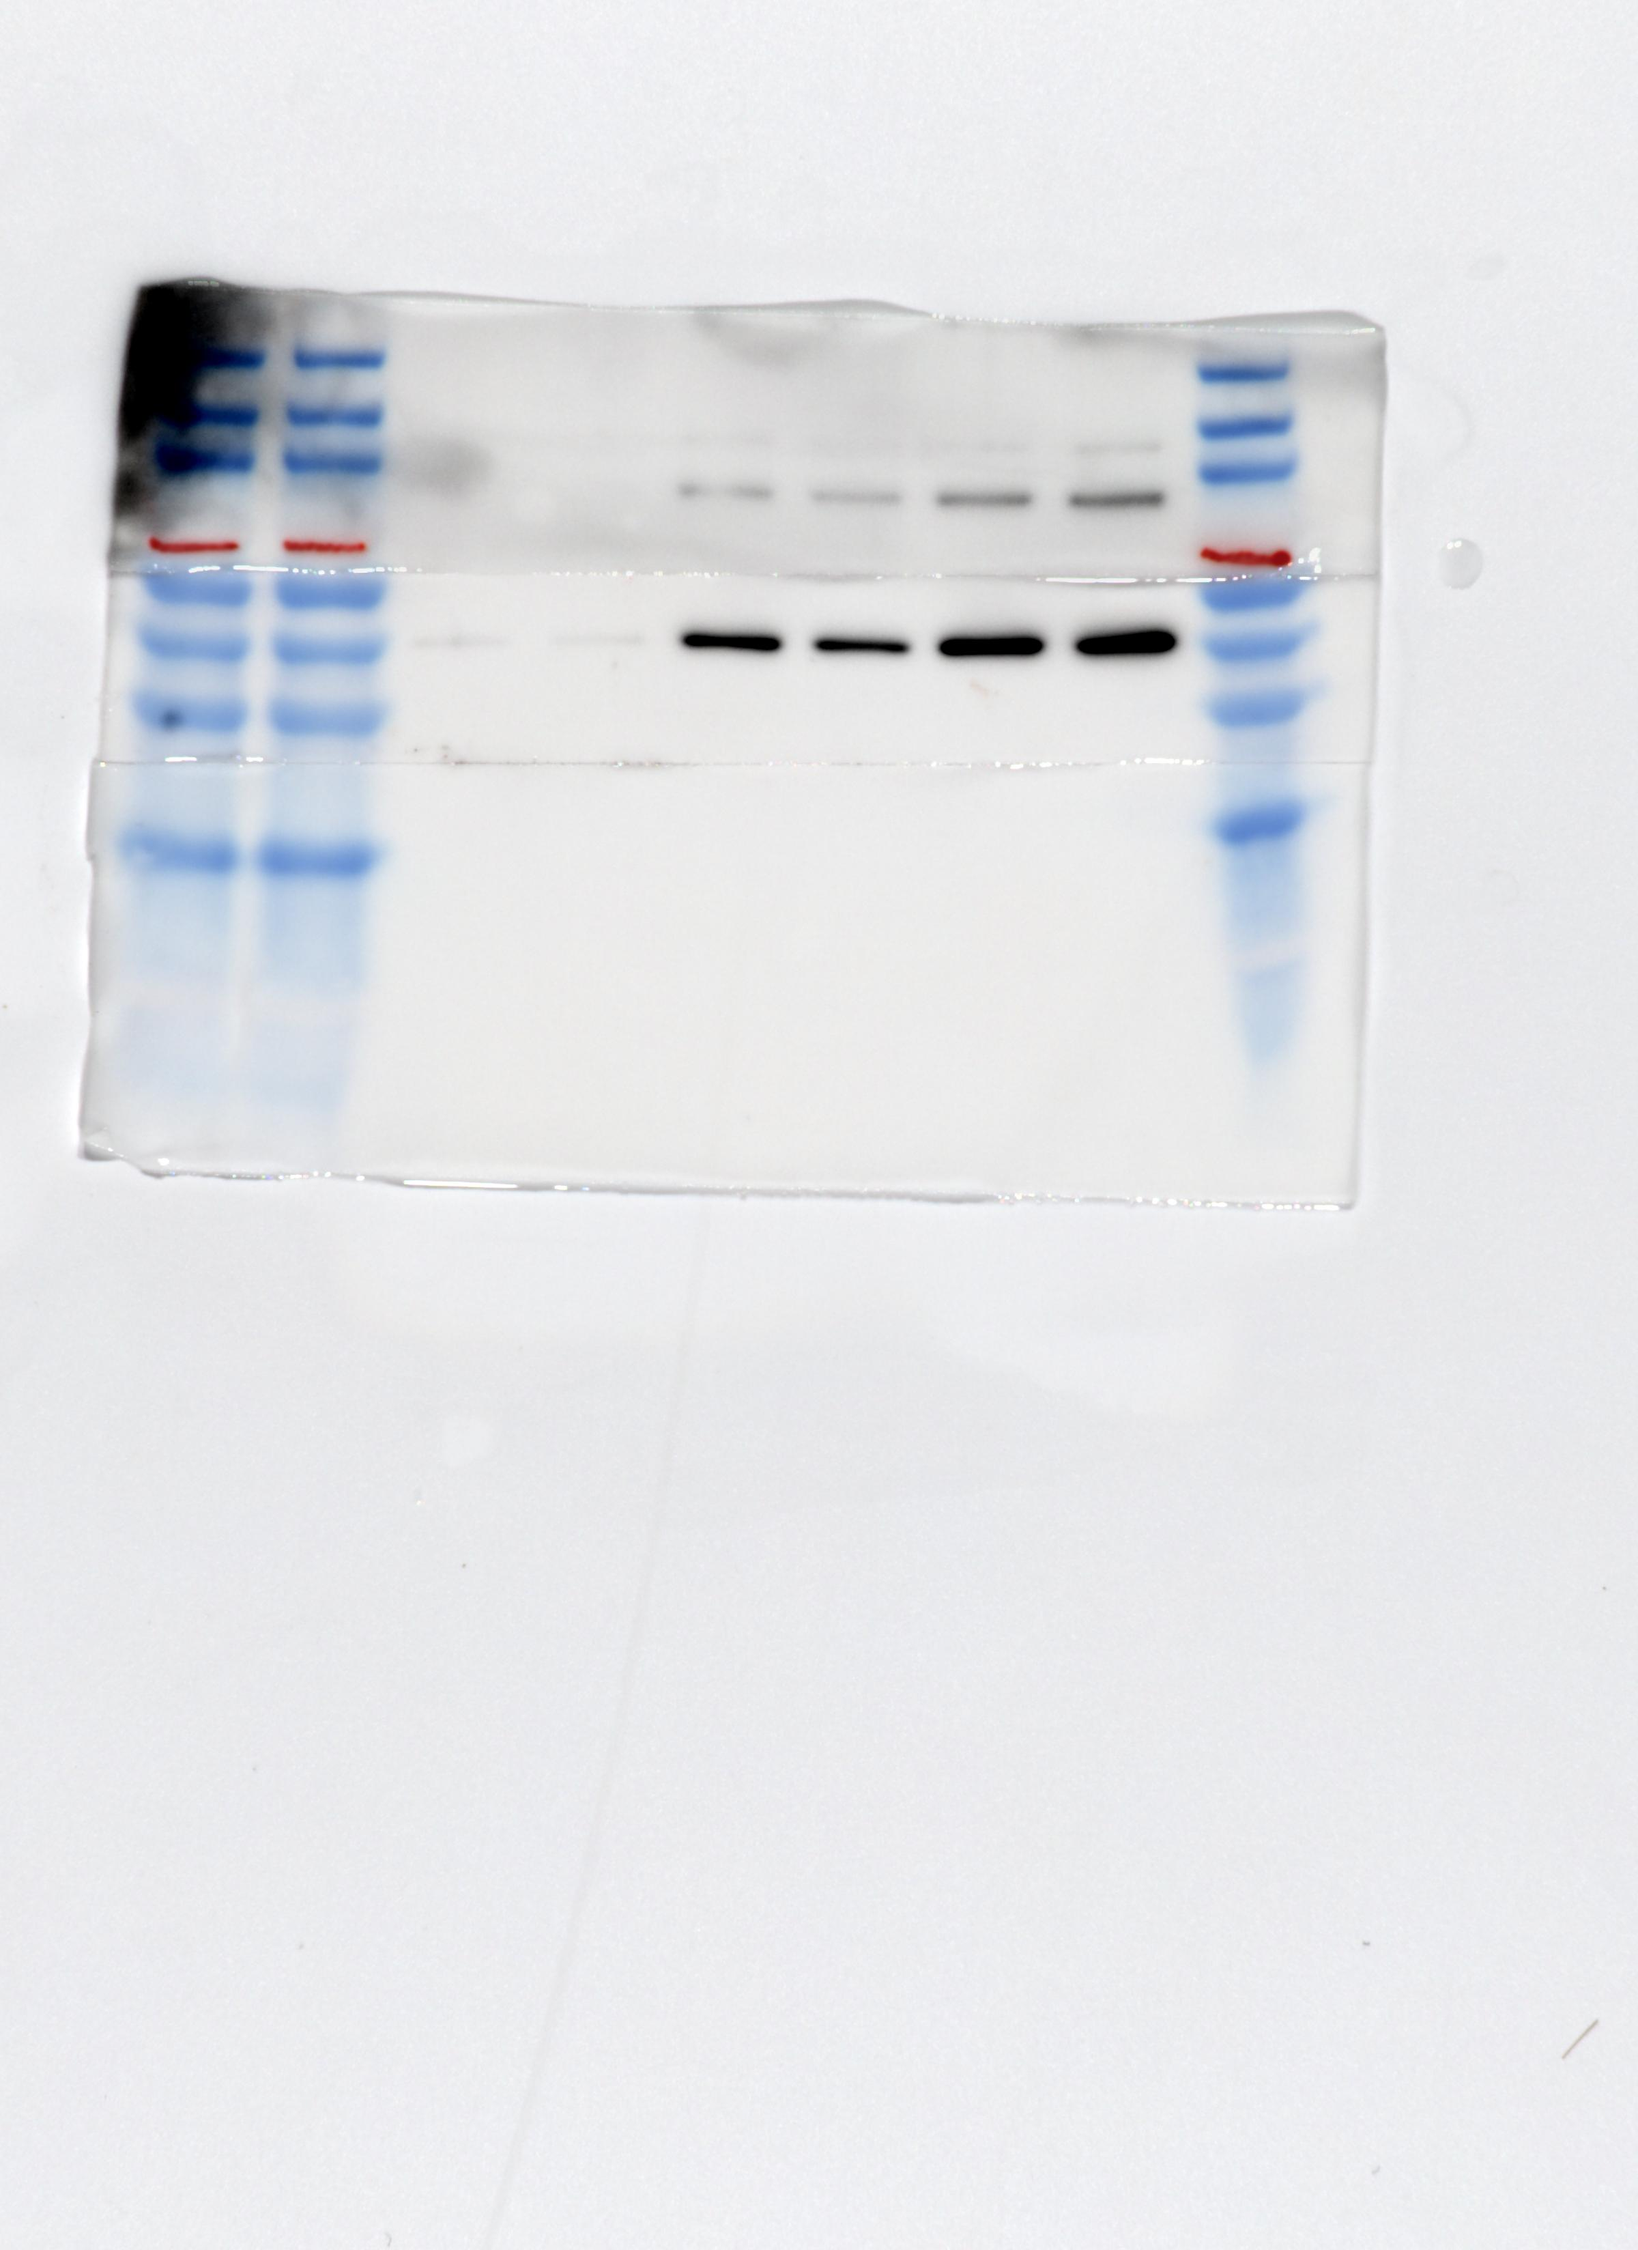
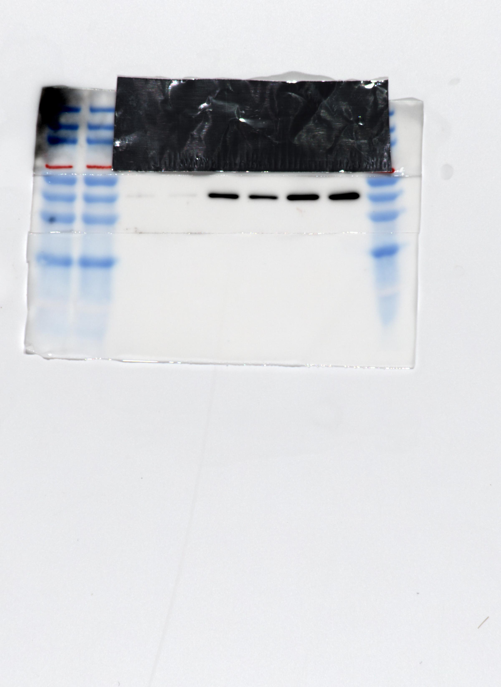
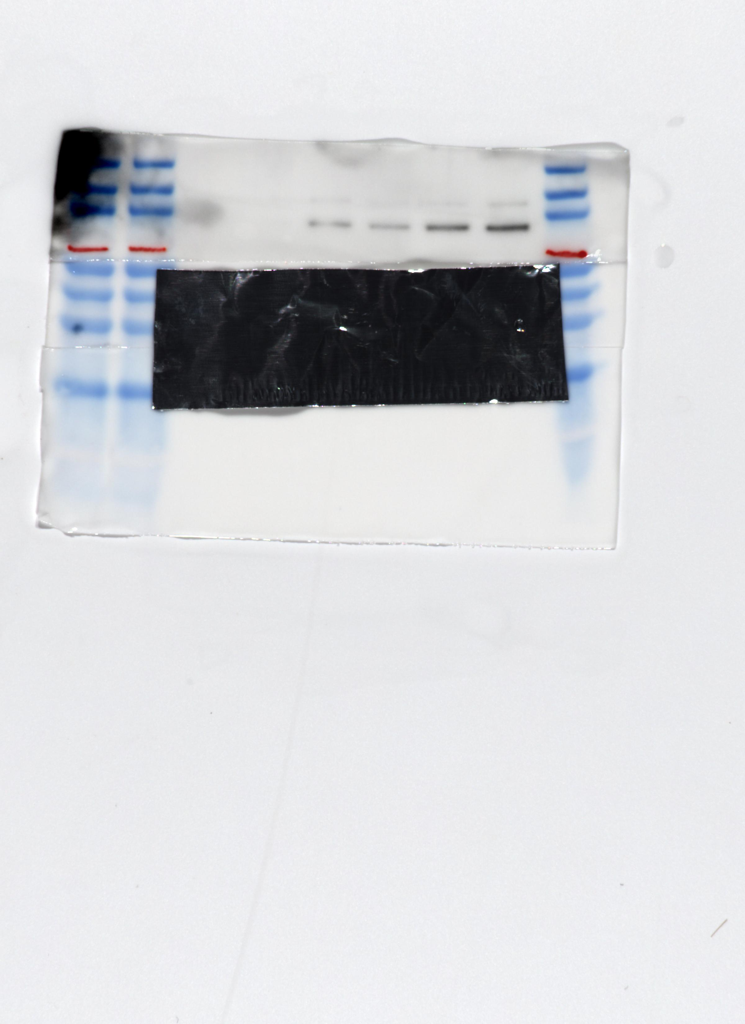
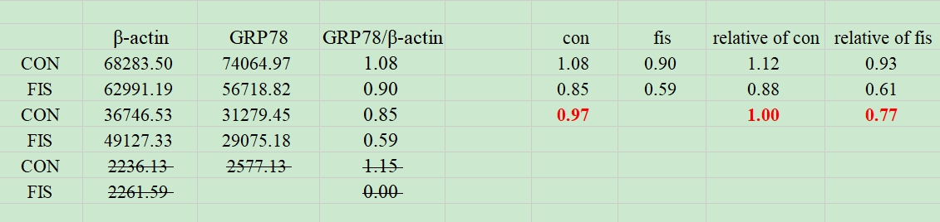
β-actin and GRP78 correspond to gel images as follows ①
From left to right, merker, con, fis, con, fis, con, fis, marker, marker.
Marker Schematic：
β-actin and GRP78 exposed together
β-actin exposure alone
GRP78 exposure alone
Gray value and gray value ratio and normalized relative ratio of the strip from left to right
data analysis

Slide 2
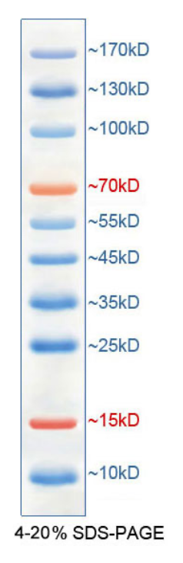
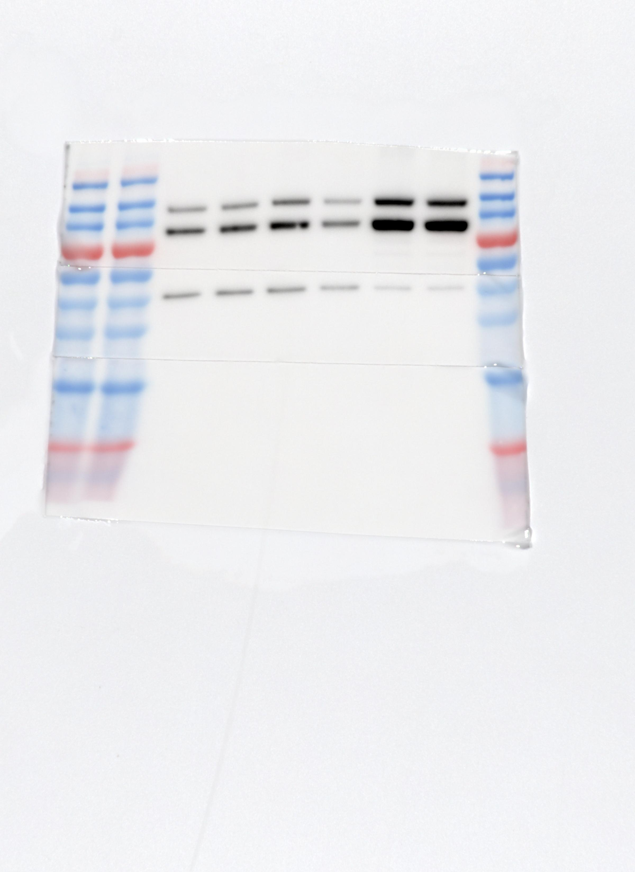
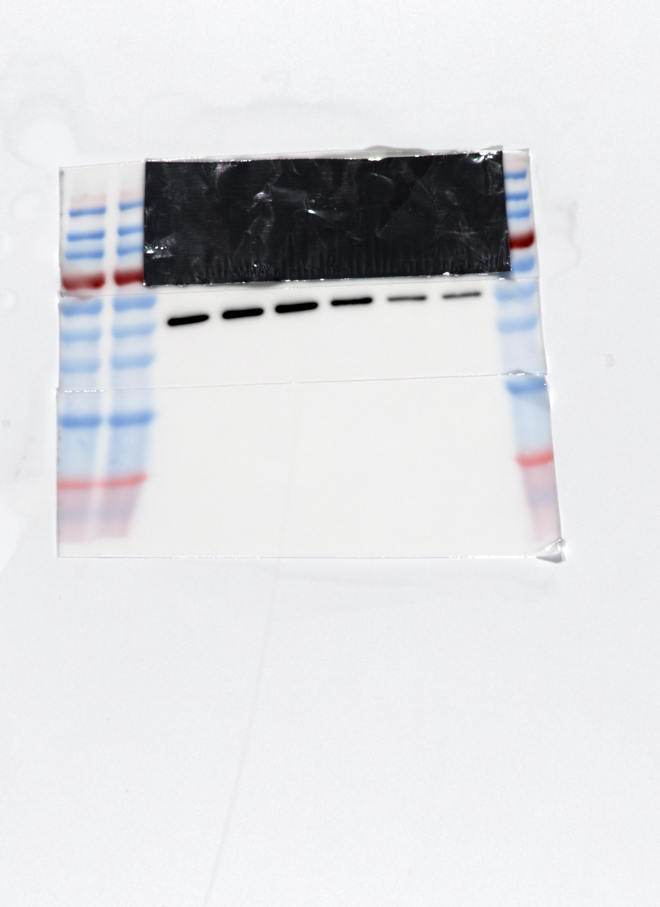
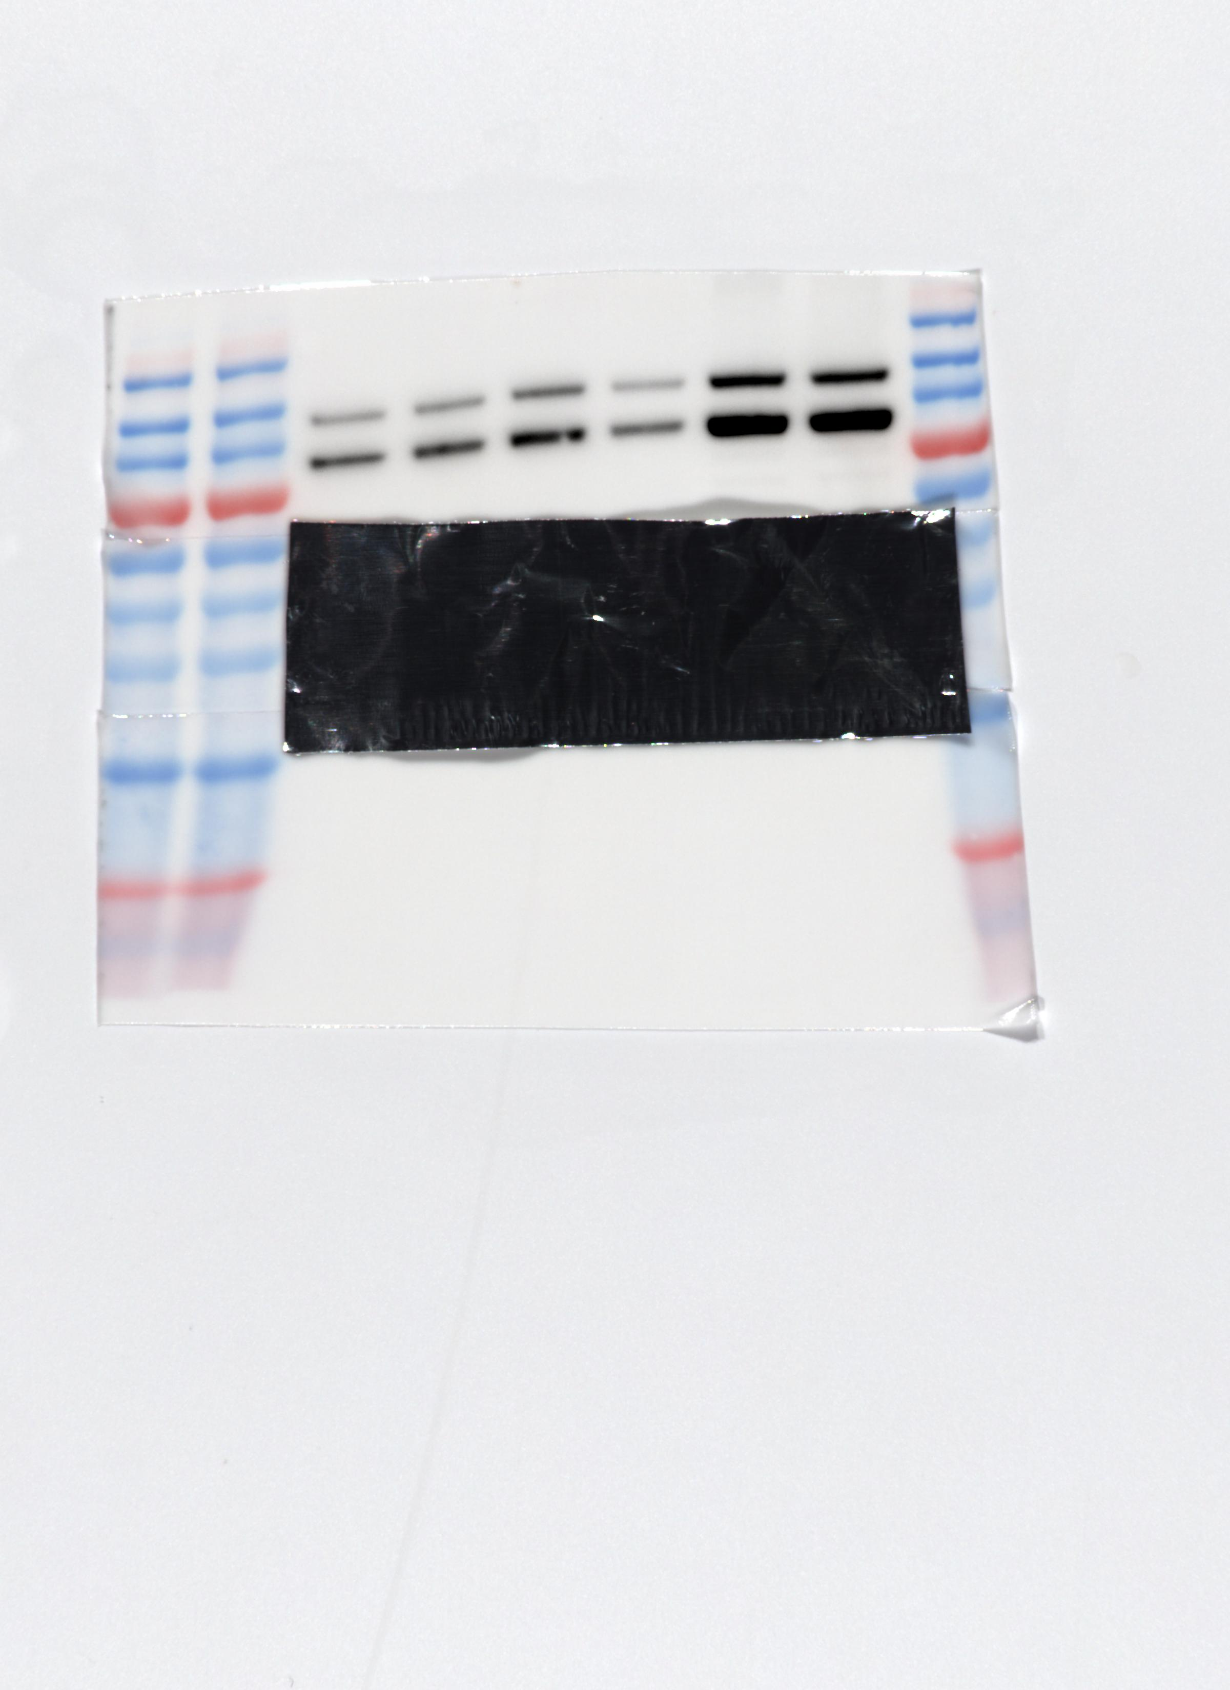
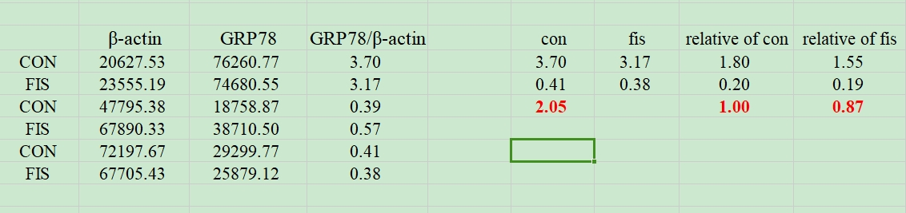
β-actin and GRP78 correspond to gel images as follows ②
From left to right, merker, con, fis, con, fis, con, fis, marker, marker.
Marker Schematic：
β-actin and GRP78 exposed together
β-actin exposure alone
GRP78 exposure alone
Gray value and gray value ratio and normalized relative ratio of the strip from left to right
data analysis

Slide 3
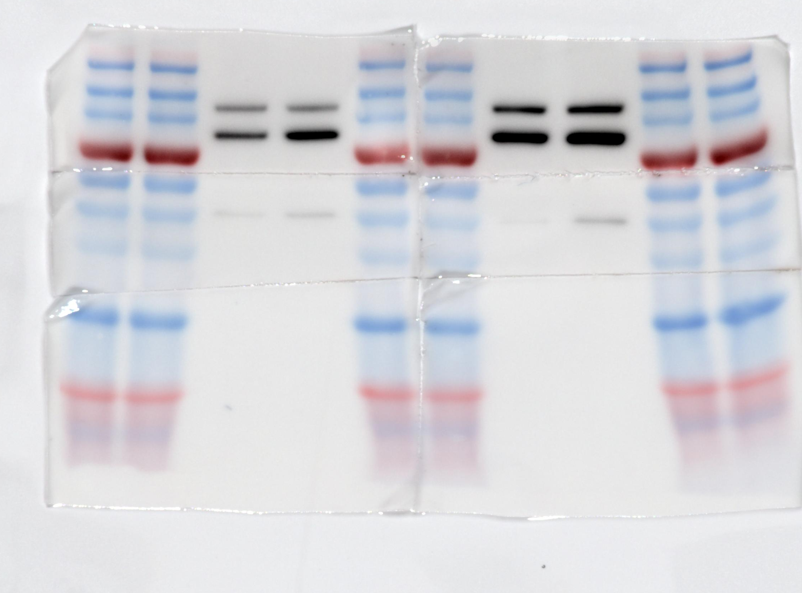
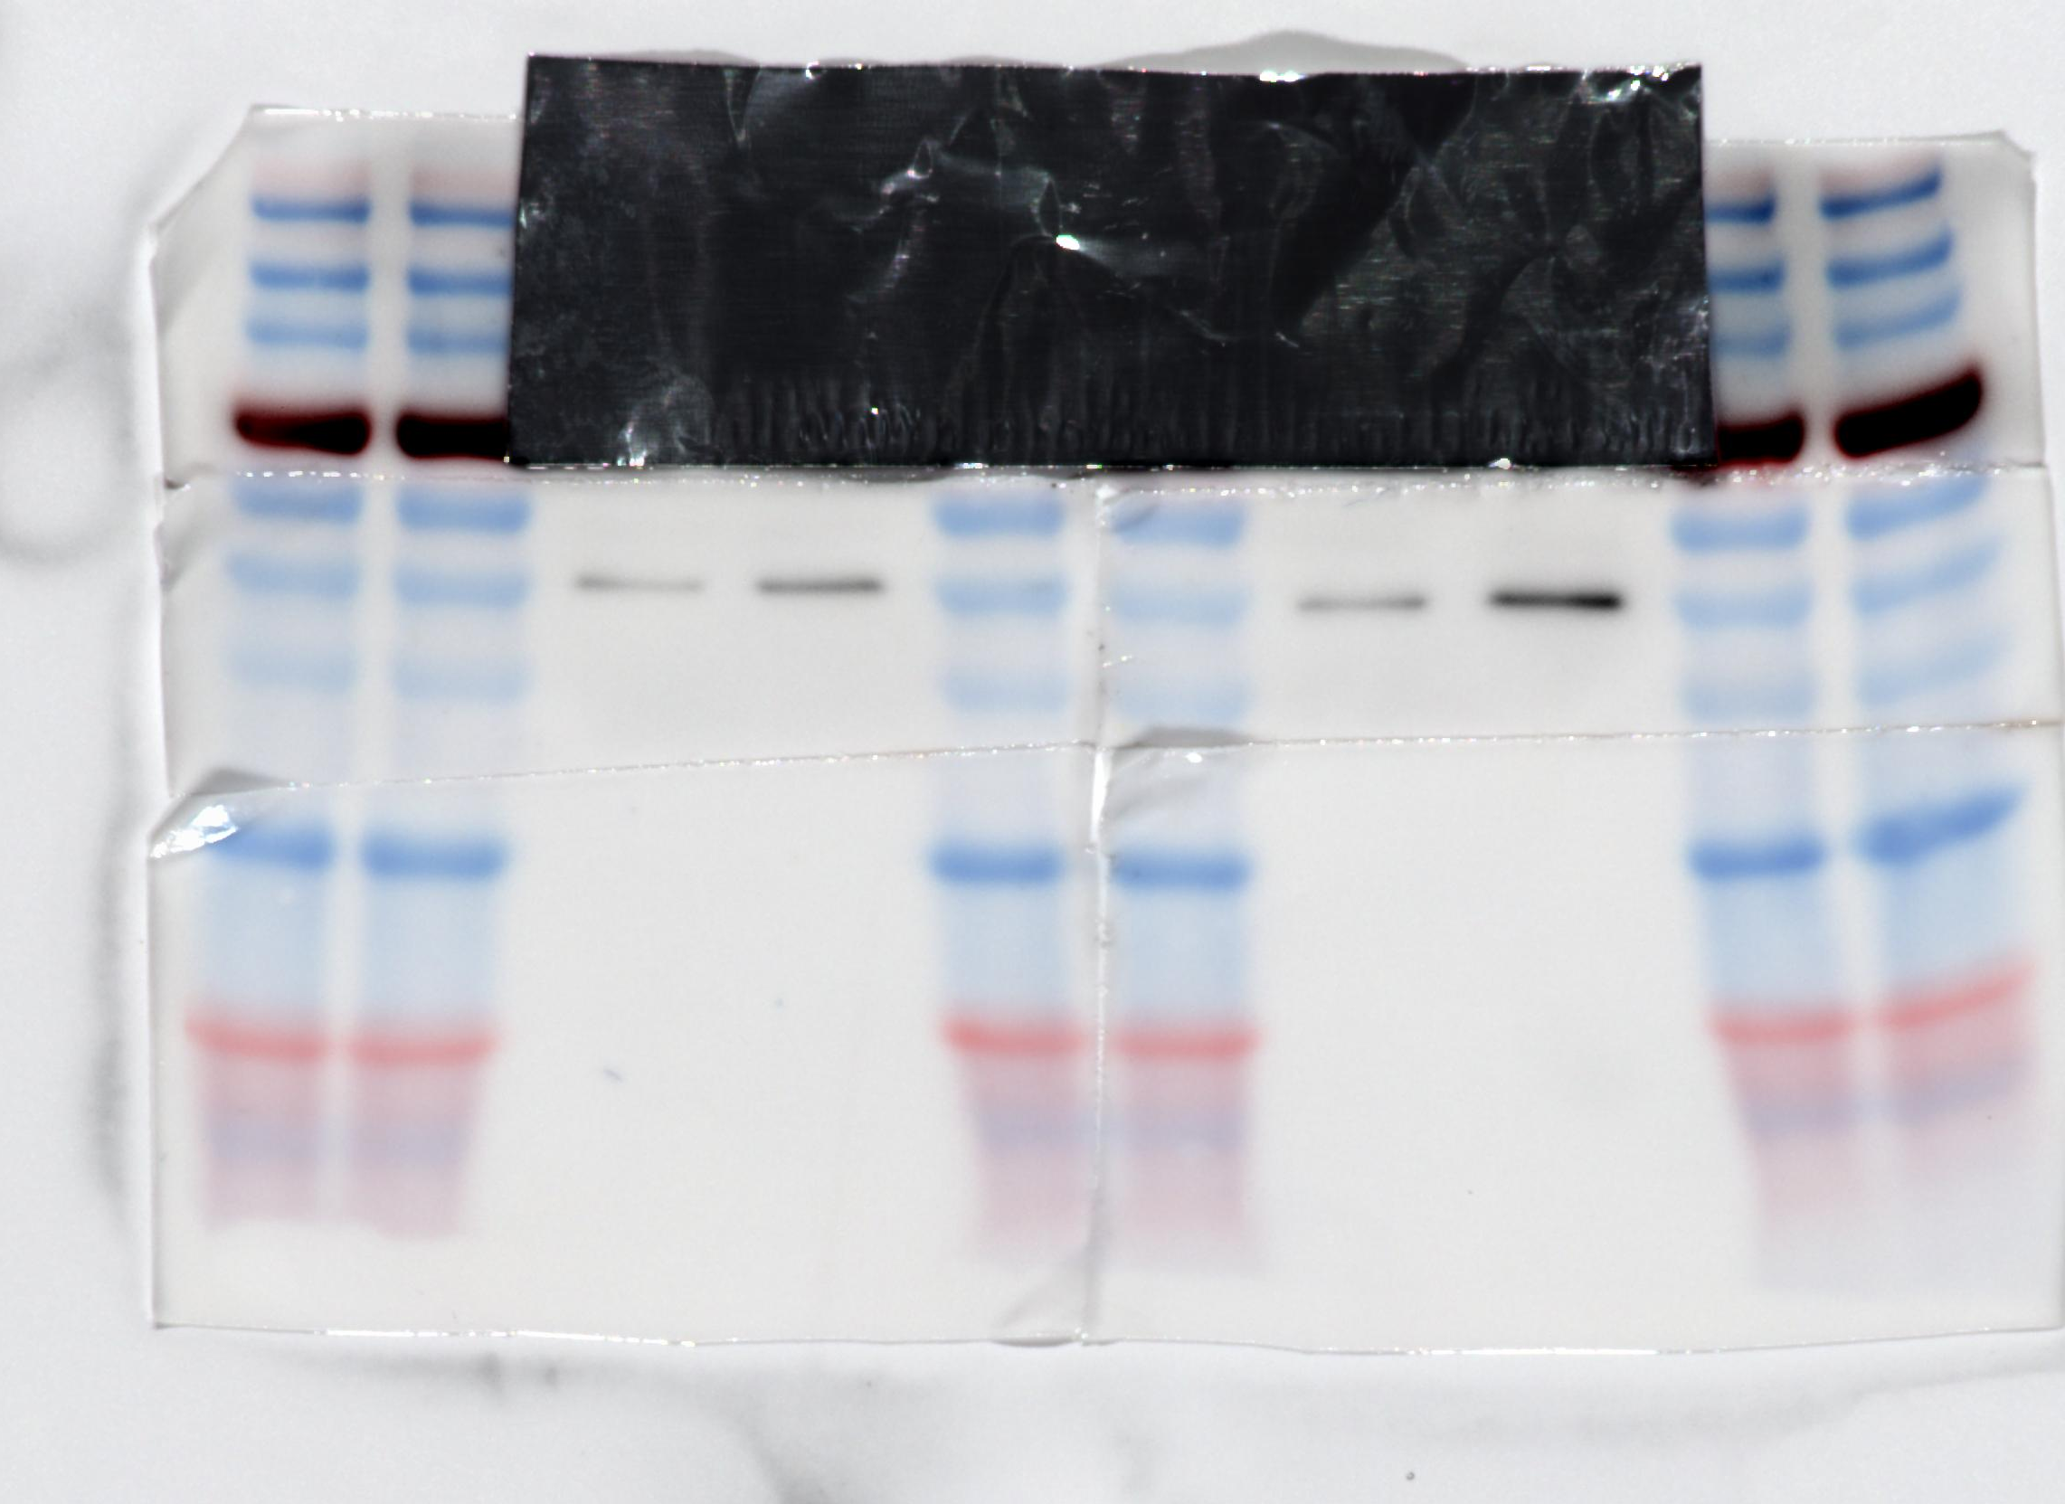
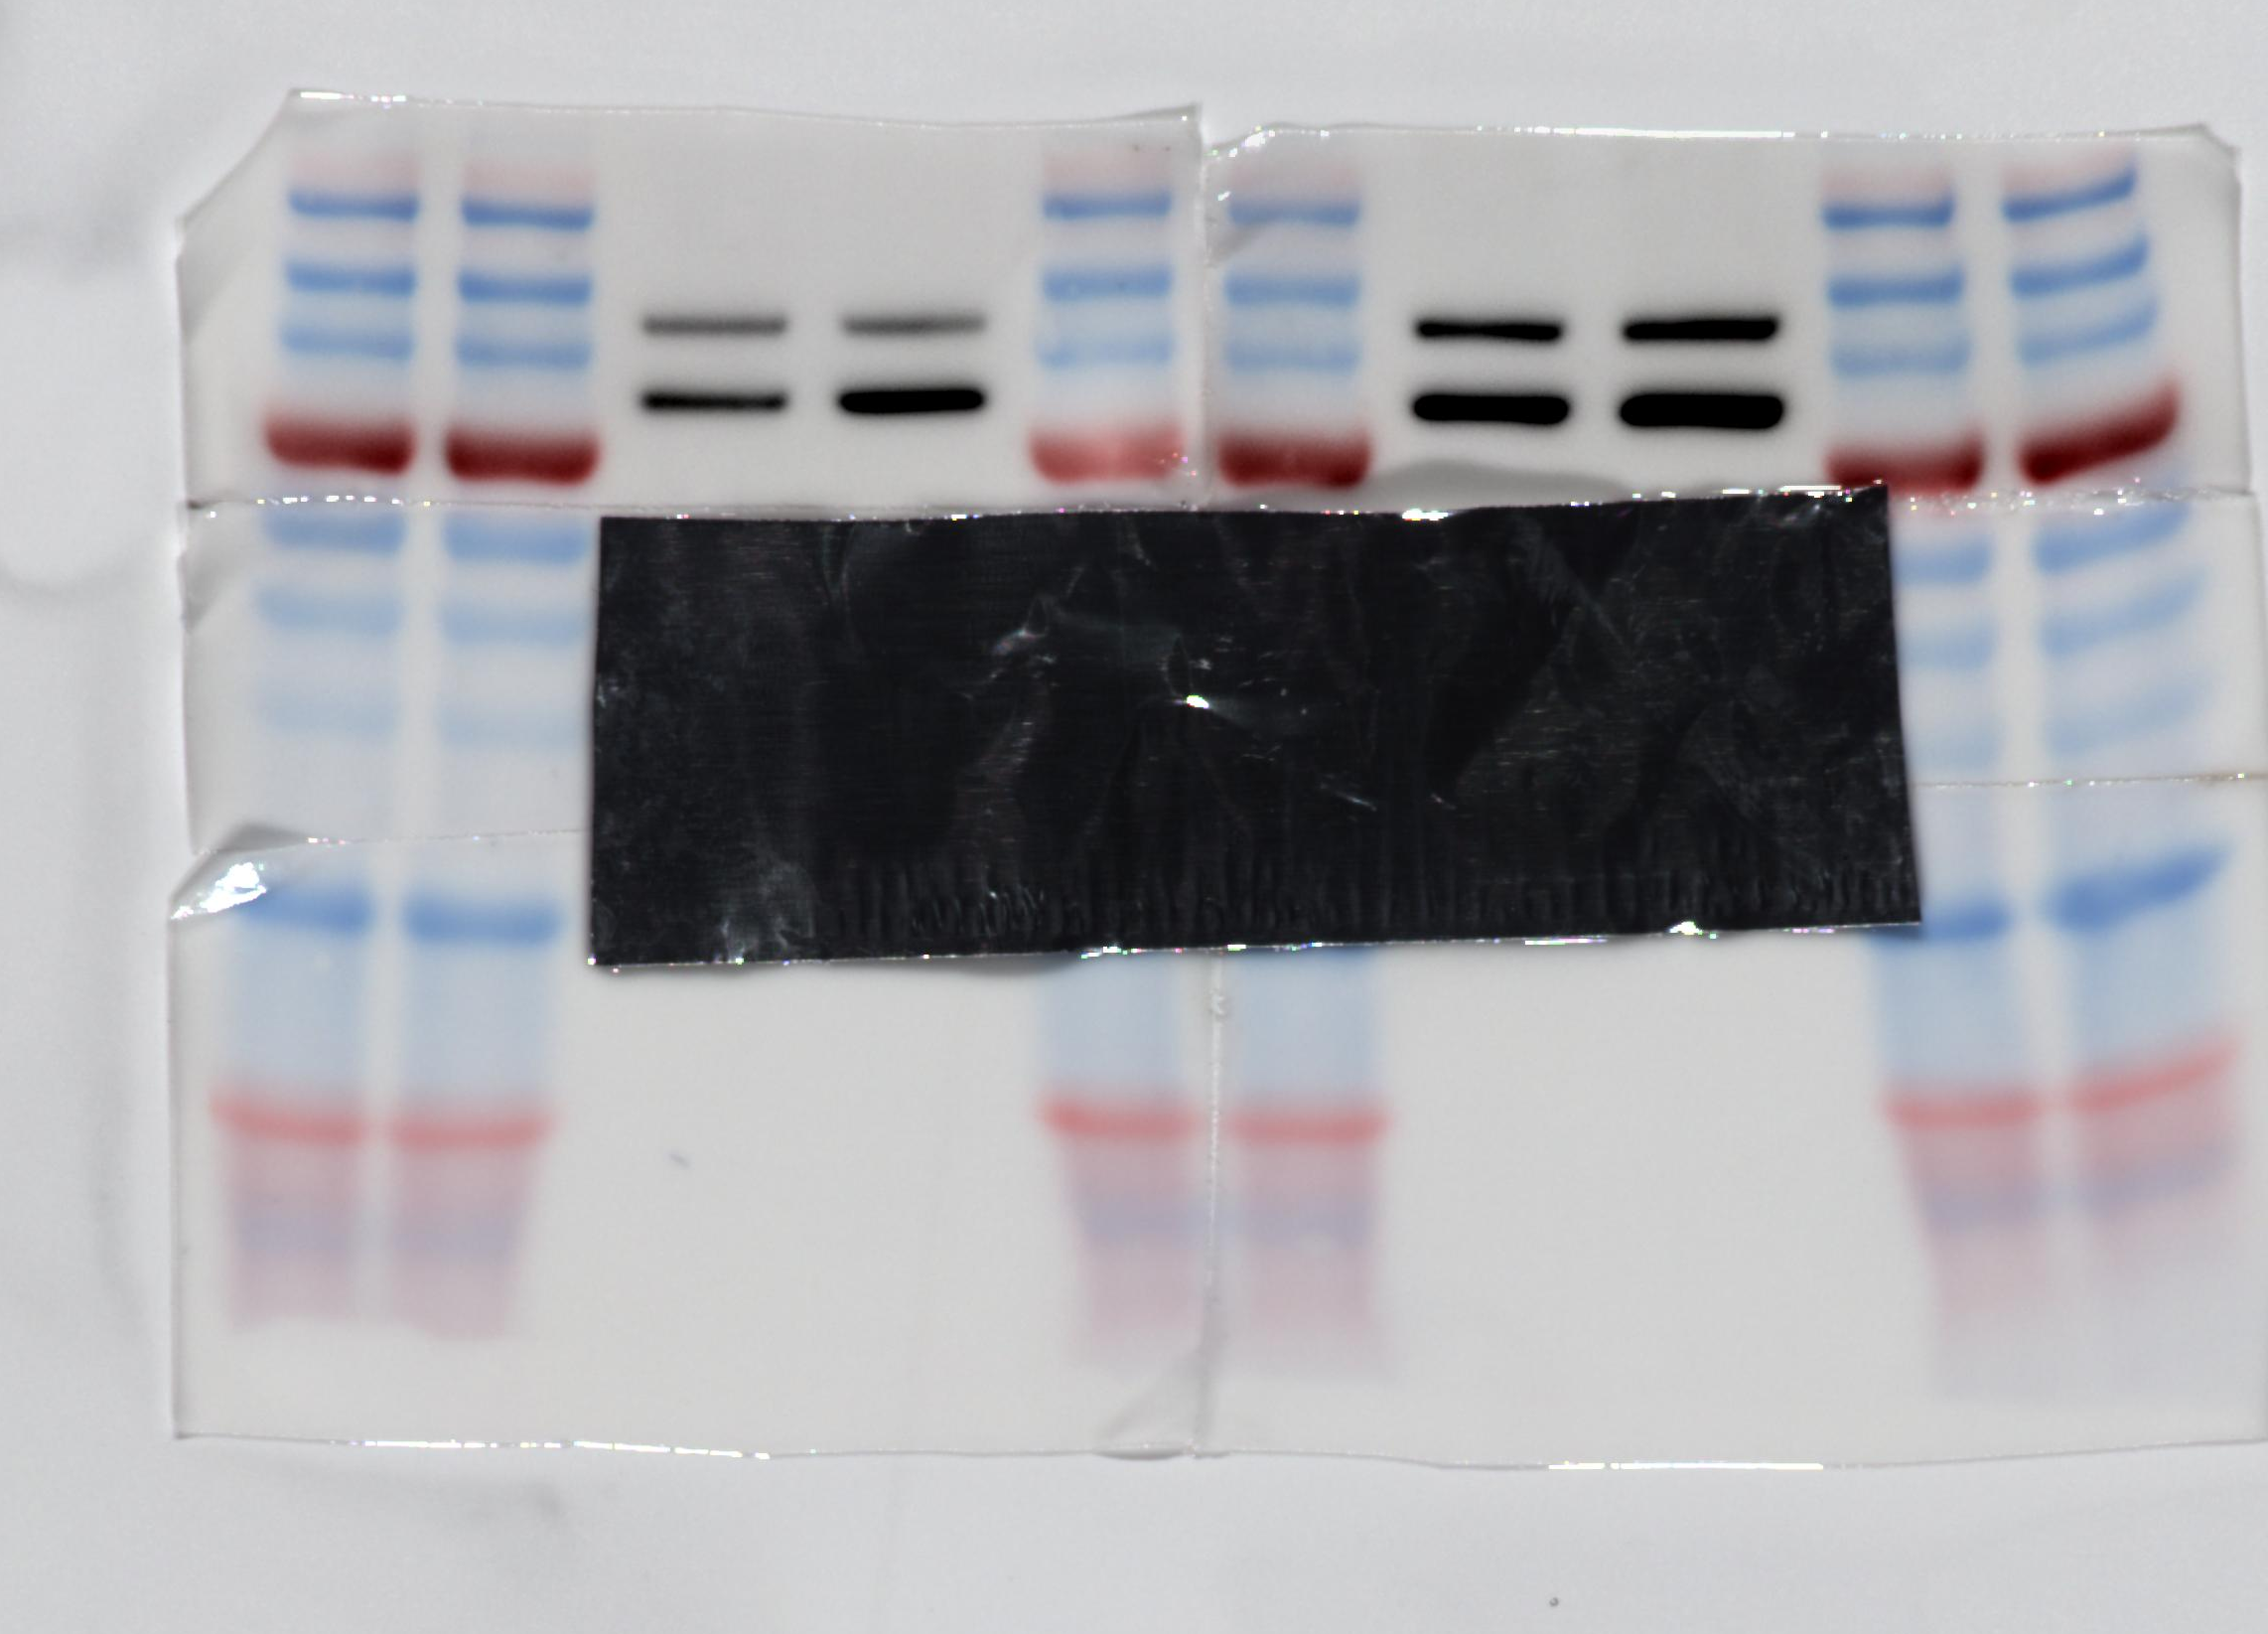
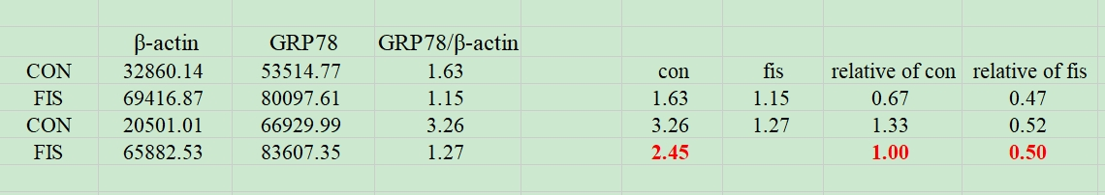
β-actin and GRP78 correspond to gel images as follows ③
From left to right, marker, marker, con, fis, marker, marker, con, fis, marker, marker.
Marker Schematic：
β-actin and GRP78 exposed together
β-actin exposure alone
GRP78 exposure alone
Gray value and gray value ratio and normalized relative ratio of the strip from left to right
data analysis

