Slide 1
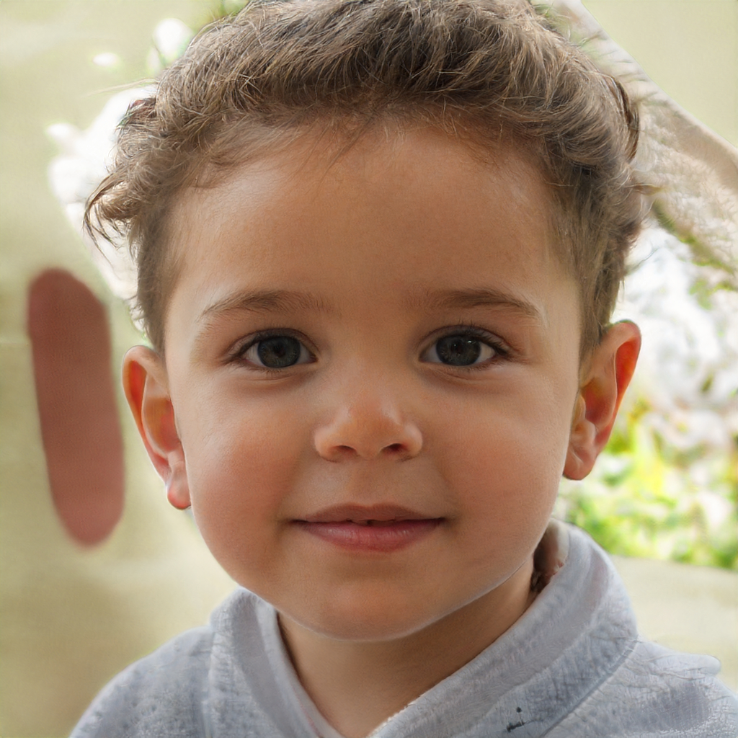
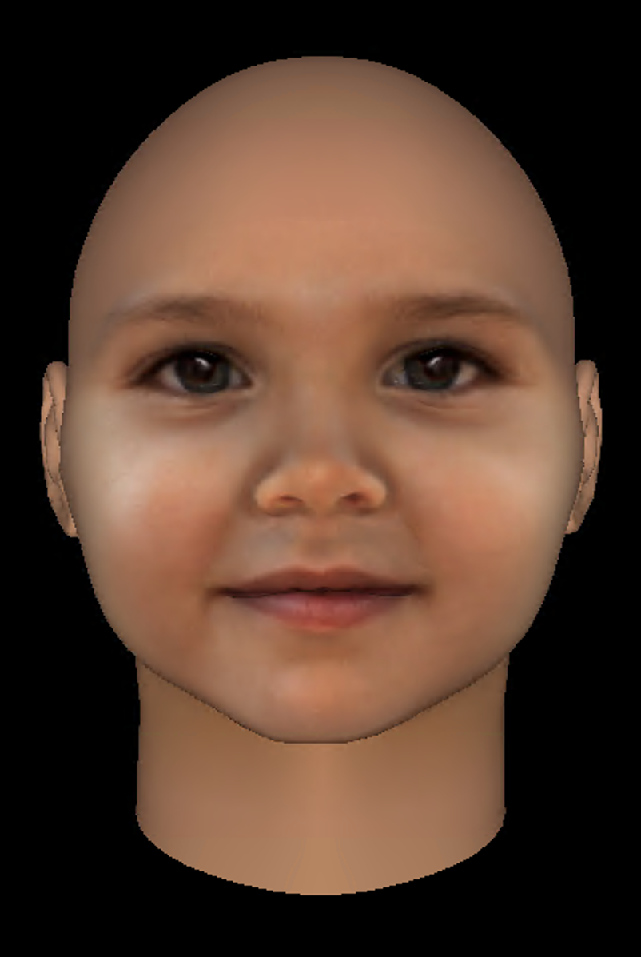
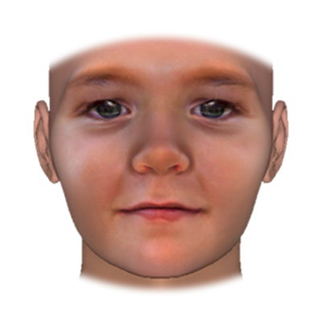
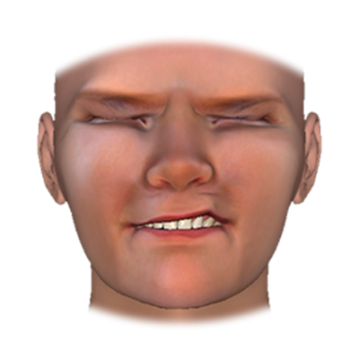
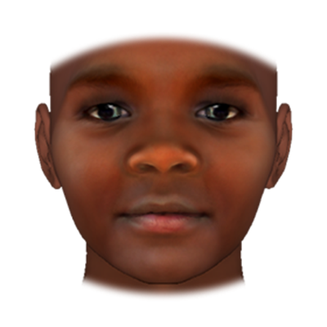
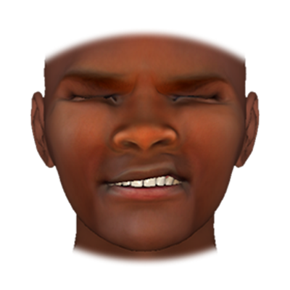
A
B
C
D
+
+
+
+
+
+
+
+
+
+
+
Notes:
Figure 1. Stimulus generation pipeline. A) Child faces were created randomly via generative adversarial network through the website ThisPersonDoesNotExist.com. (Faces were generated one at a time by refreshing the site; images that appeared to depict children were saved for further testing.) Suitable images (i.e., without hair obstructions, with neutral expressions) were imported into FaceGen. Landmarks (green crosses) were placed on key features. B) The initial FaceGen version of the photo depicted in Panel A. C) White and Black versions of the imported stimulus in Panel B. Images were standardized via Demographics sliders in FaceGen. For boys, the Gender slider was set to 0; for girls, this slider was set to -1. For Black versions of each selected face, the African slider was set to +1.5 and the European slider was set to -1.5. These slider values were reversed for White versions of each selected face. Where necessary, additional manual edits were made via Shape and Color sliders. Finalized stimuli were vignetted in Photoshop to remove “bald” appearance. D) The same full intensity pain expression rendered on the Black and White versions depicted in Panel C.

Slide 2
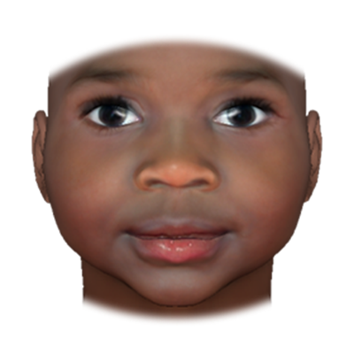
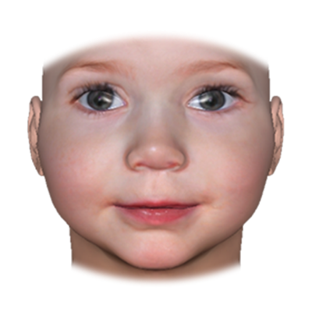
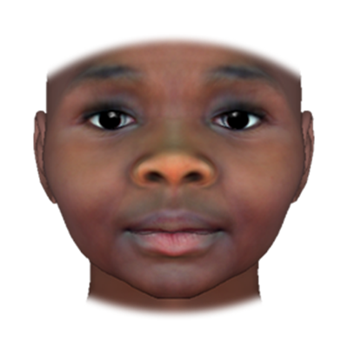
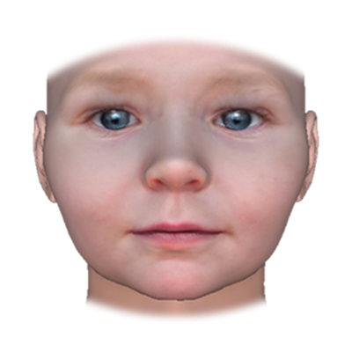
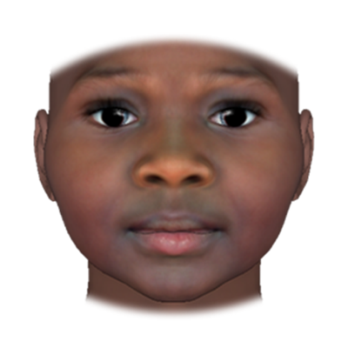
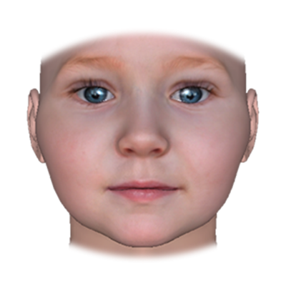
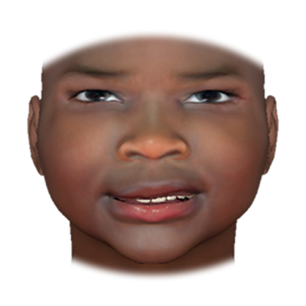
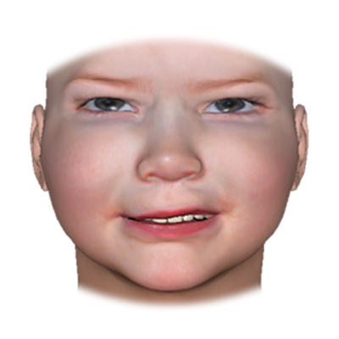
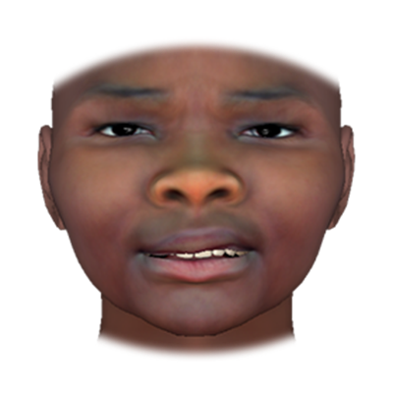
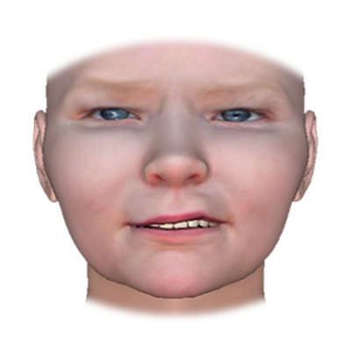
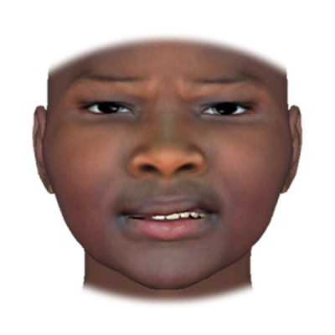
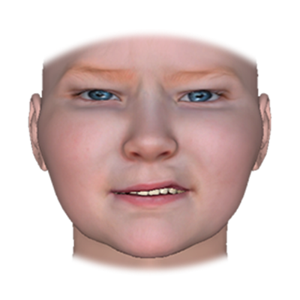
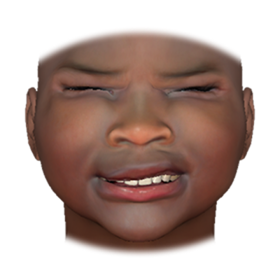
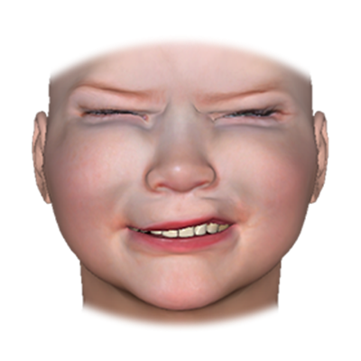
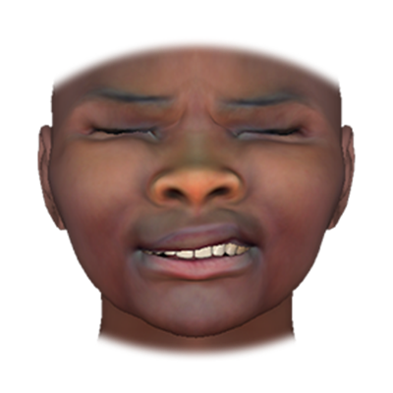
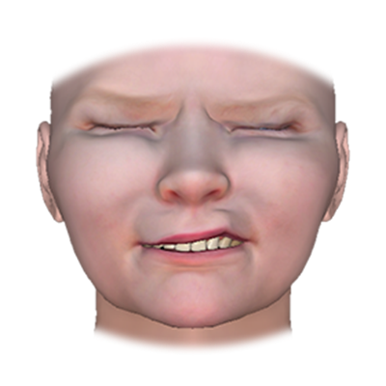
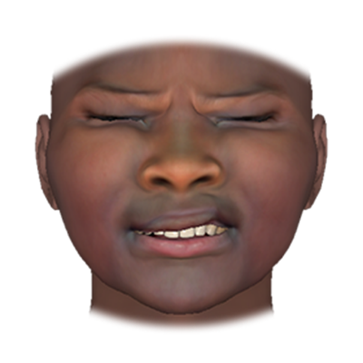
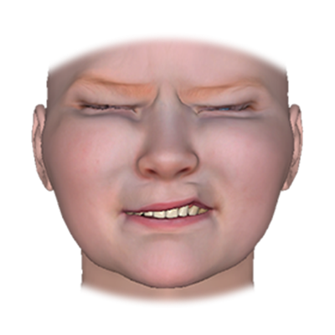
Neutral
Moderate
intensity
High
intensity
Notes:
Figure 2. Black and White girl stimuli. We created Black and White versions of each of the three girl base heads we selected. Neutral expressions for each set of stimuli are depicted in the top row, moderate intensity (i.e., 67%) pain expressions are depicted in the middle row, and high intensity pain expressions (i.e., 100%) are depicted in the bottom row.

Slide 3
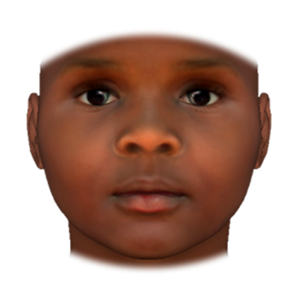
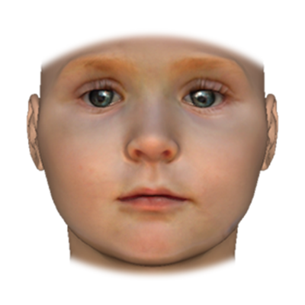
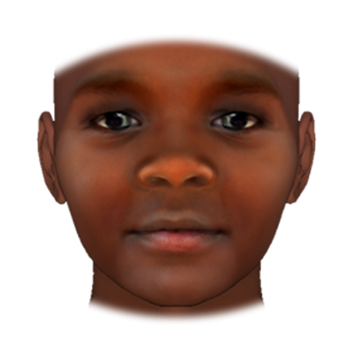
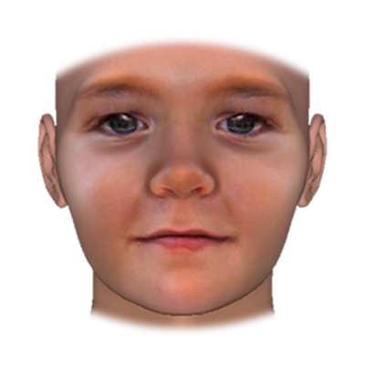
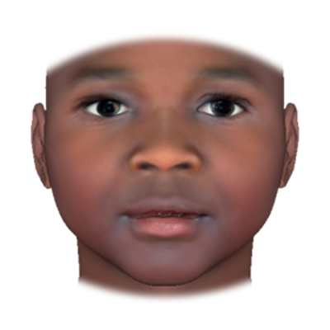
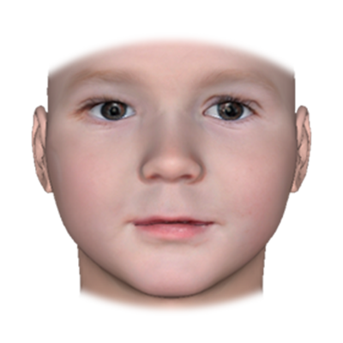
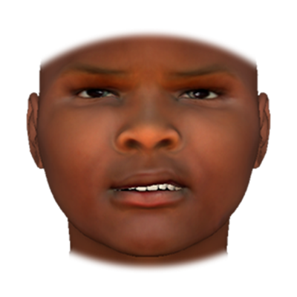
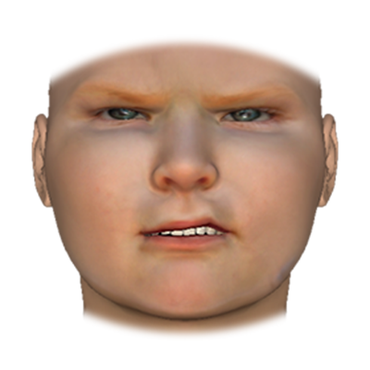
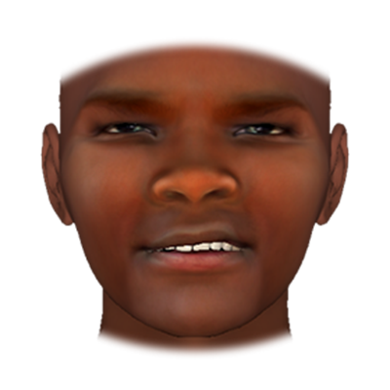
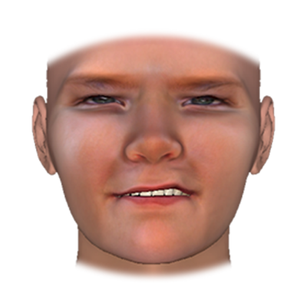
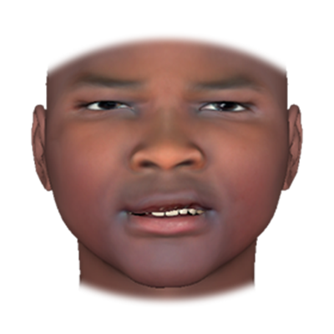
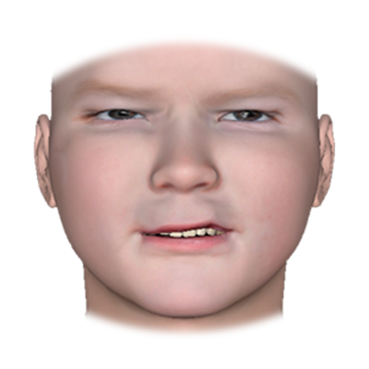
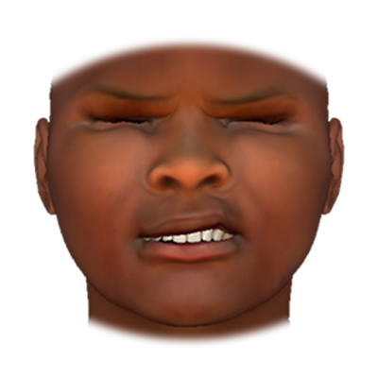
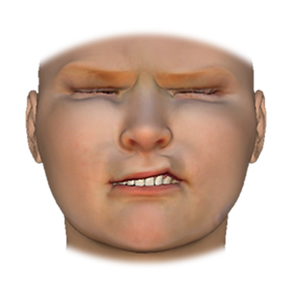
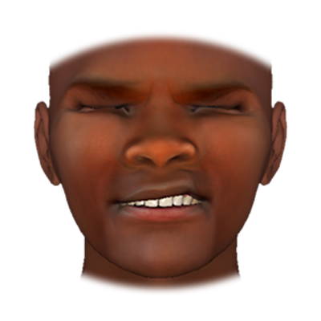
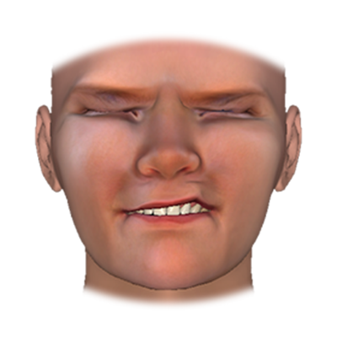
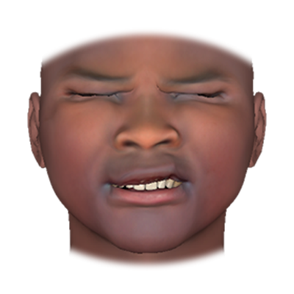
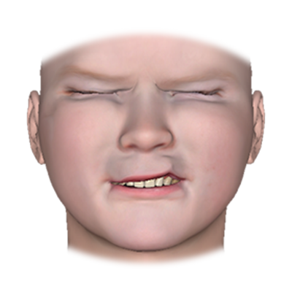
Neutral
Moderate
intensity
High
intensity
Notes:
Figure 3. Black and White boy stimuli. We created Black and White versions of each of the three boy base heads we selected. Neutral expressions for each set of stimuli are depicted in the top row, moderate intensity (i.e., 67%) pain expressions are depicted in the middle row, and high intensity pain expressions (i.e., 100%) are depicted in the bottom row.

