Slide 1
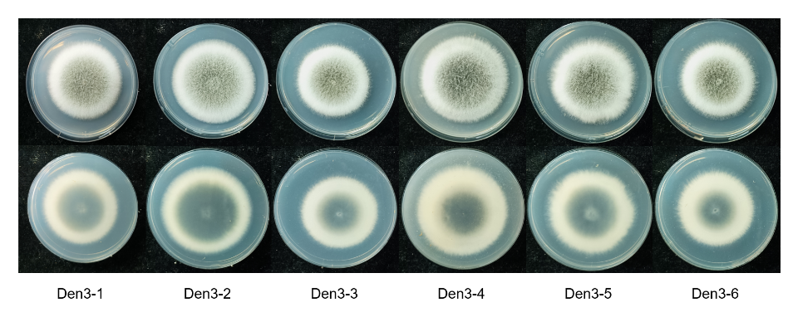
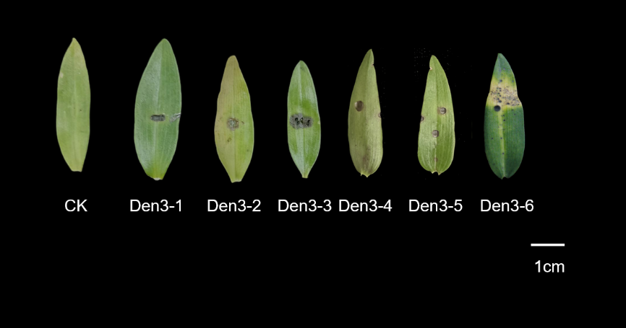
Figure S1. 6 isolates were randomly selected from the Den3 strains for supplementary pathogenicity testing.

Slide 2
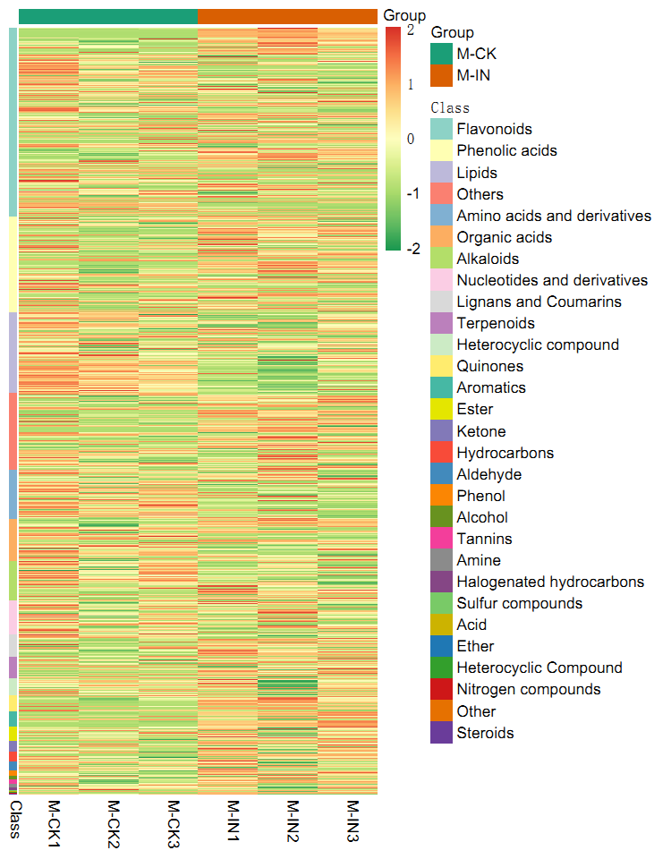
Figure S2. Overall qualitative analysis of the metabolomics data.

Slide 3
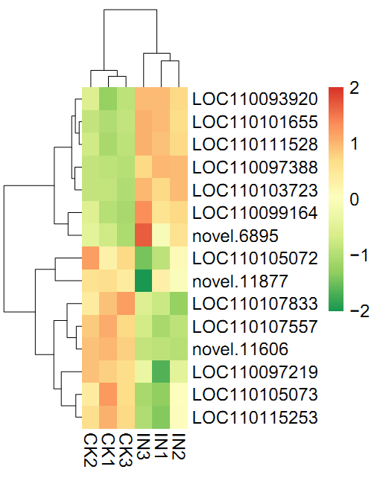
Figure S3. Flavonoid biosynthesis pathway related DEGs in CK and IN.
LOC110093920 dihydroflavonol 4-reductase isoform X1 [Dendrobium catenatum]
LOC110101655 Dihydroflavonol-4-reductase [Dendrobium catenatum]
LOC110111528 Dihydroflavonol-4-reductase [Dendrobium catenatum]
LOC110097388 flavanone 3-dioxygenase [Dendrobium catenatum]
LOC110103723 Leucoanthocyanidin dioxygenase [Dendrobium catenatum]
LOC110099164 chalcone--flavonone isomerase-like [Dendrobium catenatum]
novel.6895 naringenin 3-dioxygenase [Bromheadia finlaysoniana]
LOC110097219 flavonol synthase/flavanone 3-hydroxylase-like [Dendrobium catenatum]
LOC110105072 bibenzyl synthase-like [Dendrobium catenatum]
LOC110105073 Bibenzyl synthase [Dendrobium catenatum]
LOC110107557 probable 2-oxoglutarate-dependent dioxygenase [Dendrobium catenatum]
LOC110107833 chalcone synthase 8-like [Dendrobium catenatum]
LOC110115253 bibenzyl synthase-like [Dendrobium catenatum]
novel.11606 flavonol synthase/flavanone 3-hydroxylase-like [Dendrobium catenatum]
novel.11877 bibenzyl synthase-like [Dendrobium catenatum]

Slide 4
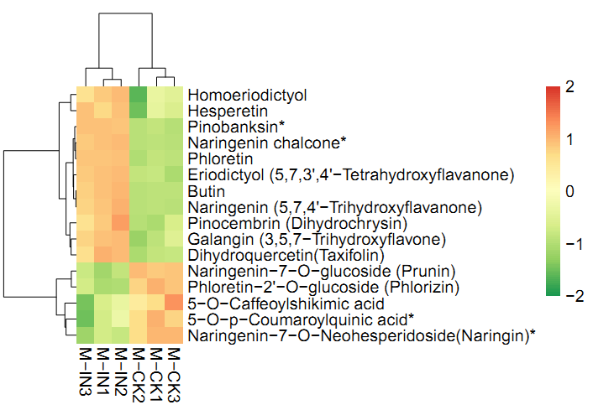
Figure S5. Flavonoid biosynthesis pathway related DAMs in M-CK and M-IN.

Slide 5
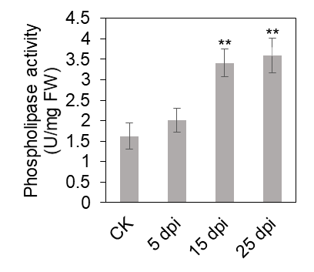
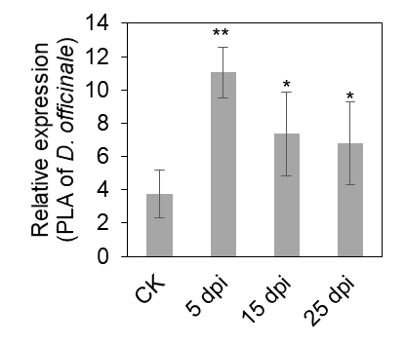
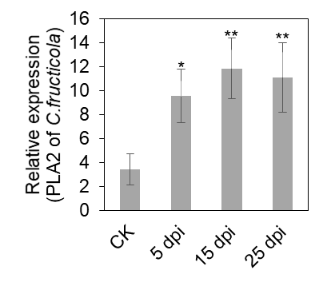
a
b
c
Figure S5. Phospholipase activity and gene expression dynamics during infection. a,Total phospholipase activity in healthy (CK) and infected leaves at 5, 15, and 25 dpi. Data are mean ± SD (n=3); **p < 0.01, ***p < 0.001 vs. CK. b,c, Relative expression of host PLA and pathogen PLA2 genes at 5, 15, and 25 dpi, normalized to Actin (host) or β-tubulin (pathogen). Values are mean ± SD (n=3); different letters indicate significant differences (p < 0.05) by Student’s test.

